Slide 1
GOD
GOD

Slide 2
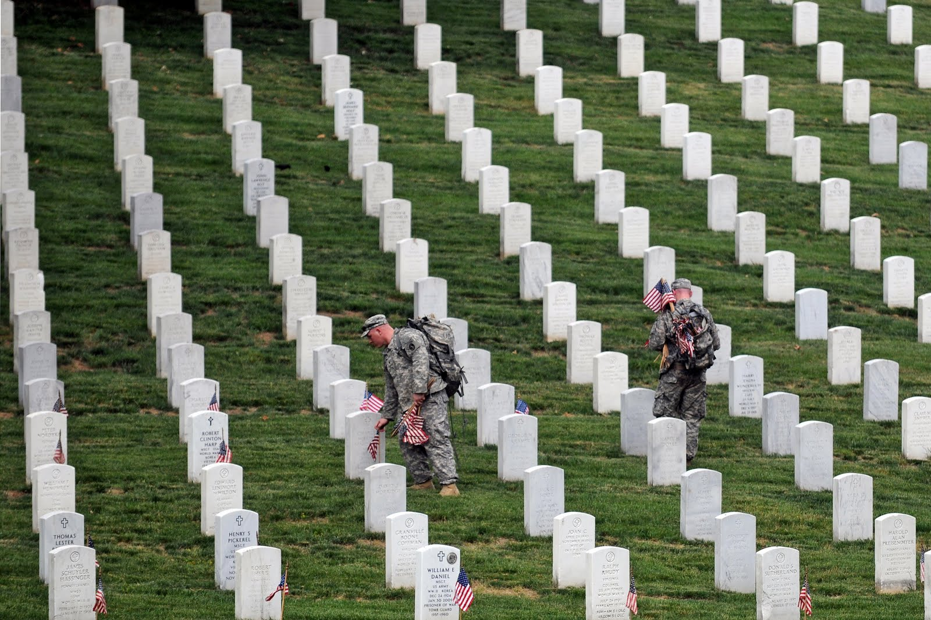
Memorial Day
Notes:
TODAY is memorial. Tomorrow will be a different memorial day.
Tomorrow, the United States has set aside an annual observance they call Memorial Day. It is designed as a day to remember all those who died serving our nation.
While its exact origin is uncertain, we know that in 1868 it was proclaimed by General John Logan to remember soldiers of the civil war.
IN 1971, Congress officially recognized it as a national holiday to be observed the last Monday in May.
On this day, many take pause to remember those who have sacrificed their lives for our freedom. As Americans, this day is worthy of taking a few moments to be thankful for what we have. Of course, not everyone appreciates the significance of this holiday, and sees it simply as a day to enjoy the company of friends and family. Often times, as time moves on, the significance of such memorials fades unless someone takes the time to preserve its meaning.
→ Memorials in OT

Slide 3
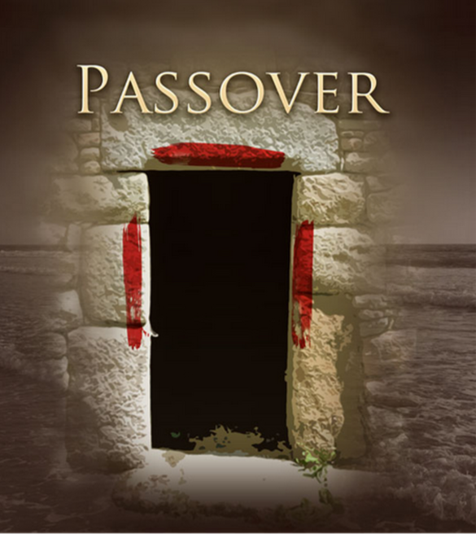
GOD
GOD
Notes:
Passover – Exod. 12:14, 26-27
→ Tassels on garments

Slide 4
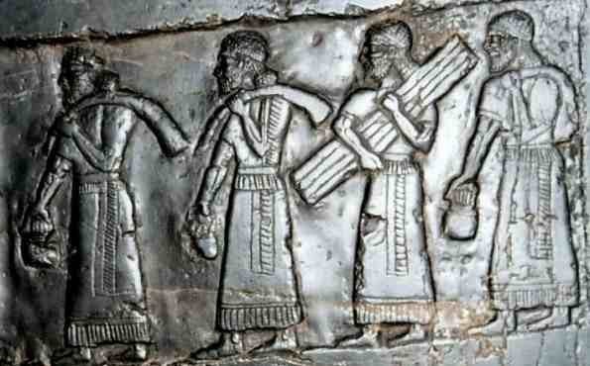
GOD
GOD
Tassels – Num. 15:37-40
Notes:
Tassels - Num. 15:37-40 – so they would remember to do all my commandments!
→ Deut. – the GREAT reminder to the 2nd generation! 5:15

Slide 5
¹⁵You shall remember that you were a slave in the land of Egypt, and the LORD your God brought you out from there with a mighty hand and an outstretched arm. Therefore the LORD your God commanded you to keep the Sabbath day. Dt. 5:15
Notes:
Deut. 5:15 ¹⁵You shall remember that you were a slave in the land of Egypt, and the LORD your God brought you out from there with a mighty hand and an outstretched arm. Therefore the LORD your God commanded you to keep the Sabbath day.
→ 7:18

Slide 6
¹⁸you shall not be afraid of them but you shall remember what the LORD your God did to Pharaoh and to all Egypt, 7:18
Notes:
[when faced with the destroying of nations greater than themselves, not to be afraid but shall REMEMBER]
Deuteronomy 7:18 ¹⁸you shall not be afraid of them but you shall remember what the LORD your God did to Pharaoh and to all Egypt,
→ 9:7

Slide 7
⁷Remember and do not forget how you provoked the LORD your God to wrath in the wilderness. From the day you came out of the land of Egypt until you came to this place, you have been rebellious against the LORD. 9:7
Notes:
[WHEN brought into the land and begin thinking that God did this because THEY DESERVED IT… He did NOT… because they were rebellious!]
Deuteronomy 9:7 ⁷Remember and do not forget how you provoked the LORD your God to wrath in the wilderness. From the day you came out of the land of Egypt until you came to this place, you have been rebellious against the LORD. [WHEN brought into the land and begin thinking that God did this because THEY DESERVED IT… He did NOT… because they were rebellious!]
→ 15:15

Slide 8
15You shall remember that you were a slave in the land of Egypt, and the LORD your God redeemed you; therefore I command you this today 15:15
Notes:
. [When freeing a servant, to liberally furnish him out of your flock, threshing floor, and winepress… AS the LORD has blessed you.. you are to give to him… FOR]
Deuteronomy 15:15 15You shall remember that you were a slave in the land of Egypt, and the LORD your God redeemed you; therefore I command you this today
→ 16:3 passover again

Slide 9
that all the days of your life you may remember the day when you came out of the land of Egypt. 16:3
Notes:
[16:1-3 – observe and keep the Passover.. where and How the LORD instructed…]
Deuteronomy 16:3 ³You shall eat no leavened bread with it. Seven days you shall eat it with unleavened bread, the bread of affliction—for you came out of the land of Egypt in haste—that all the days of your life you may remember the day when you came out of the land of Egypt.
→ 16:12 – Feast of weeks / Pentecost

Slide 10
¹²You shall remember that you were a slave in Egypt; and you shall be careful to observe these statutes. 16:12
Notes:
[The Feast of WEEKS (Pentecost) – first fruits – giving unto the LORD the tribute of a freewill offering… giving AS the LORD has blessed.. ]
Deuteronomy 16:12 ¹²You shall remember that you were a slave in Egypt; and you shall be careful to observe these statutes.
→ 24:9 – dealing with lepers

Slide 11
⁹Remember what the LORD your God did to Miriam on the way as you came out of Egypt.
24:9
Notes:
[instructions on dealing with leprous disease. Be VERY careful to do according to ALL.. as the LORD commanded…
Deuteronomy 24:9 ⁹Remember what the LORD your God did to Miriam on the way as you came out of Egypt.
→ Not perverting justice against disadvantaged

Slide 12
…not pervert justice…
¹⁸but you shall remember that you were a slave in Egypt and the LORD your God redeemed you from there; therefore I command you to do this.
Notes:
Deuteronomy 24:17–18 ¹⁷“You shall not pervert the justice due to the sojourner or to the fatherless, or take a widow’s garment in pledge,
18but you shall remember that you were a slave in Egypt and the LORD your God redeemed you from there; therefore I command you to do this.
→ In GENERAL … REMEMBER

Slide 13
⁷Remember the days of old; consider the years of many generations; ask your father, and he will show you, your elders, and they will tell you. 32:7
Notes:
Deuteronomy 32:7 ⁷Remember the days of old; consider the years of many generations; ask your father, and he will show you, your elders, and they will tell you.
→ 8: When come into the land – and prosper !... REMEMBER

Slide 14
When come into the land –
Remember
And do not forget
Notes:
WHEN come into the land and prosper – DO NOT FORGET… but REMEMBER
Deuteronomy 8:2 ²And you shall remember the whole way that the LORD your God has led you these forty years in the wilderness, that he might humble you, testing you to know what was in your heart, whether you would keep his commandments or not.
Deuteronomy 8:18 ¹⁸You shall remember the LORD your God, for it is he who gives you power to get wealth, that he may confirm his covenant that he swore to your fathers, as it is this day.
→ Crossing the Jordon – Josh. 4:1-7

Slide 15
Jordon Memorial Stones
Notes:
Crossing the Jordan - Joshua 4:1-7 one man from each tribe.. pile up.. may be a sign among you
→ Judges 2: generation that knew not God

Slide 16
A generation that knew not God
THEY FORGOT
Did NOT Remember!
Notes:
Judges 2: a generation that KNEW NOT GOD… they FORGOT! They NOT REMEMBER.
This became the mark of generation after generation.
→ Jesus to the churches

Slide 17
Jesus to the churches
Remember!
Rev. 2:5, 3:3
Notes:
Jesus – and the church.
A similar pattern seen in Revelation -
Revelation 2:5 ⁵Remember therefore from where you have fallen; repent, and do the works you did at first. If not, I will come to you and remove your lampstand from its place, unless you repent.
Revelation 3:3 ³Remember, then, what you received and heard. Keep it, and repent. If you will not wake up, I will come like a thief, and you will not know at what hour I will come against you.
→ Lord’s Supper – memorial – do in remembrance!

Slide 18
Notes:
SO we have the Lord's Supper.
For us who are followers of Jesus, TODAY is a day of remembrance.
Do this in Remembrance of Me. Luke 22:19; 1Cor. 11:23-26;
→ IN order to remember

Slide 19
In ORDER to remember
Notes:
In ORDER to remember…
The place of such memorial is so that we don’t forget!
It reminds us.. And God set the weekly reminder…

Slide 20
BECAUSE
We
remember
Notes:
BECAUSE we remember …
AS we eat – we are reminded that it took this for our forgiveness!
The propitiation of God’s wrath
The forgiveness of sins by the blood –
→ invitation

