Slide 1
GOD
GOD

Slide 2
GOD
GOD
GOD
Notes:
God – Man Created FOR HIM..
Walked & Talked with God..
→ SIN

Slide 3
GOD
GOD
sin
GOD
Notes:
God – SIN – man
Gen. 3: /
Isa. 59:1-2 /
Ezek. 18:4, 20 /
Eph. 2:1-3 ETC….
→ God restores/redeems / reconciles thru Jesus

Slide 4
GOD
GOD
Jesus
GOD
Notes:
God – Christ – Man –
Rom. 5:
6 For while we were still weak, at the right time Christ died for the ungodly.
7 For one will scarcely die for a righteous person—though perhaps for a good person one would dare even to die—
8 but God shows his love for us in that while we were still sinners, Christ died for us.
9 Since, therefore, we have now been justified by his blood, much more shall we be saved by him from the wrath of God.
10 For if while we were enemies we were reconciled to God by the death of his Son, much more, now that we are reconciled, shall we be saved by his life.
11 More than that, we also rejoice in God through our Lord Jesus Christ, through whom we have now received reconciliation.
→ MORE SO – God dwells ‘in us’

Slide 5
GOD
GOD
GOD
Notes:
God – Christ – Man -
God / Christ / HS – IN man, man IN THEM
John 17:20-21 - You, father are in me, and I in you, that THEY also may be in US
John 17:23 – I in them, and you in me….
1 John 3:24 –
Romans 8:10-11
Col. 1:27 – Christ in you, the hope of Glory…
→ BUT ALSO PLURAL

Slide 6
GOD
GOD
GOD
Notes:
Jesus → CHURCH (men)
'people' – plural.
Universal church –
1Cor. 3:16 Do you not know that you are God’s temple and that God’s Spirit dwells in you?
2Cor. 6:16 – WE are the temple of the Loving God….
Eph. 2:20-22 – built TOGETHER into 'temple' for the dwelling of God..
Eph. 1:22-23 the church WHICH IS HIS BODY…
→
ONE BODY – which is the church..
Many members / ONE BODY –

Slide 7
GOD
GOD
Kingdom
Church
GOD
Body
Temple
Family
Notes:
1Cor. 3:16 Do you not know that you are God’s temple and that God’s Spirit dwells in you?
2Cor. 6:16 – WE are the temple of the Loving God….
Eph. 2:20-22 – built TOGETHER into 'temple' for the dwelling of God..
Eph. 1:22-23 the church WHICH IS HIS BODY…
1 Tim. 3:15 – the household of God, which is the church of the living God…
Col. 1:13 – translated into the Kingdom of God’s dear son ….
→ Relationship vertical AND horizontal…
I love Thy kingdom, Lord,
The house of Thine abode,
The Church our blest Redeemer saved
With His own precious blood.
For her my tears shall fall;
For her my prayers ascend;
To her my cares and toils be giv’n,
Till toils and cares shall end.

Slide 8
433 - I Love Thy Kingdom, Lord - Title

Slide 9
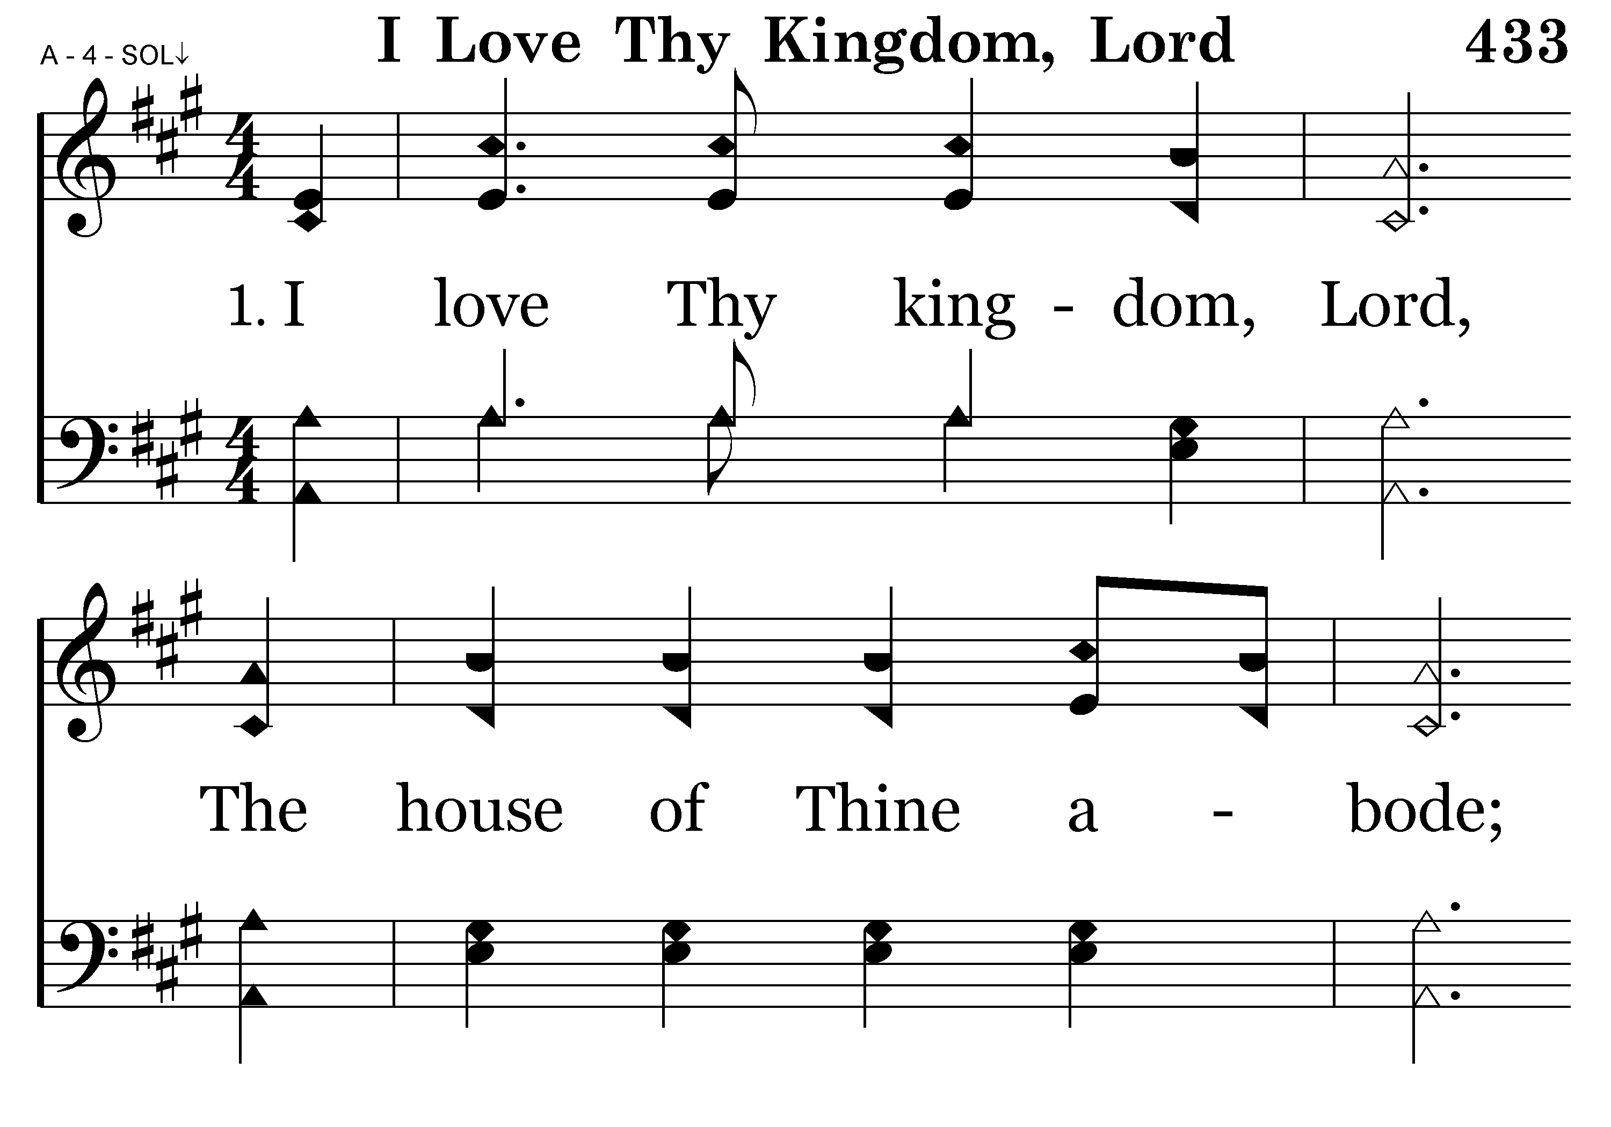
433 - I Love Thy Kingdom, Lord - 1.1

Slide 10
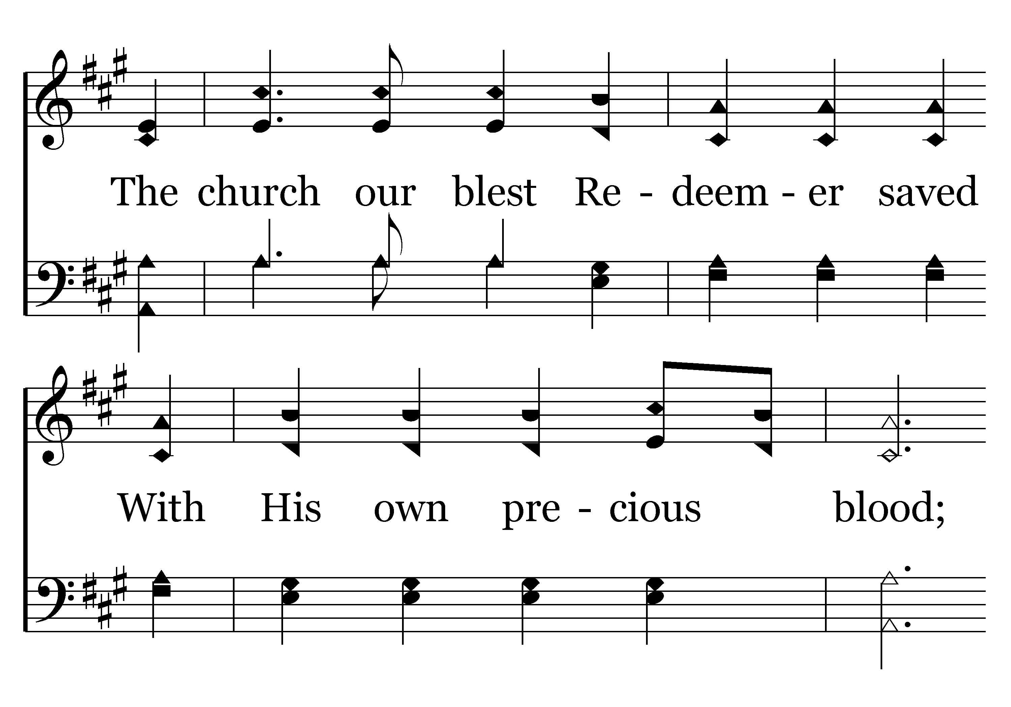
433 - I Love Thy Kingdom, Lord - 1.2

Slide 11
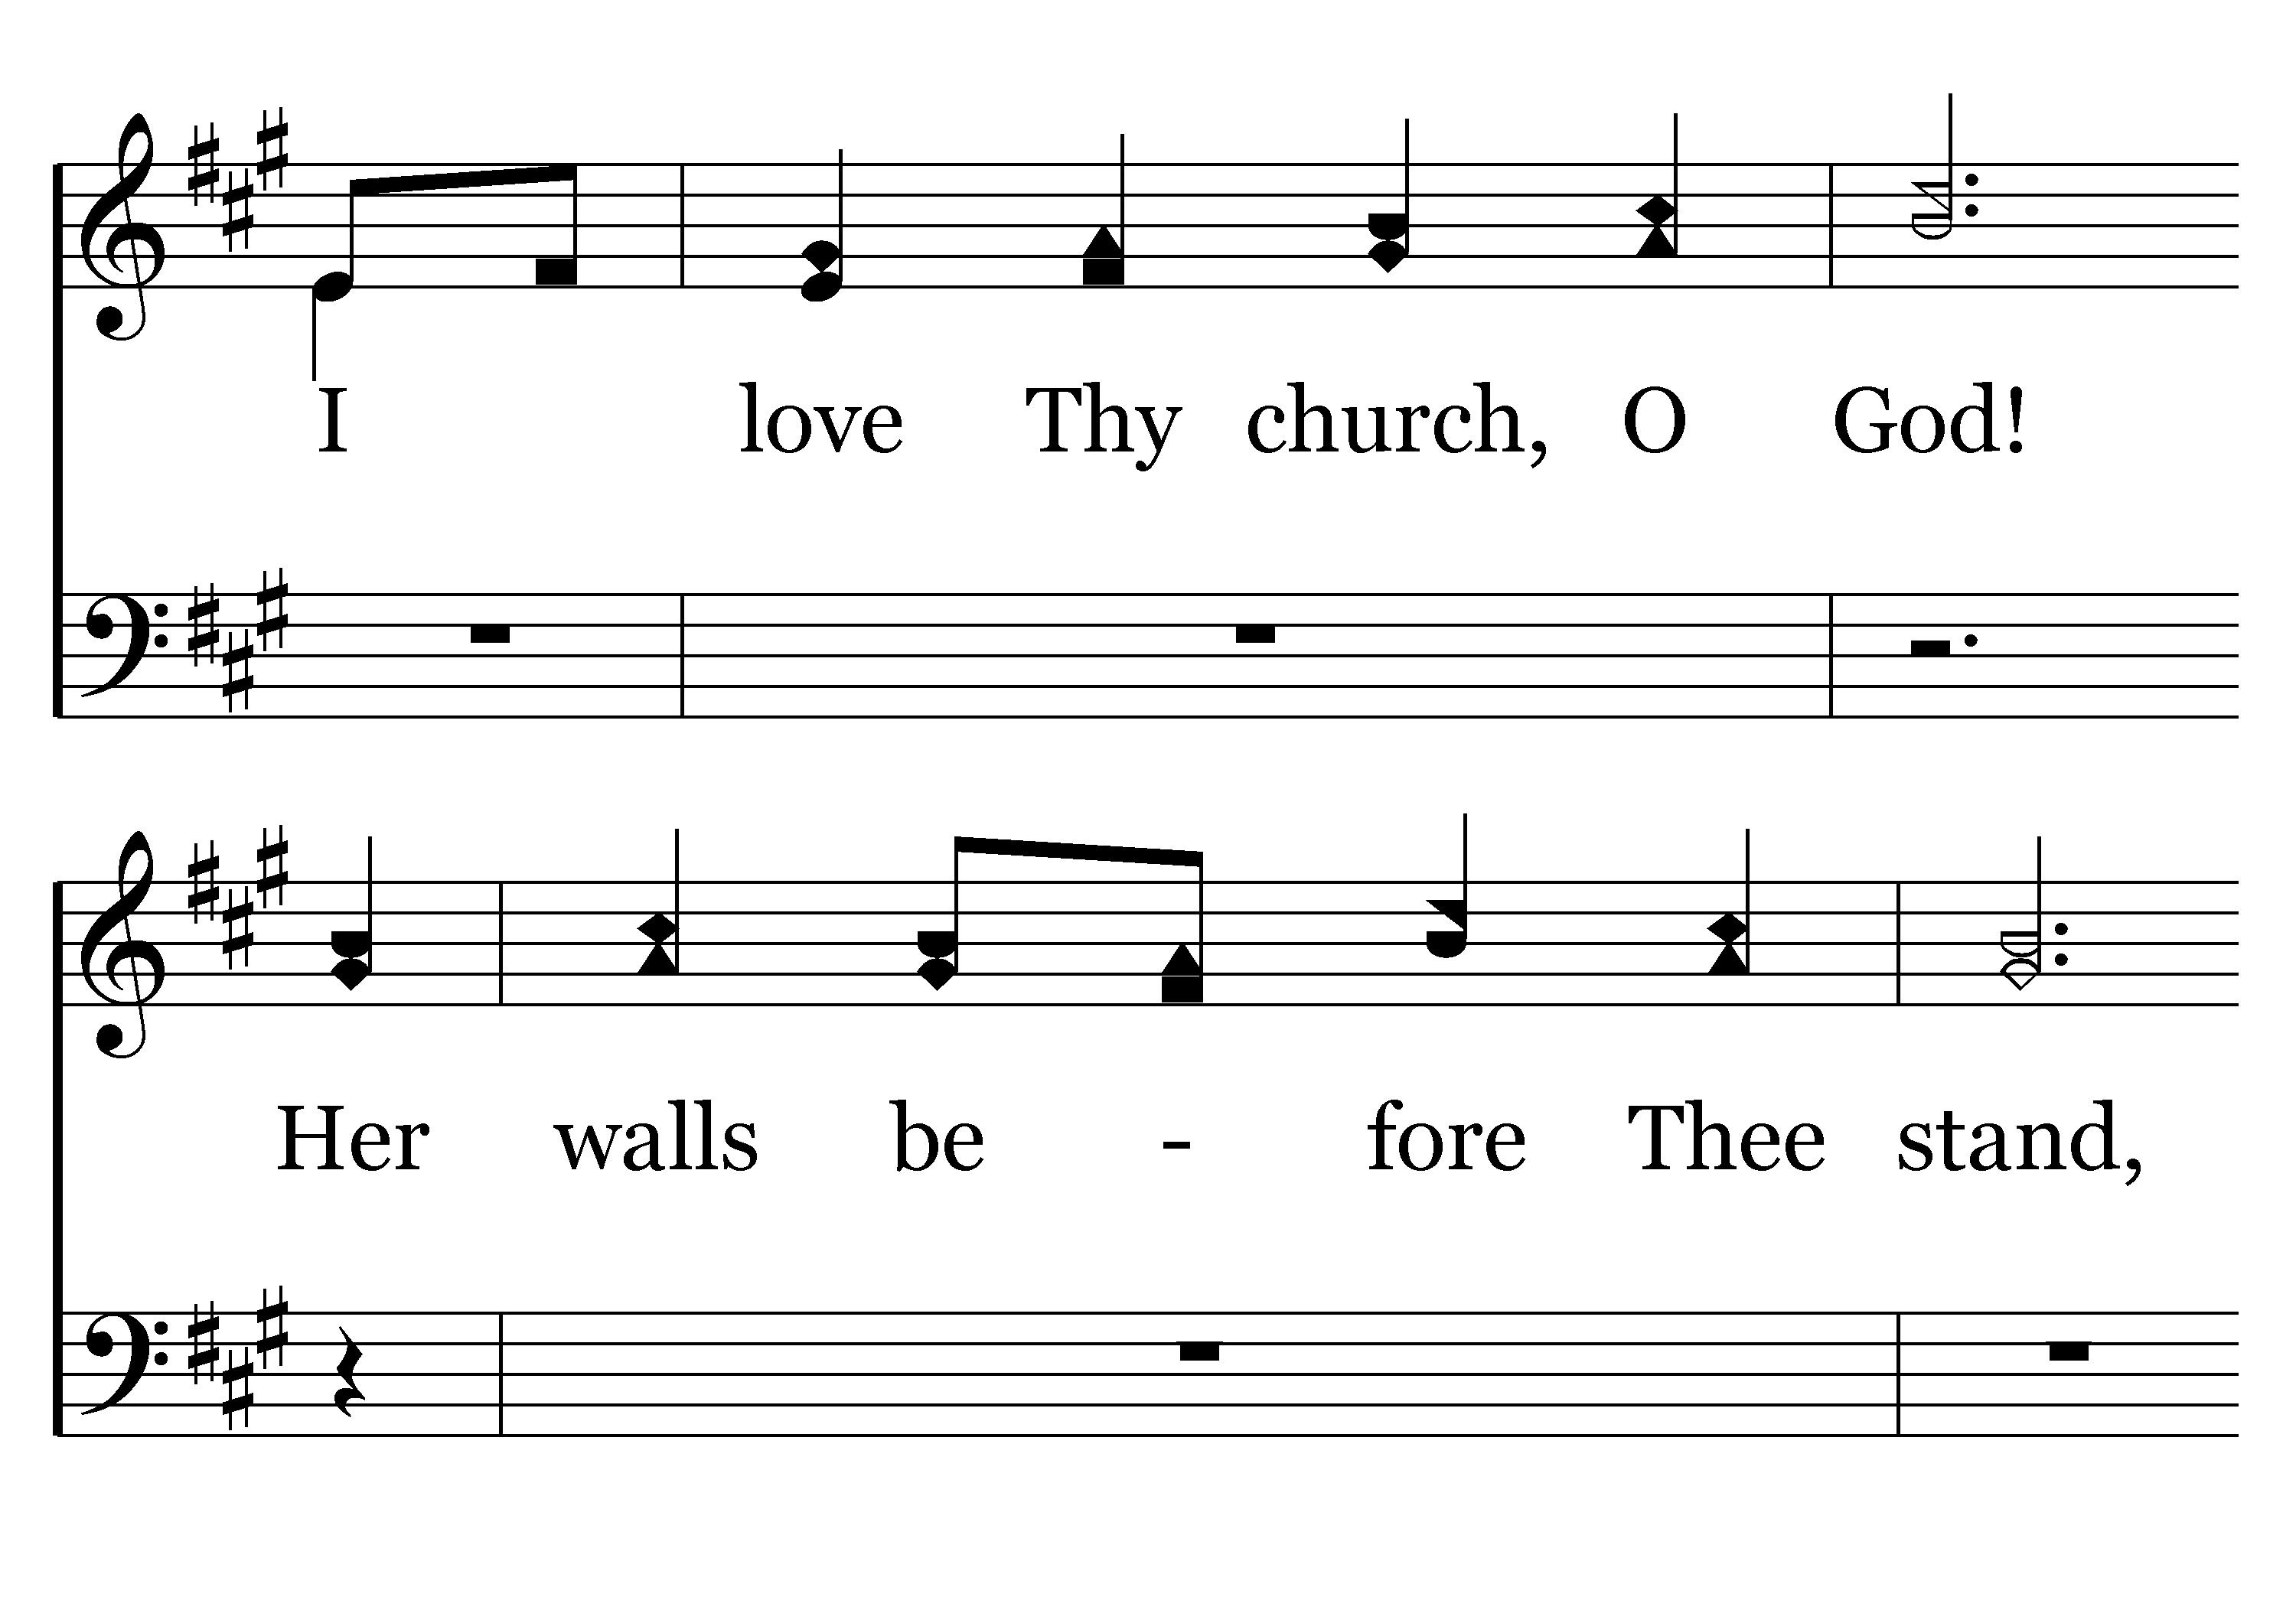
433 - I Love Thy Kingdom, Lord - 1.3

Slide 12
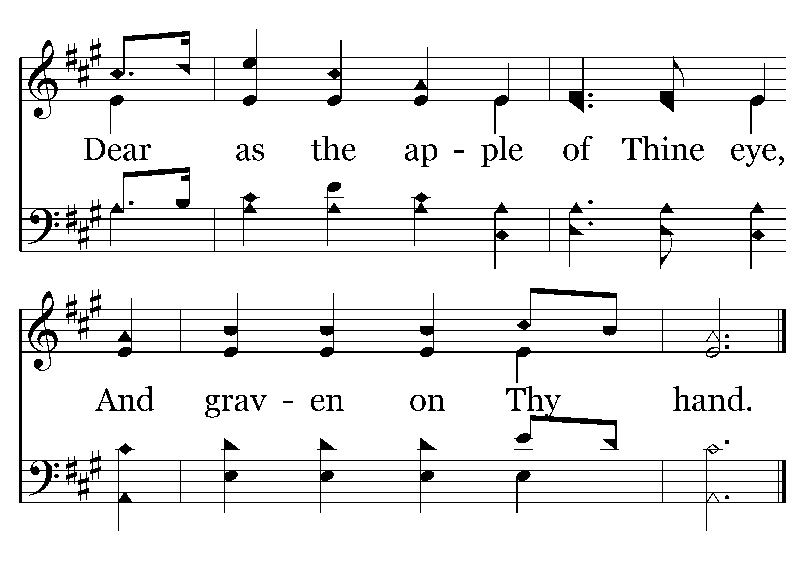
433 - I Love Thy Kingdom, Lord - 1.4
End of Verse 1

Slide 13
433 - I Love Thy Kingdom, Lord - 2.1

Slide 14
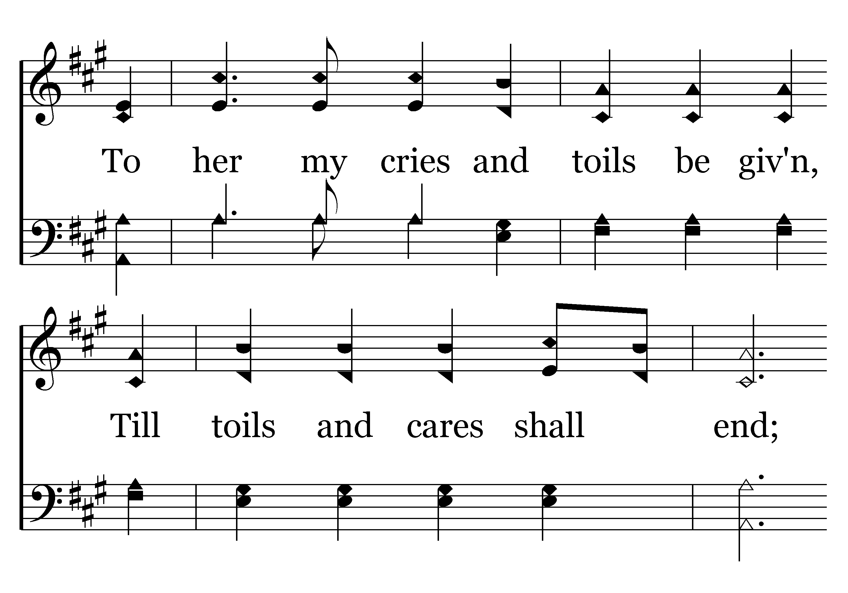
433 - I Love Thy Kingdom, Lord - 2.2

Slide 15
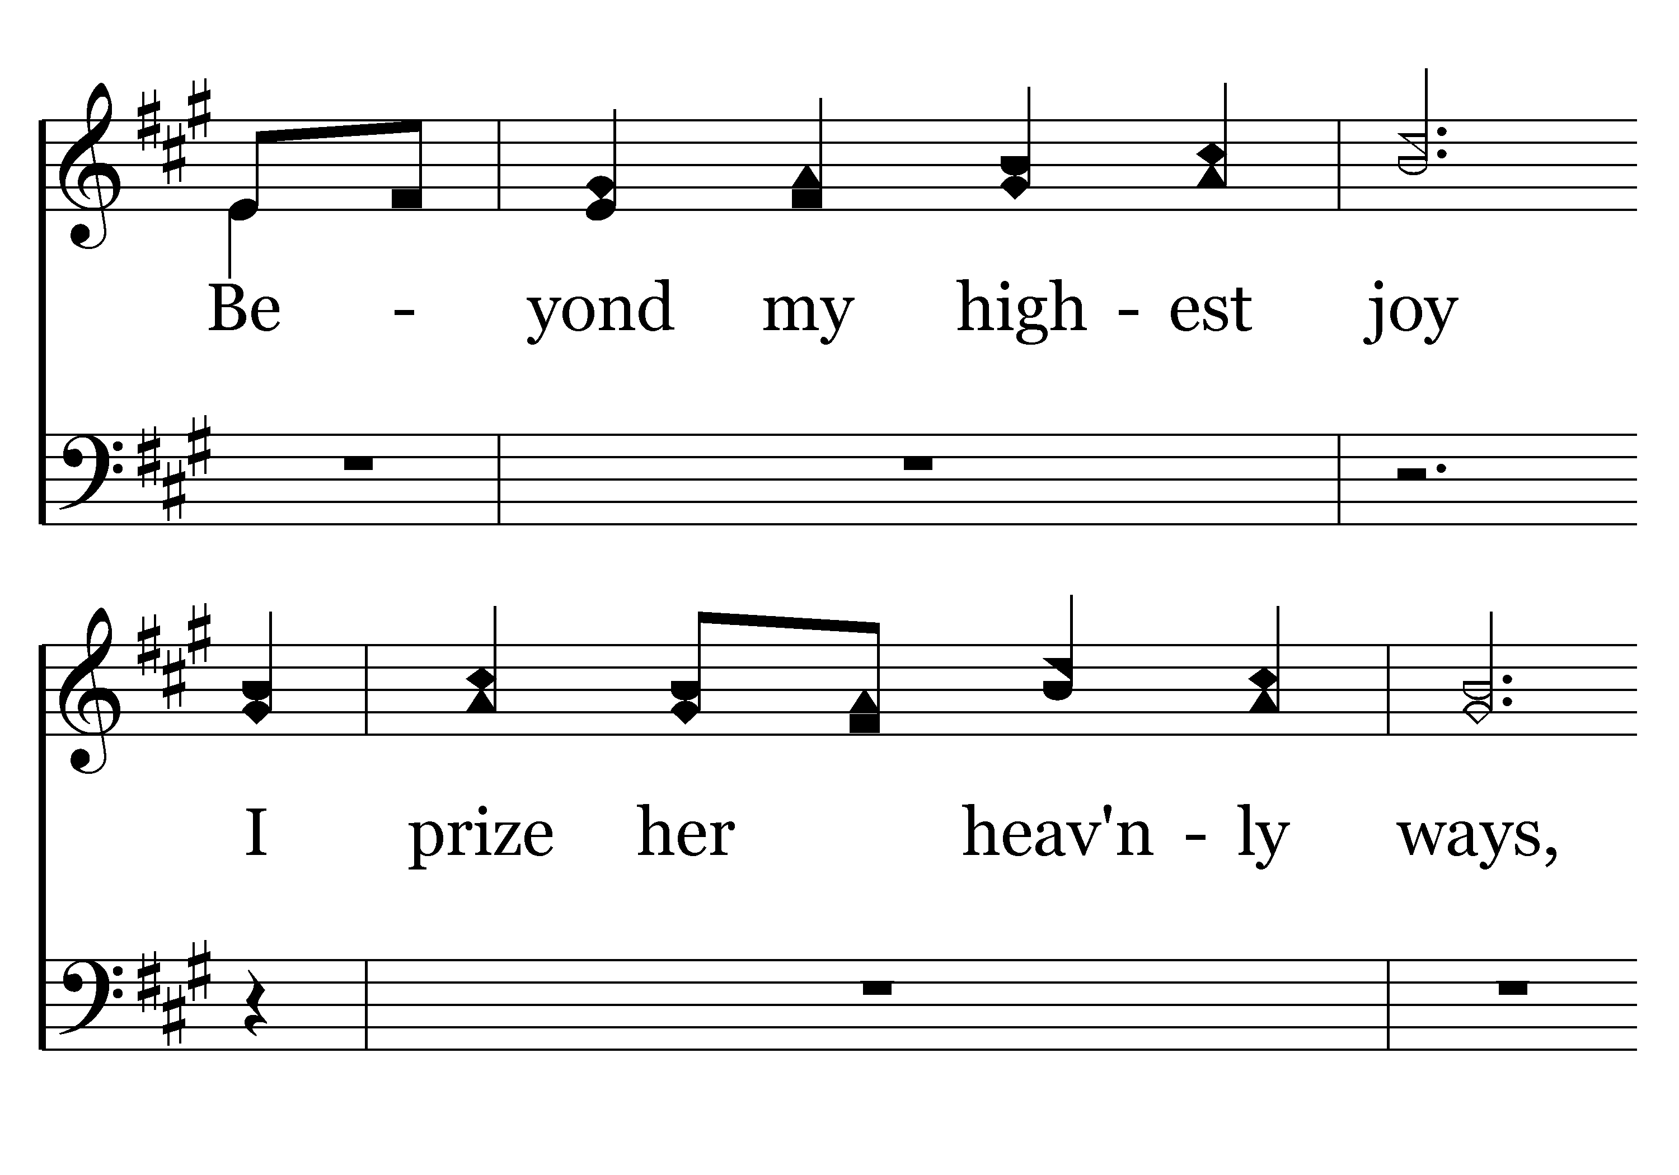
433 - I Love Thy Kingdom, Lord - 2.3

Slide 16
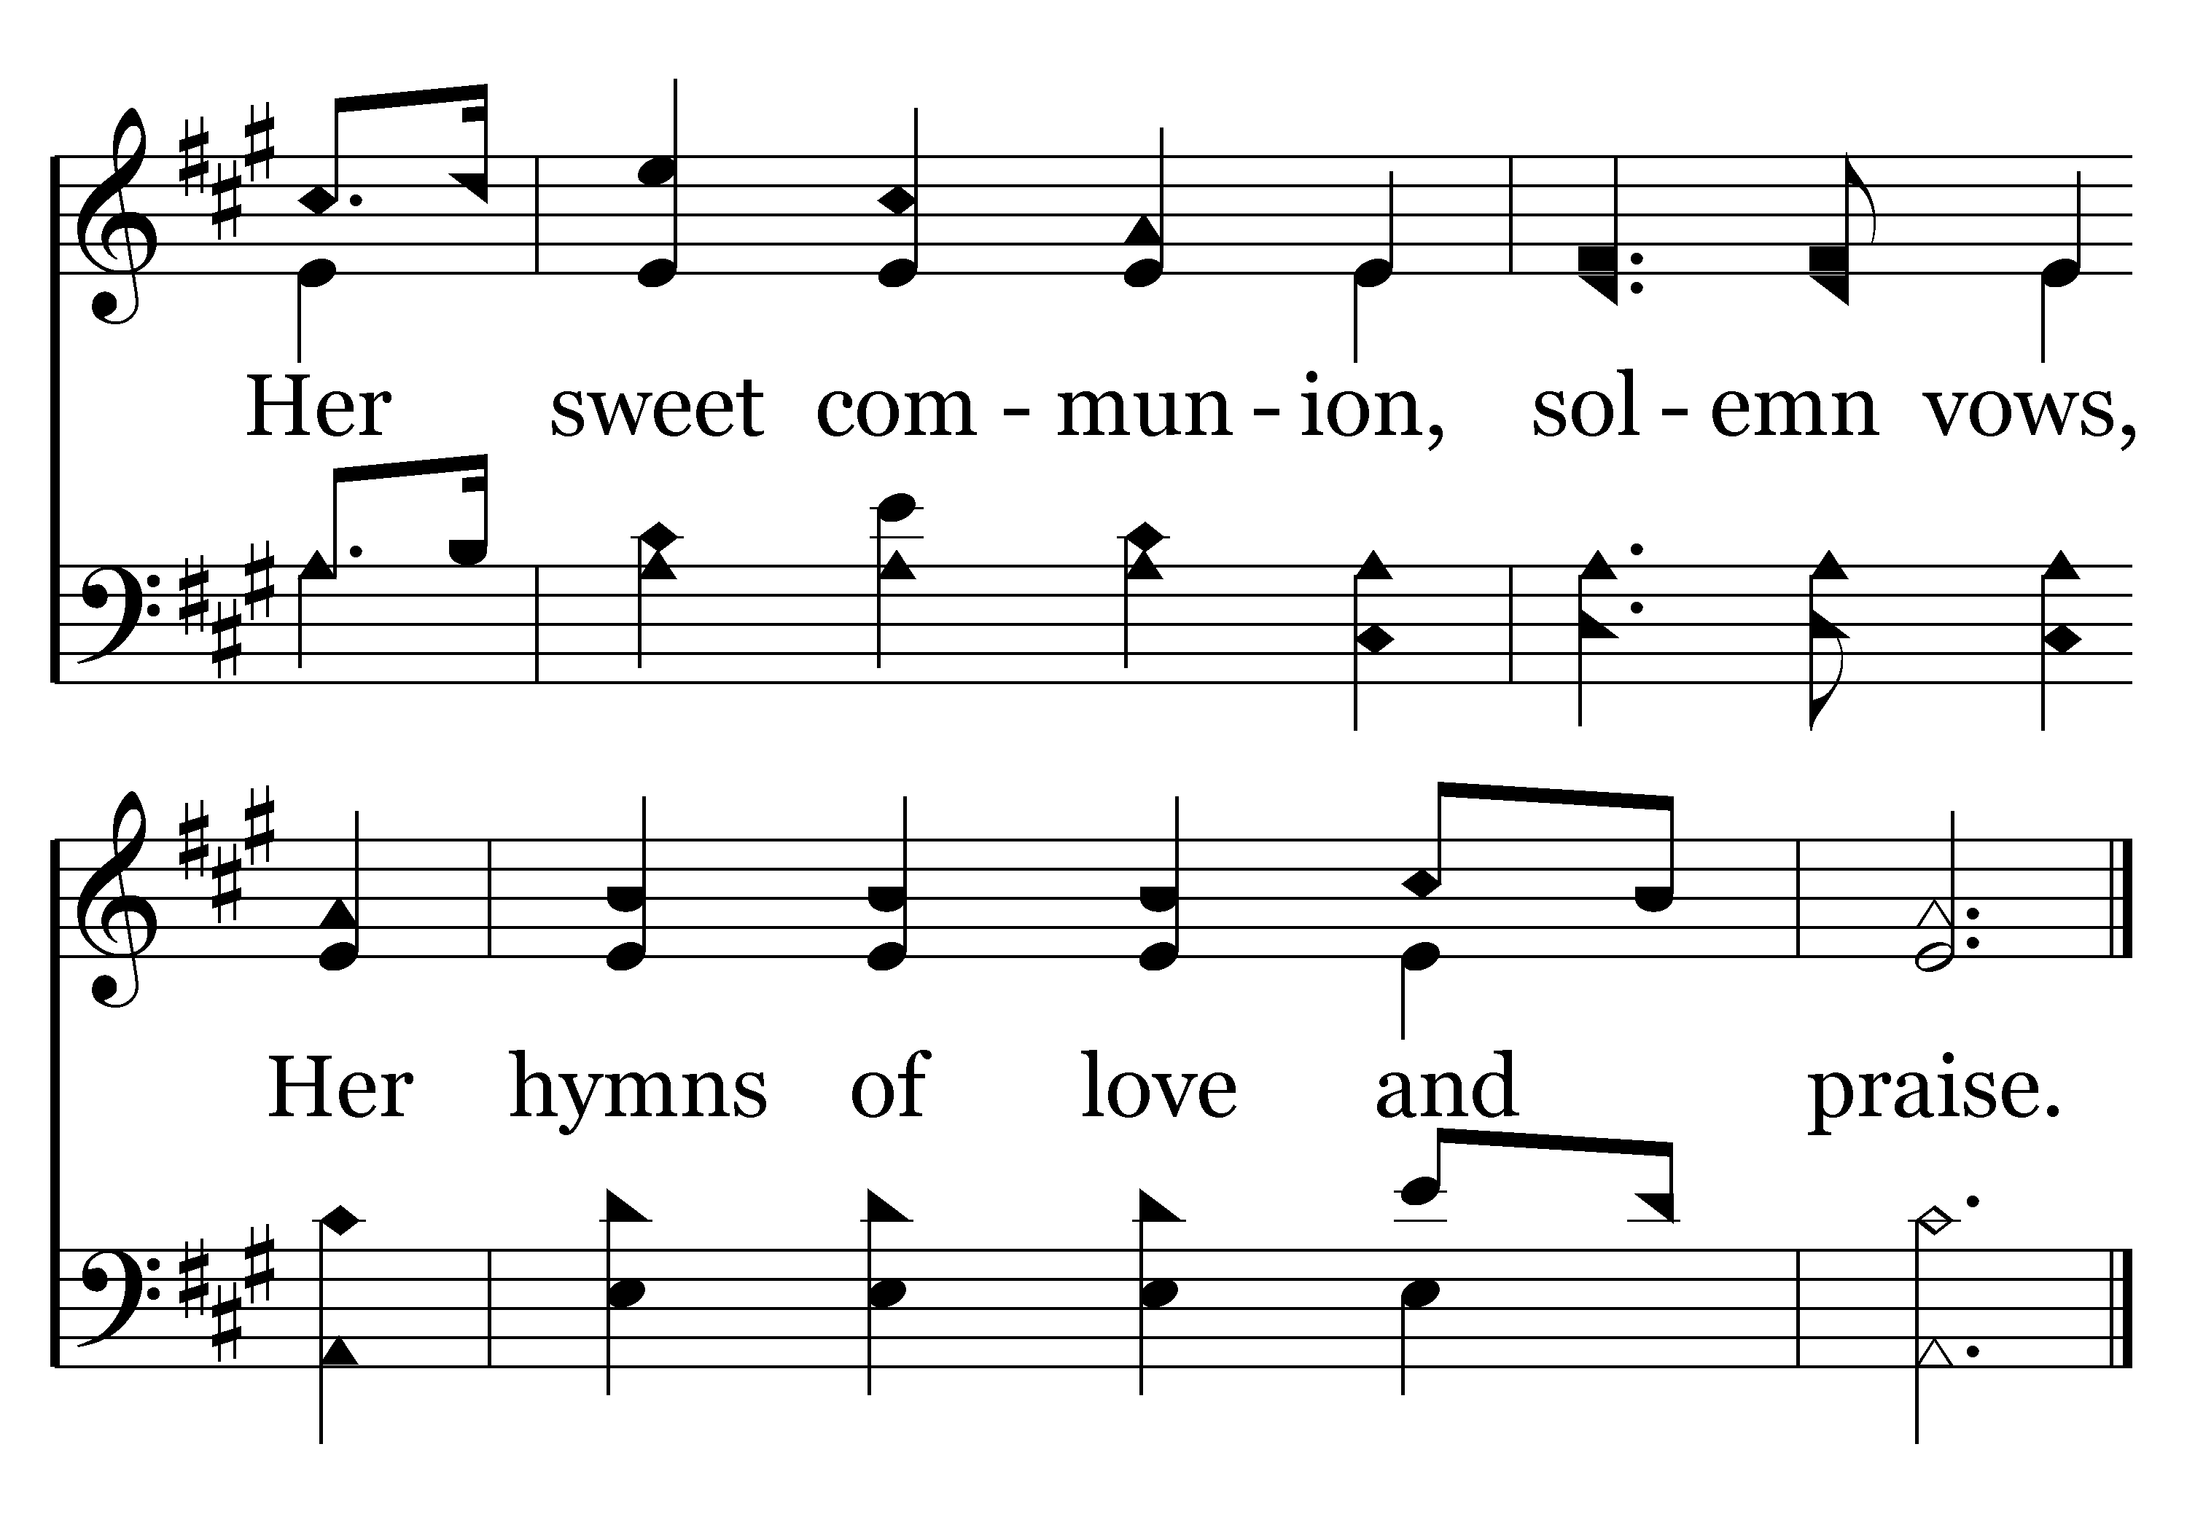
433 - I Love Thy Kingdom, Lord - 2.4
End of Verse 2
Notes:
Relationship…

Slide 17
GOD
GOD
GOD
Notes:
Church → Church
We have OUR relationship with GOD –
BUT that creates the ‘horizontal’ relationship with other believers….
1John 4:11 Beloved, if God so loved us, we also ought to love one another.
1John 4:20-21 If anyone says, “I love God,” and hates his brother, he is a liar; for he who does not love his brother whom he has seen cannot love God whom he has not seen. 21 And this commandment we have from him: whoever loves God must also love his brother.
→ BUT that is multifaceted !
We are members one of another…
If one suffers / YOU suffer ?

Slide 18
GOD
GOD
Notes:
Many members – One Body –
EACH connected to EACH…
One Another to one another…
→ Such relationship is found in a local congregation!

Slide 19
Such relationship is found in a local congregation
GOD
GOD
Notes:
Such relationship is mostly found and practiced in a local congregation.
There IS love of the brotherhood, they did send to help relieve needy saints..
BUT most one another responsibilities are fulfilled ‘face to face’, and hence in local relationship.
→ This is SO special to God that He has instructed us in these ‘one another’ responsibilities!

Slide 20
“One Another…”
GOD
GOD
Notes:
→ This is SO special to God that He has instructed us in these ‘one another’ responsibilities!
One of the most often used phrases in writing to God’s people …
→ NOTICE SOME of them…

Slide 21
Live in harmony with one another – R. 15:5
Instruct one another – R. 15:14
Serve one another – G. 6:2
Be kind to one another – E. 4:32
Teaching one another – E. 5:19
Notes:
Live in harmony with one another – R. 15:5
Instruct one another – R. 15:14
Serve one another – G. 6:2
Be kind to one another – E. 4:32
Teaching one another – E. 5:19
→ continue

Slide 22
Encourage one another 1T. 4:18
Build One another up – 1T.5:11
Exhort one another – H. 3:13
Stir up one another unto love and good works – H. 10:24-25
Notes:
Encourage one another 1T. 4:18
Build One another up – 1T.5:11
Exhort one another – H. 3:13
Stir up one another unto love and good works – H. 10:24-25
→ ‘greatest of these is love’

Slide 23
John 13:34-35 – LOVE
John 15:12 – LOVE
John 15:17 – LOVE
Rom. 12:10 – LOVE
1Pet. 1:22 – LOVE
1Pet. 4:8 - LOVE
Notes:
John 13:34-35 – LOVE
John 15:12 – LOVE
John 15:17 – LOVE
Rom. 12:10 – LOVE
1Pet. 1:22 – LOVE
1Pet. 4:8 - LOVE
Greatest need I see among us is right here!

Slide 24
1 John 3:11 – LOVE
1 John 3:23 – LOVE
1 John 4:7 – LOVE
1 John 4:12 – LOVE
2 John 5 - LOVE

