Slide 1
GOD
GOD

Slide 2
Dead IN Sin and Separated from God
GOD
GOD
Notes:
WHEN we sin – we die…
ARE then dead IN Sin
Separated FROM God…
BUT such sin also changed our mind, our actions… Rom. 1:21-23

Slide 3
Corrupted our mind and actions.
GOD
GOD
Notes:
It also corrupts our mind / spirit -
Notice the progress in Rom. 1:21-23
Also ( Eph. 4:17-19
Ro 8:7–8
⁷For the mind that is set on the flesh is hostile to God, for it does not submit to God’s law; indeed, it cannot.
⁸Those who are in the flesh cannot please God.

Slide 4
they became futile in their thinking, and their foolish hearts were darkened.
GOD
GOD
Romans 1:21-23
Notes:
It also corrupts our mind / spirit -
Notice the progress in Rom. 1:
21 For although they knew God, they did not honor him as God or give thanks to him, but they became futile in their thinking, and their foolish hearts were darkened.
22 Claiming to be wise, they became fools,
23 and exchanged the glory of the immortal God for images resembling mortal man and birds and animals and creeping things.
Eph. 4:17-19
Ro 8:7–8
⁷For the mind that is set on the flesh is hostile to God, for it does not submit to God’s law; indeed, it cannot.
⁸Those who are in the flesh cannot please God.

Slide 5
Ephesians 4:17-19
GOD
Futility of their minds
Darkened in understanding
Alienated from the life of God
Ignorance that is in them
Hardness of heart
GOD
Notes:
It also corrupts our mind / spirit –
Eph. 4:17-19
17 Now this I say and testify in the Lord, that you must no longer walk as the Gentiles do, in the futility of their minds.
18 They are darkened in their understanding, alienated from the life of God because of the ignorance that is in them, due to their hardness of heart.
19 They have become callous and have given themselves up to sensuality, greedy to practice every kind of impurity.
Ro 8:7–8
⁷For the mind that is set on the flesh is hostile to God, for it does not submit to God’s law; indeed, it cannot.
⁸Those who are in the flesh cannot please God.

Slide 6
The Old man must DIE !
GOD
GOD
Romans 6:17-19
Notes:
The OLD MAN MUST DIE..
BUT – Romans 6:17-19
7 But thanks be to God, that you who were once slaves of sin have become obedient from the heart to the standard of teaching to which you were committed,
18 and, having been set free from sin, have become slaves of righteousness.
19 I am speaking in human terms, because of your natural limitations. For just as you once presented your members as slaves to impurity and to lawlessness leading to more lawlessness, so now present your members as slaves to righteousness leading to sanctification.

Slide 7
²⁰ I have been crucified with Christ. It is no longer I who live, but Christ who lives in me. And the life I now live in the flesh I live by faith in the Son of God, who loved me and gave himself for me. Gal. 2:20
GOD
GOD
Notes:
Ga 2:20
²⁰I have been crucified with Christ. It is no longer I who live, but Christ who lives in me. And the life I now live in the flesh I live by faith in the Son of God, who loved me and gave himself for me.

Slide 8
²⁴ And those who belong to Christ Jesus have crucified the flesh with its passions and desires. Gal. 5:24
GOD
GOD
Notes:
Ga 5:24
²⁴And those who belong to Christ Jesus have crucified the flesh with its passions and desires.

Slide 9
¹⁴ But far be it from me to boast except in the cross of our Lord Jesus Christ, by which the world has been crucified to me, and I to the world. Gal. 6:14
GOD
GOD
Notes:
Ga 6:14
¹⁴But far be it from me to boast except in the cross of our Lord Jesus Christ, by which the world has been crucified to me, and I to the world.

Slide 10
¹⁵ and he died for all, that those who live might no longer live for themselves but for him who for their sake died and was raised. 2 Cor. 5:15
GOD
GOD
Notes:
2 Co 5:15
¹⁵and he died for all, that those who live might no longer live for themselves but for him who for their sake died and was raised.

Slide 11
¹⁰ who died for us so that whether we are awake or asleep we might live with him. 1Thess. 5:10
GOD
GOD
Notes:
1 Th 5:10
¹⁰who died for us so that whether we are awake or asleep we might live with him.

Slide 12
²⁰ If with Christ you died to the elemental spirits of the world, why, as if you were still alive in the world, Col. 2:20
GOD
GOD
Notes:
Col 2:20
²⁰If with Christ you died to the elemental spirits of the world, why, as if you were still alive in the world, do you submit to regulations—

Slide 13
³ For you have died, and your life is hidden with Christ in God. Col. 3:3-4
GOD
GOD
Notes:
Col 3:3–4
³For you have died, and your life is hidden with Christ in God.
⁴When Christ who is your life appears, then you also will appear with him in glory.

Slide 14
¹¹ In him also you were circumcised with a circumcision made without hands, by putting off the body of the flesh Col. 2:11-14
GOD
GOD
Notes:
Col 2:11–14
¹¹In him also you were circumcised with a circumcision made without hands, by putting off the body of the flesh, by the circumcision of Christ,
¹²having been buried with him in baptism, in which you were also raised with him through faith in the powerful working of God, who raised him from the dead.
¹³And you, who were dead in your trespasses and the uncircumcision of your flesh, God made alive together with him, having forgiven us all our trespasses,
¹⁴by canceling the record of debt that stood against us with its legal demands. This he set aside, nailing it to the cross.

Slide 15
¹ Since therefore Christ suffered in the flesh, arm yourselves with the same way of thinking, for whoever has suffered in the flesh has ceased from sin, 1Peter 4:1-3
GOD
GOD
Notes:
1 Pe 4:1–3
¹Since therefore Christ suffered in the flesh, arm yourselves with the same way of thinking, for whoever has suffered in the flesh has ceased from sin,
²so as to live for the rest of the time in the flesh no longer for human passions but for the will of God.
³For the time that is past suffices for doing what the Gentiles want to do, living in sensuality, passions, drunkenness, orgies, drinking parties, and lawless idolatry.

Slide 16
²³ And he said to all, “If anyone would come after me, let him deny himself and take up his cross daily and follow me. Luke 9:23
GOD
GOD
Notes:
Lk 9:23
²³And he said to all, “If anyone would come after me, let him deny himself and take up his cross daily and follow me.

Slide 17
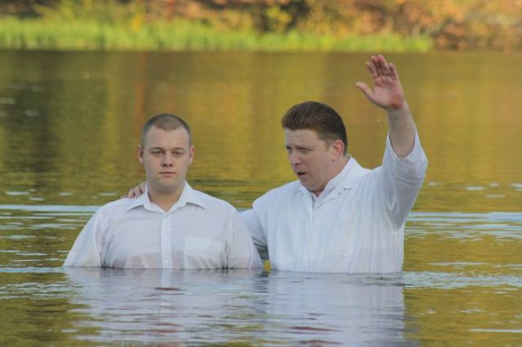
Baptized INTO Christ
GOD
GOD
Notes:
Romans 6 begins with the question
Shall we CONTINUE IN SIN that Grace may abound…
The answer is of course NOT for we understand / remember what happened..
IS THIS WHAT happened when you were baptized …

Slide 18
… died to sin
GOD
GOD
Romans 6:2
Notes:
6:1 What shall we say then? Are we to continue in sin that grace may abound?
2 By no means! How can we who died to sin still live in it?
WHEN? HOW ? – vs. 3-4

Slide 19
… baptism into death…
GOD
GOD
Romans 6:4
Notes:
3 Do you not know that all of us who have been baptized into Christ Jesus were baptized into his death?
4 We were buried therefore with him by baptism into death, in order that, just as Christ was raised from the dead by the glory of the Father, we too might walk in newness of life.
→ Continues in 5-6

Slide 20
… old self crucified… body of sin brought to nothing
GOD
GOD
Romans 6:6
Notes:
5 For if we have been united with him in a death like his, we shall certainly be united with him in a resurrection like his.
6 We know that our old self was crucified with him in order that the body of sin might be brought to nothing, so that we would no longer be enslaved to sin.

Slide 21
… died set free FROM sin
GOD
GOD
Romans 6:7
Notes:
7 For one who has died has been set free from sin.
→ vs. 8

Slide 22
IF - died with Christ THEN we can live
GOD
GOD
Romans 6:8
Notes:
8 Now if we have died with Christ, we believe that we will also live with him.
→ vs. 9-10

Slide 23
HE died to sin once for all
GOD
GOD
Romans 6:9-10
Notes:
9 We know that Christ, being raised from the dead, will never die again; death no longer has dominion over him.
10 For the death he died he died to sin, once for all, but the life he lives he lives to God.
→ Look at again!...

Slide 24
HE died to sin once for all
GOD
GOD
We are buried
With Christ
Romans 6:2
Notes:
HE died to sin once for all
We are buried
With Christ

Slide 25
HE died to sin once for all
GOD
GOD
We are baptized
into His death
Romans 6:3
Notes:
HE died to sin once for all
We are baptized
into His death

Slide 26
HE died to sin once for all
GOD
GOD
We are united
in a death like his…
Romans 6:5
Notes:
HE died to sin once for all
We are united
in a death like his…

Slide 27
WE are to have died to sin once for all
GOD
GOD
Romans 6
Notes:
WE are to have died to sin once for all
This all encompassed in our being baptized into Christ – we buried into death – united in His death – died with Christ – crucified self…
→ Paul then draws three conclusions – vs. 11-13

Slide 28
CONSIDER yourself dead to sin
GOD
GOD
Romans 6:11
Notes:
Paul's makes three specific applications
11 – So you also must consider yourselves dead to sin and alive to God in Christ Jesus.
12 – LET NOT Sin therefore 'reign' …
13 – DO NOT present your … but present yourself unto God
11 So you also must consider yourselves dead to sin and alive to God in Christ Jesus.
12 Let not sin therefore reign in your mortal body, to make you obey its passions.
13 Do not present your members to sin as instruments for unrighteousness, but present yourselves to God as those who have been brought from death to life, and your members to God as instruments for righteousness.

Slide 29
LET NOT Sin therefore 'reign’ in your body
GOD
GOD
Romans 6:12
Notes:
Paul's makes three specific applications
12 Let not sin therefore reign in your mortal body, to make you obey its passions.
13 Do not present your members to sin as instruments for unrighteousness, but present yourselves to God as those who have been brought from death to life, and your members to God as instruments for righteousness.
11 – CONSIDER yourself dead to sin
12 – LET NOT Sin therefore 'reign' …
13 – DO NOT present your … but present yourself unto God
11 So you also must consider yourselves dead to sin and alive to God in Christ Jesus.

Slide 30
Do not present your members to sin as instruments for unrighteousness
GOD
GOD
Romans 6:13
Notes:
Paul's makes three specific applications
11 – CONSIDER yourself dead to sin
12 – LET NOT Sin therefore 'reign' …
13 – DO NOT present your body … but present yourself unto God
Do not present your members to sin as instruments for unrighteousness, but present yourselves to God as those who have been brought from death to life, and your members to God as instruments for righteousness.

Slide 31
but present yourselves to God as those who have been brought from death to life,
GOD
GOD
Romans 6:13
Notes:
Paul's makes three specific applications
11 – CONSIDER yourself dead to sin
12 – LET NOT Sin therefore 'reign' …
13 – DO NOT present your body … but present yourself unto God
Do not present your members to sin as instruments for unrighteousness, but present yourselves to God as those who have been brought from death to life, and your members to God as instruments for righteousness.

Slide 32
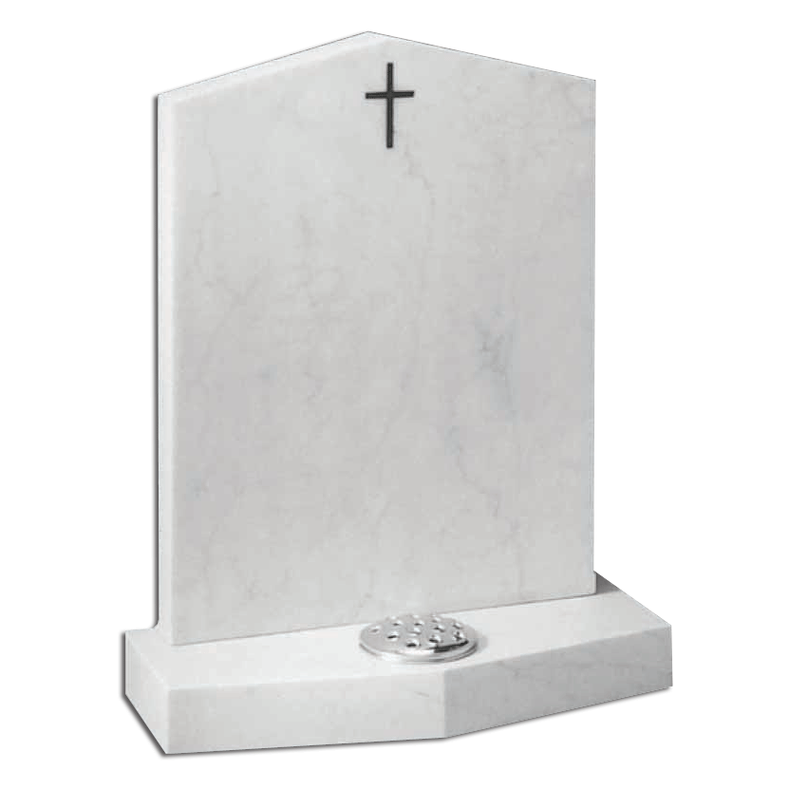
GOD
Here Lies
The Old Man
Crucified
with Christ
GOD

Slide 33
GOD
GOD

