Slide 1
GOD
GOD

Slide 2
“First…”
GOD
GOD
Notes:
INTRODUCTION
1. Life is a series of choices. Every day there are choices of what to choose!
2. Every choice then begins to affect the rest of your life - illust. Boots on before socks? Jeans?
3. Even so in our religious life - there are things that must be FIRST -

Slide 3
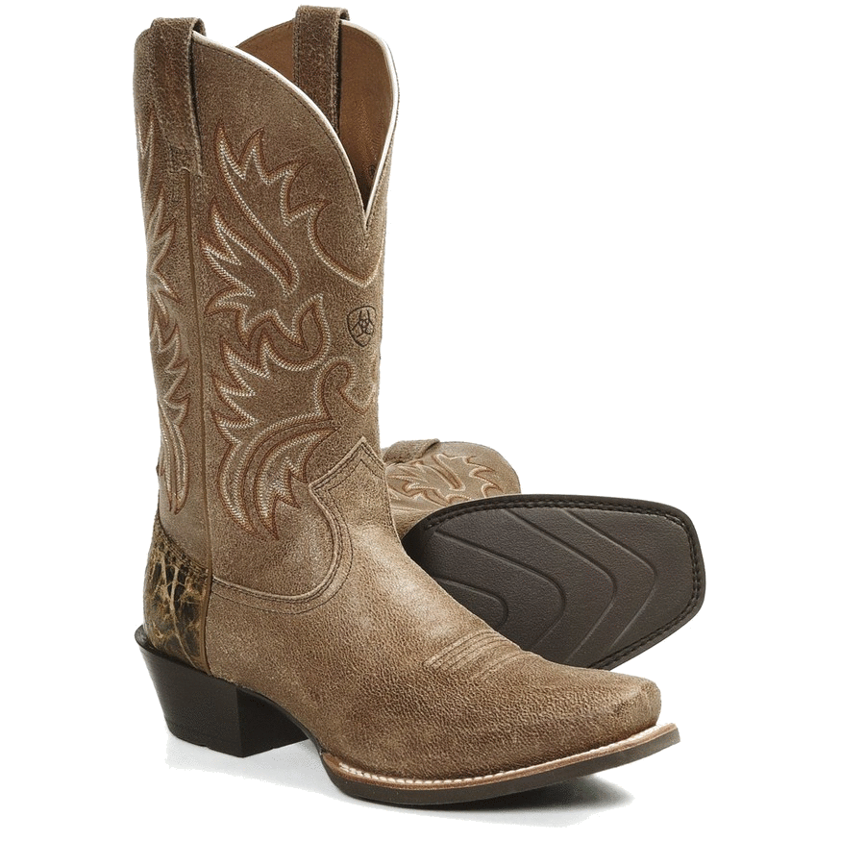
First…
GOD
GOD
Notes:
Some things need to be done FIRST.. . Before …
2 Cor. 8:12 First a willing mind

Slide 4
First – A willing mind.
GOD
GOD
2 Cor. 8:12
Notes:
1. IF THERE BE FIRST A WILLING MIND
a. 2 Cor. 8:12
1. Continuing the thought - what makes the giving acceptable is not the amount - but the mind!
2. The parable of the widow’s might -
b. Principle goes beyond $ - to service.
Exodus 35:5
⁵ Take ye from among you an offering unto the LORD: whosoever is of a willing heart, let him bring it, an offering of the LORD; gold, and silver, and brass, (KJV)
1 Chronicles 28:9
⁹ And thou, Solomon my son, know thou the God of thy father, and serve him with a perfect heart and with a willing mind: for the LORD searcheth all hearts, and understandeth all the imaginations of the thoughts: if thou seek him, he will be found of thee; but if thou forsake him, he will cast thee off for ever. (KJV)
c. We basically do what we WANT - don’t need to have more hours - need to simply change our WANTS.

Slide 5
Cleanse First the inside
GOD
GOD
Matt. 23:26
Notes:
2. CLEANSE FIRST THE INSIDE!
a. Matt. 23:26 - its context
b. Matt. 15:10-11, 15-20 - What keeps one from getting drunk? Adultery? Stealing –
character - integrity - what is on the inside.
c. 1 Peter 3: Peter’s advise to the women - inner man of the heart!

Slide 6
First cast out the beam of your own eye…
GOD
GOD
Matt. 7:5
Notes:
3. FIRST CAST OUT THE BEAM OUT OF THINE OWN EYE
a. Mtt. 7:5
b. All want to help others - yet to do so without care of self is hypocrisy.
c. 1 Timothy 4:16
¹⁶ Take heed unto thyself, and unto the doctrine; continue in them: for in doing this thou shalt both save thyself, and them that hear thee. (KJV)

Slide 7
First be reconciled to your brother
GOD
GOD
Matt. 5:23-24
Notes:
4. FIRST BE RECONCILED TO THY BROTHER
a. Matt. 5:23-24
b. Worship is needed - but can worship God if hate brother -
c. How many this morning have made a mockery of the Lord’s service?
1. fighting in churches - yet ‘worship’ -
2. 1 Cor. 6: - law suits, etc. - yet ‘worshipped’ -
3. 1 Cor. 11: - division over have and have nots - this is NOT the LS!

Slide 8
Seek First the kingdom of God
GOD
GOD
Matt. 6:33
Notes:
5. SEEK YE FIRST THE KINGDOM OF GOD
a. Matt. 6:33 - which bring s us back to where we started!
b. God’s kingdom = God’s rule over our lives.
c. Religion the number one priority in our lives - yet is often the wheel that squeaks the least!

Slide 9
First give self to the Lord
GOD
GOD
2 Cor. 8:5
Notes:
6. FIRST GIVE SELF TO THE LORD
a. 2 Cor. 8:5
1. These had gone beyond their ability. They exceeded that which Paul had hoped for them. Though poor - they gave OUT of their poverty.
b. Such came about BECAUSE they had FIRST given themselves to the Lord.
c. Problem of Christian and his money is really here -

Slide 10
First things First
GOD
GOD
Notes:
CONCLUSION:
1. First things first = must choose what you will do with your life and in your life.
2. First thing of serving God is obeying the gospel and becoming a child of GOD –

