Slide 1
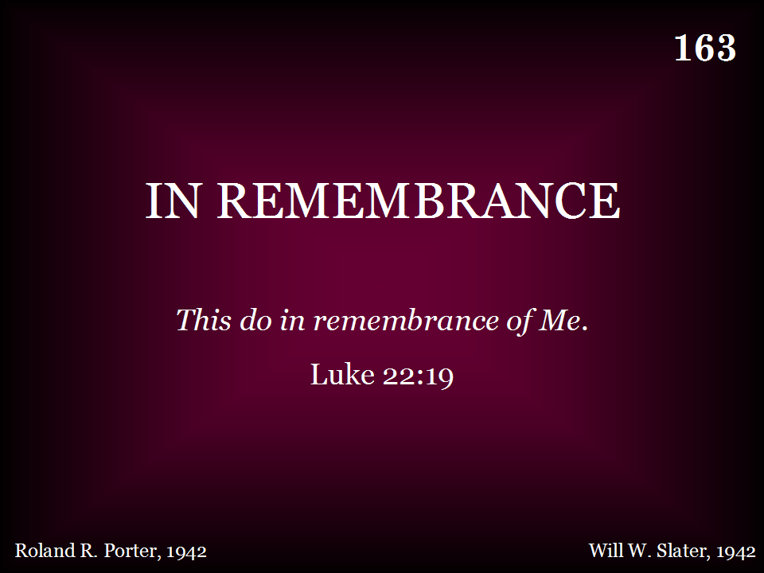
163 - In Remembrance - Title

Slide 2
The
Lord’s Supper
Notes:
The Lord’s supper.
→ The story begins -

Slide 3
The Story Begins
John 1:1-3
John 1:14
John 21:25
John 20:30-31
Notes:
The Story Begins
John 1:1-3
John 1:14
John 21:25
John 20:30-31
406 More About Jesus Would I know

Slide 4
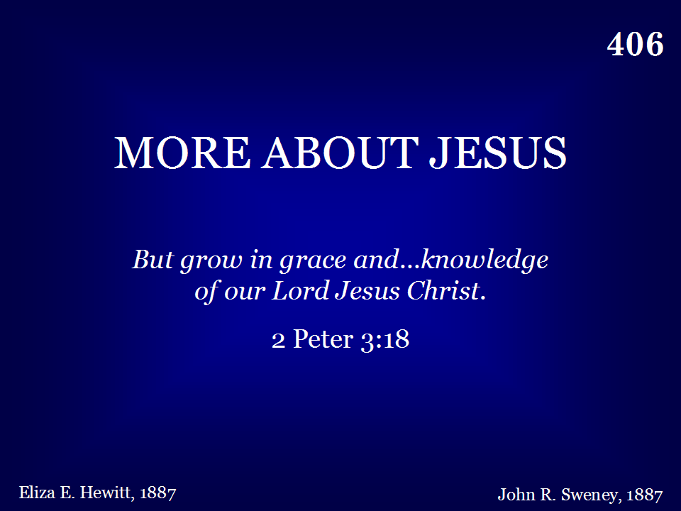
406 - More About Jesus - Title

Slide 5
Luke 2
7 – Mary gives birth
8-14 - Angels
Notes:
Luke 2
7 – Mary gives birth
8-14 – the Angels
#46 – Hark the Herald Angels Sing…

Slide 6
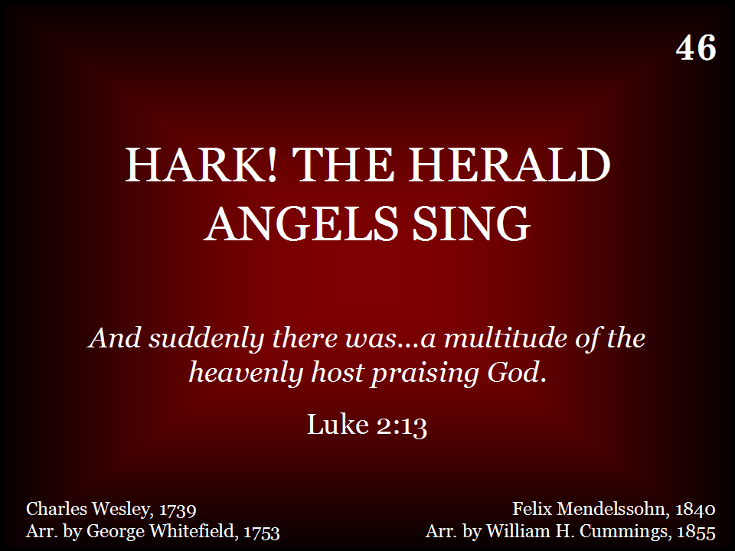
046 - Hark, The Herald Angels Sing - Title

Slide 7
Jesus
Luke 2:40
Hebrews 2:14-15
Hebrews 4:15
Notes:
Luke 2:40 – grew…
Hebrews 2:14-15 … partook of humanity..
Hebrews 4:15… tempted in all points, but without SIN
→ 558 Sweeter as the Years Go By…

Slide 8
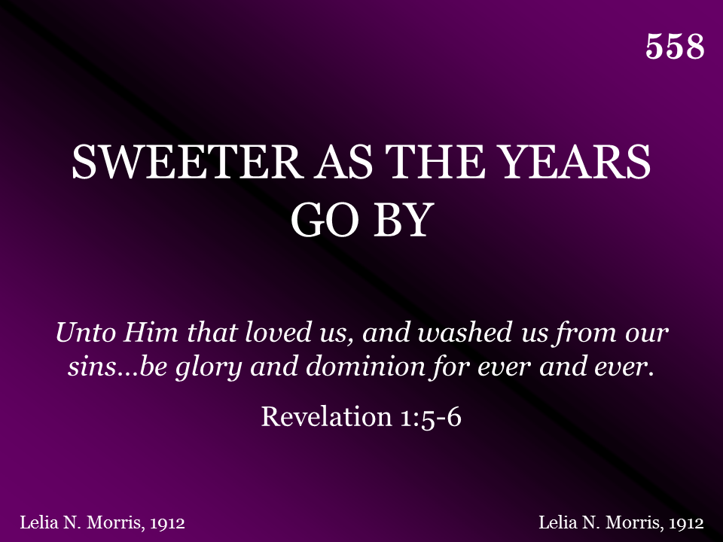
558 - Sweeter As The Years Go By - Title
Vs. 1 & 2, Chorus

Slide 9
I am the
Bread of Life
John 6:1-2, 26-33
Notes:
Teacher – John 6:1-2, 26-27, 28-33 his great teaching…
I am the bread of life…
Unless you eat / drink –
The words are spirit and life….
355 Break Thou The Bread of Life…

Slide 10
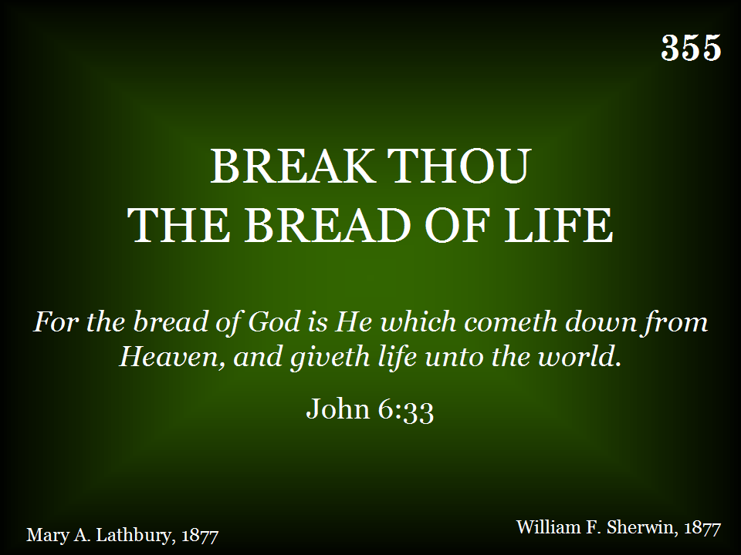
355 - Break Thou The Bread Of Life - Title

Slide 11
To Whom
Shall we Go?
John 6:66-68
Notes:
SOME – walked away – John 6:38-41
48 – I am the bread of life
51 – I am the living bread that came down from heaven….
53 – Unless you eat flesh / drink blood –
57 – Whoever feeds on this bread will live forever.
60 – This is a hard saying; who can listen to it?
66 – 68 many turned back and walked no longer with Jesus – do you want to go away as well?... To whom shall we go….
75s To Whom Shall We Go

Slide 12
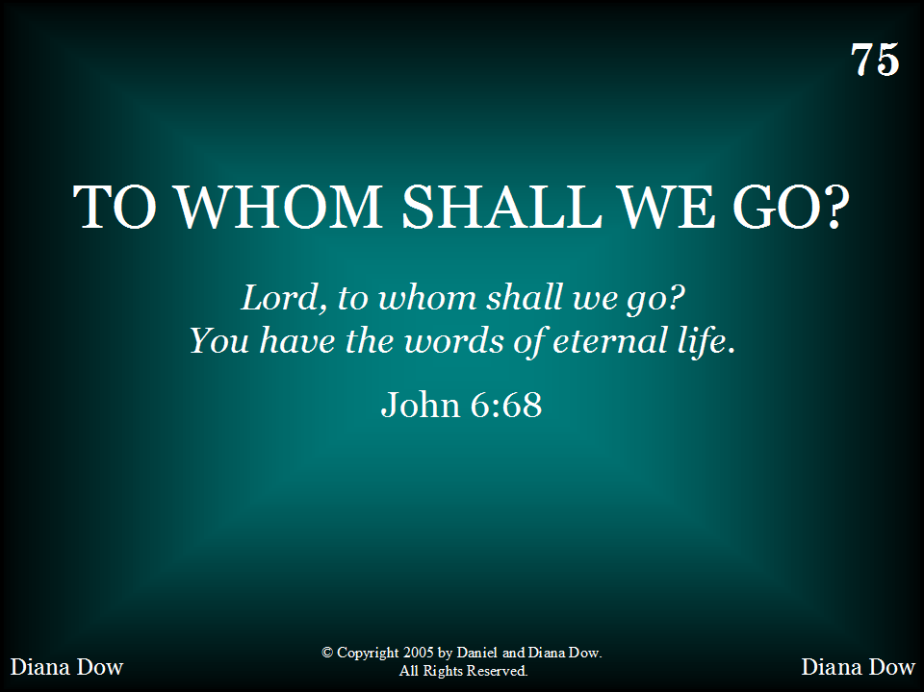
075 - To Whom Shall We Go - Title

Slide 13
Phil. 2:5-10
A Servant
Notes:
Phil. 2:5-10 – a SERVANT
97s Servant’s Song

Slide 14
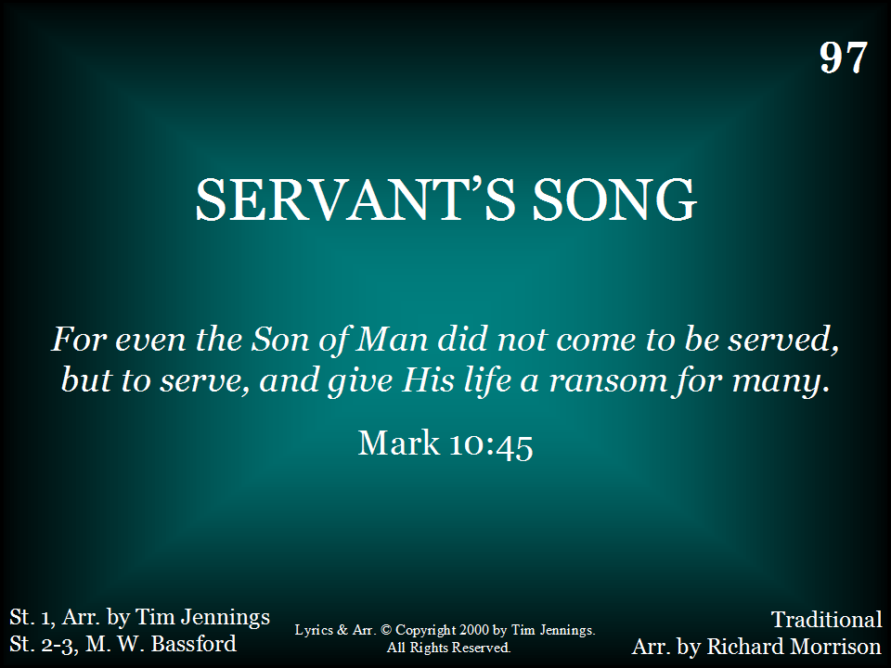
097 - Servant's Song - Title

Slide 15
A life of
Serving…
Matt. 11:2-6
Notes:
Savior came from glory… his healing, his cleansing power, made the lame to walk, cause the blind to see..
Matt. 11:2-6
Victory in Jesus (vs. 1,2, and Chorus)
Matt. 11:2-6
Now when John heard in prison about the deeds of the Christ, he sent word by his disciples
3 and said to him, “Are you the one who is to come, or shall we look for another?”
4 And Jesus answered them, “Go and tell John what you hear and see:
5 the blind receive their sight and the lame walk, lepers are cleansed and the deaf hear, and the dead are raised up, and the poor have good news preached to them.
6 And blessed is the one who is not offended by me.”
s)

Slide 16
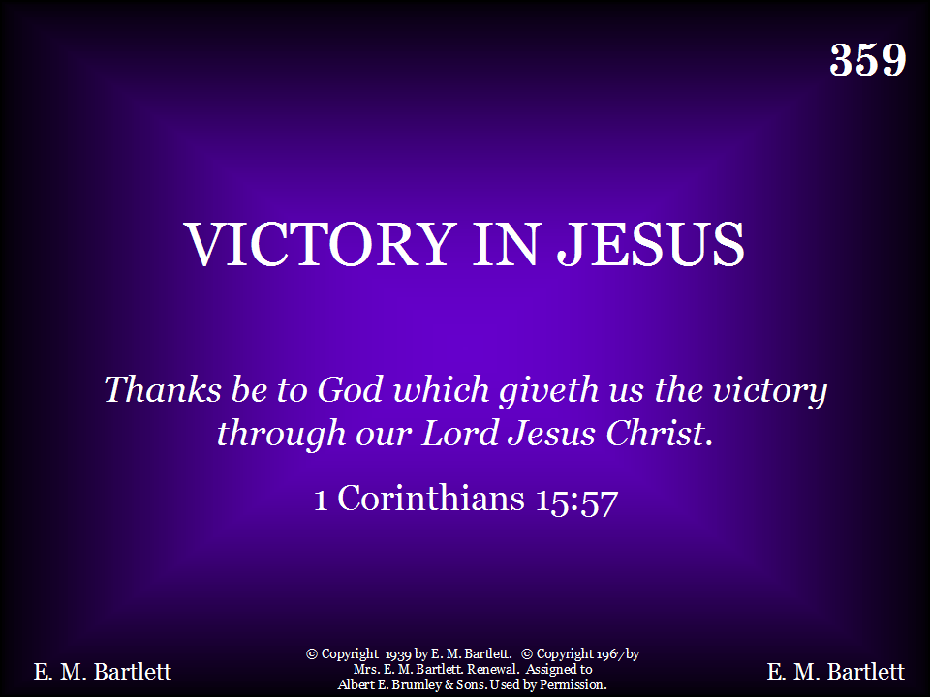
359 - Victory In Jesus - Title
Verses 1 & 2, Chorus

Slide 17
Jesus Prayed
Matt. 26:30
(36-39, 42, 44)
Notes:
Matt. 26:30 – when they had sung a hymn, they went out to the Mount of Olives
36-39, 42, 44
635 A Beautiful Prayer

Slide 18
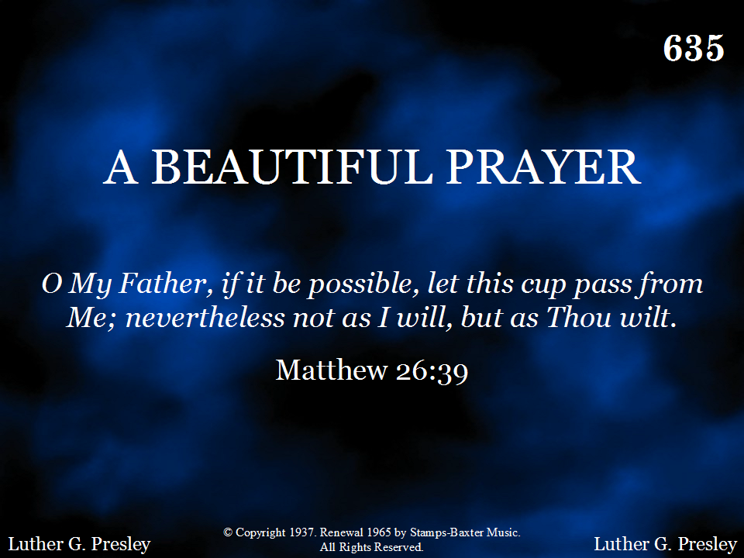
635 - A Beautiful Prayer - Title
Vs. 1 & 2, Chorus
Vs. 3 + Chorus

Slide 19
Night, with black wings,
Hovered over the valley,
All around was silent,
Save the wail of the night wind.
Notes:
Night, with black wings, hovered over the valley… All around was silent, save the wail of the night wind…
Night With Ebon Pinion

Slide 20
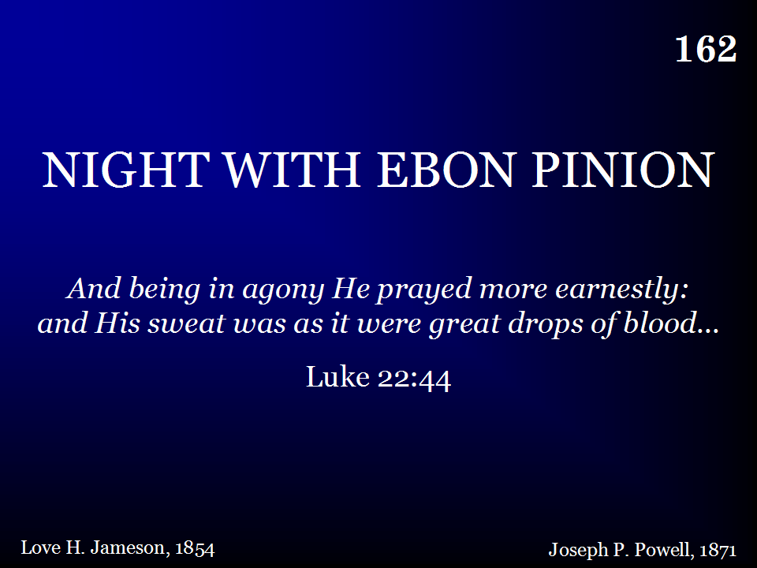
162 - Night With Ebon Pinion - Title

Slide 21
Crucified Him
Matthew 27:25-31
Luke 23:33
Notes:
Crucified Him
Matthew 27:25-31
Luke 23:33
When I Survey the Wondrous Cross 1,3

Slide 22
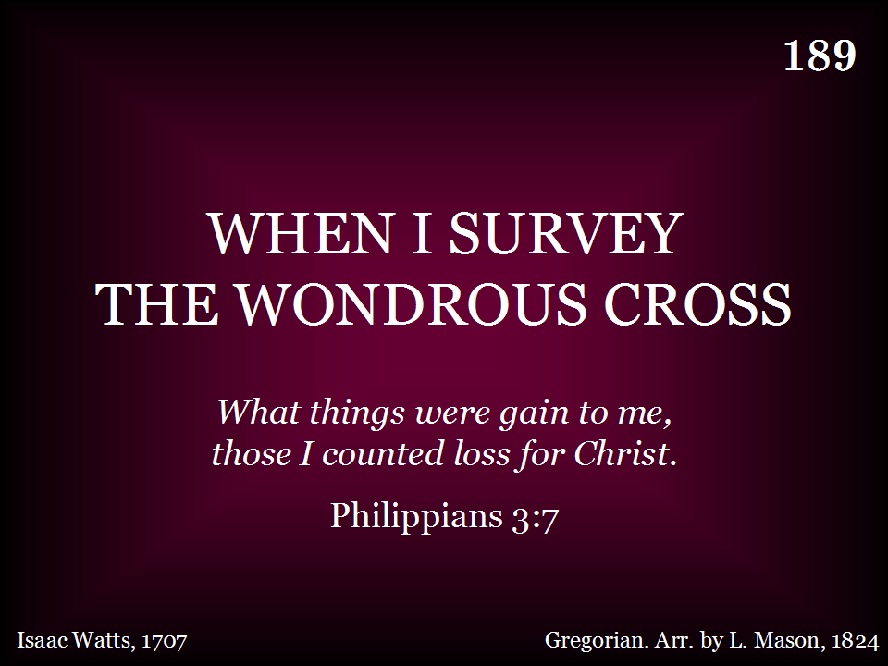
189 - When I Survey The Wondrous Cross - Title
Verses 1 & 3

Slide 23
Died & Buried
Luke 23:46, 50-52
Notes:
Died and Buried
Luke 23:46 46 Then Jesus, calling out with a loud voice, said, “Father, into your hands I commit my spirit!” And having said this he breathed his last.
Luke 23:50-52 – Joseph of Arimathea
174 Christ Arose – vs. 1 & 2, NO CHORUS

Slide 24
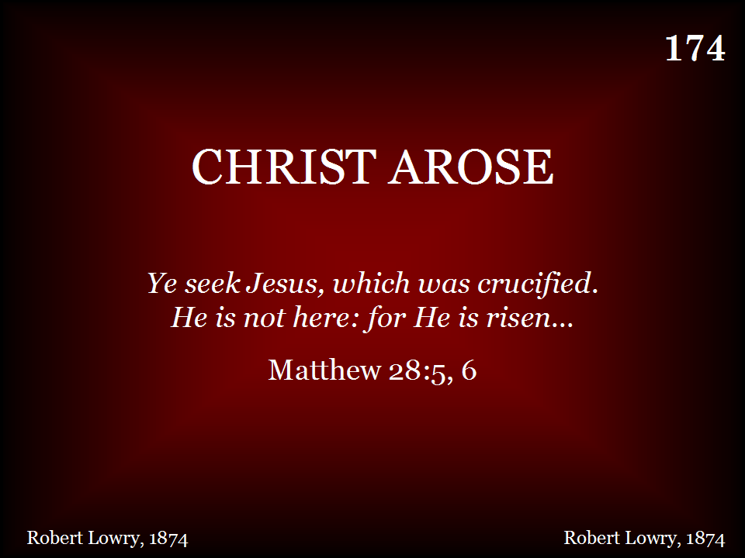
174 - Christ Arose - Title
Verses 1 & 2 ONLY

Slide 25
Arose
1 Cor. 15:1-3
Notes:
He Arose – 1 Cor. 15:1-3
Now I would remind you, brothers, of the gospel I preached to you, which you received, in which you stand,
2 and by which you are being saved, if you hold fast to the word I preached to you—unless you believed in vain.
3 For I delivered to you as of first importance what I also received: that Christ died for our sins in accordance with the Scriptures,
4 that he was buried, that he was raised on the third day in accordance with the Scriptures,
174 Christ Arose – vs. 3 + CHORUS

Slide 26
I Know whom
I have believed!
2 Tim. 1:12
Notes:
2 Tim. 1:12
… I am not ashamed, for I know whom I have believed, and I am convinced that he is able to guard until that Day what has been entrusted to me.
186 I stand Amazed

Slide 27
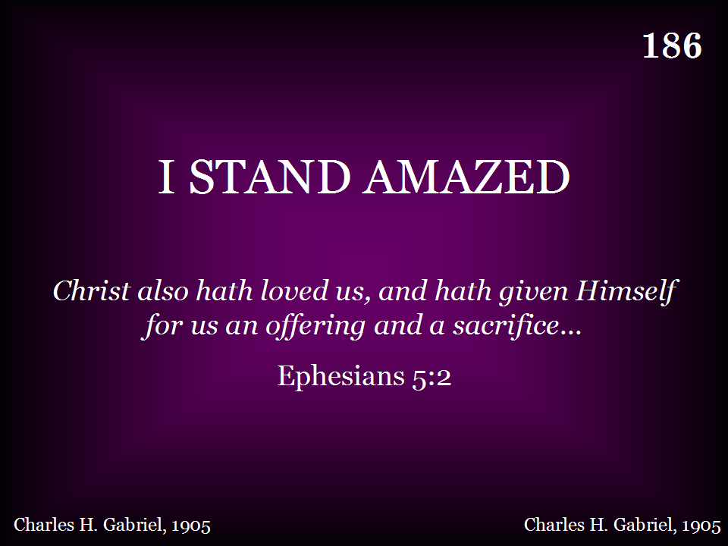
186 - I Stand Amazed - Title

Slide 28
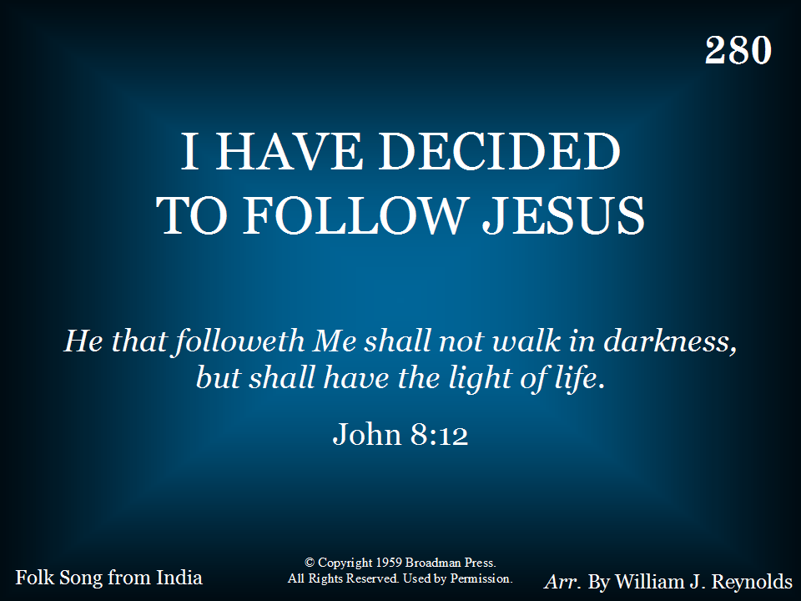
280 - I Have Decided To Follow Jesus - Title

