Slide 1
GOD
GOD

Slide 2
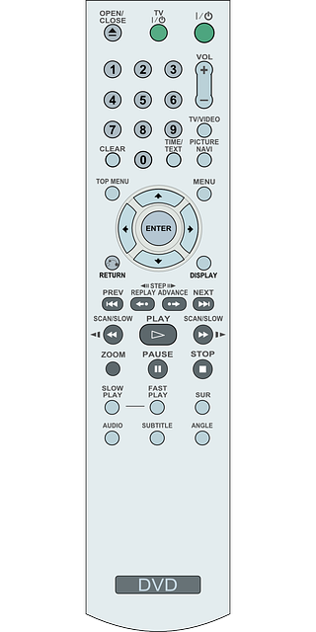
GOD
GOD
Notes:
01 Sound Words - 2 Timothy
The mute button - one of life's greatest treasures. I kind of wish that I had one that worked in real life,
except I am afraid that people would often use it on me.
Some words are 'all sound' and no substance.
Yet, as Paul keeps using it, it has a different meaning: healthy.

Slide 3
Sound Doctrine
GOD
GOD
1 Tim. 1:10; Titus 1:9; 2:1-2
Notes:
1 Timothy 1:10 (ESV) 10 the sexually immoral, men who practice homosexuality, enslavers, liars, perjurers, and whatever else is contrary to sound doctrine,
Titus 1:9 (ESV) 9 He must hold firm to the trustworthy word as taught, so that he may be able to give instruction in sound doctrine and also to rebuke those who contradict it.
Titus 2:1 (ESV) 1 But as for you, teach what accords with sound doctrine.
Titus 2:2 (ESV) 2 Older men are to be sober-minded, dignified, self-controlled, sound in faith, in love, and in steadfastness.
→ Sound WORDS

Slide 4
Sound words
GOD
GOD
1 Tim. 6:3; 2 Tim. 1:13
Notes:
1 Timothy 6:3 (ESV)
3 If anyone teaches a different doctrine and does not agree with the sound words of our Lord Jesus Christ and the teaching that accords with godliness,
2 Timothy 1:13 (ESV)
13 Follow the pattern of the sound words that you have heard from me, in the faith and love that are in Christ Jesus.
→ Sound TEACHING

Slide 5
Sound teaching
GOD
GOD
2 Tim. 4:3-4
Notes:
2 Timothy 4:3 (ESV)
3 For the time is coming when people will not endure sound teaching, but having itching ears they will accumulate for themselves teachers to suit their own passions,
4 and will turn away from listening to the truth and wander off into myths.
→ Sound in THE FAITH

Slide 6
Sound in THE faith
GOD
GOD
Titus 1:13, 2:2
Notes:
Titus 1:13 (ESV)
13 This testimony is true. Therefore rebuke them sharply, that they may be sound in the faith,
Titus 2:1 (ESV)
1 But as for you, teach what accords with sound doctrine.
2 Older men are to be sober-minded, dignified, self-controlled, sound in faith, in love, and in steadfastness.
→ unhealthy

Slide 7
Unhealthy: gangrene
GOD
GOD
2 Tim. 2:17
Notes:
UNHEALTHY – like gangrene
But avoid irreverent babble, for it will lead people into more and more ungodliness,
17 and their talk will spread like gangrene. Among them are Hymenaeus and Philetus,
→ Overthrow faith

Slide 8
Unhealthy: overthrow faith
GOD
GOD
2 Tim. 2:18
Notes:
2 Tim. 2:18 – unhealthy teaching overthrows faith…
Continues…
Among them are Hymenaeus and Philetus,
18 who have swerved from the truth, saying that the resurrection has already happened. They are upsetting the faith of some.
→ Makes shipwreck of faith – 1 Tim. 1:19
shipwrecks men's faith (1 Tim. 1:19). That kind of teaching is false teaching; it is teaching that which is not true. Unhealthy teaching causes people to believe a lie and build their life upon it. Thus we have the constant warnings concerning false teachers and false teaching. We are to be discerning students of what we hear. Prove all things and hold to that which is good (1 Thess. 5:21).

Slide 9
Unhealthy: shipwrecks faith
GOD
GOD
1 Tim. 1:19
Notes:
shipwrecks men's faith (1 Tim. 1:19).
18 This charge I entrust to you, Timothy, my child, in accordance with the prophecies previously made about you, that by them you may wage the good warfare,
19 holding faith and a good conscience. By rejecting this, some have made shipwreck of their faith,
→ Unhealthy then is FALSE teaching
That kind of teaching is false teaching; it is teaching that which is not true. Unhealthy teaching causes people to believe a lie and build their life upon it. Thus we have the constant warnings concerning false teachers and false teaching. We are to be discerning students of what we hear. Prove all things and hold to that which is good (1 Thess. 5:21).

Slide 10
Unhealthy False teaching
GOD
GOD
Notes:
Unhealthy is FALSE teaching
That kind of teaching is false teaching; it is teaching that which is not true. Unhealthy teaching causes people to believe a lie and build their life upon it. Thus we have the constant warnings concerning false teachers and false teaching. We are to be discerning students of what we hear. Prove all things and hold to that which is good (1 Thess. 5:21).
→ ALSO unhealthy – unbalanced ‘diet’ of teaching

Slide 11
Unhealthy: unbalanced
GOD
GOD
Notes:
Even healthy foods, if not balanced, become unhealthy.
→ “Limeys’.. Scurvey because no fresh vit. C….
So it is with our teaching. We have witnessed throughout history where certain subjects became the main diet of teaching to the neglect of other needful subjects.
This led to a spiritually unhealthy situation.
The deficiencies left people with an impaired spiritual immune system.
While what was taught was true, it wasn't complete and hence was unhealthy.

Slide 12
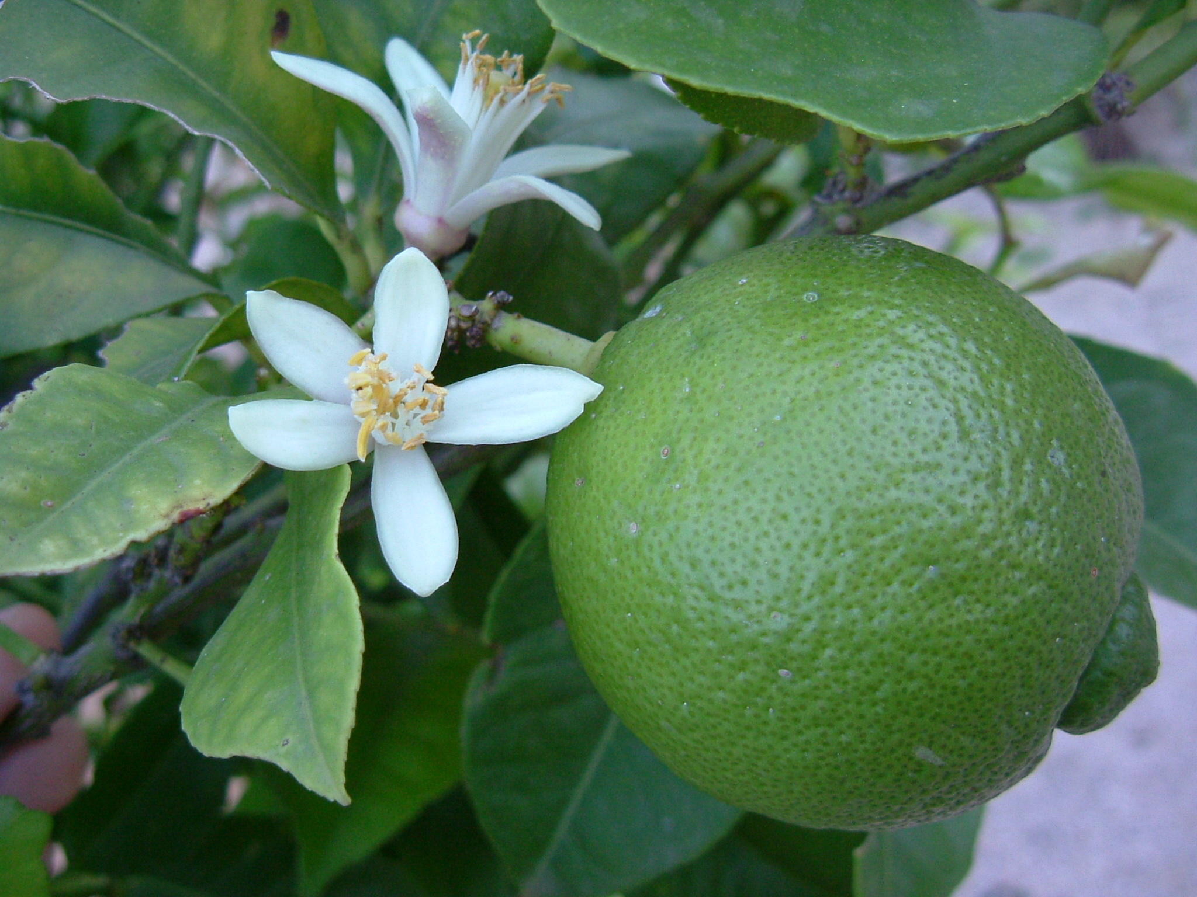
GOD
GOD
Limey
Notes:
The term is thought to have originated in the 1850s as "lime-juicer",[3] and was later shortened to "limey".[4]
It was originally used as a derogatory word for sailors in the Royal Navy, because of the Royal Navy's practice since the beginning of the 19th century of adding lemon juice or lime juice to the sailors' daily ration of watered-down rum (known as grog), in order to make stored, stagnant, water more palatable.
Doctors thought that lime juice would work better because it has more acid than lemon juice, so they substituted lime juice for lemon juice on the British Royal Navy ships.
This ration of grog helped make these sailors some of the healthiest at the time due to the ascorbic acid's ability to prevent scurvy.[2]
Balance includes all the various nutrients a body needs…
Great damage done without such little things as potassium …
SO WITH OUR TEACHING
So it is with our teaching. We have witnessed throughout history where certain subjects became the main diet of teaching to the neglect of other needful subjects.
This led to a spiritually unhealthy situation.
The deficiencies left people with an impaired spiritual immune system.
While what was taught was true, it wasn't complete and hence was unhealthy.
→ Acts 20: Paul and the elders

Slide 13
Acts 20:20
I did not shrink from declaring to you anything that was profitable, …
Notes:
Acts 20:20
I did not shrink from declaring to you anything that was profitable,
→ vs. 27

Slide 14
Acts 20:27
I did not shrink from declaring to you the whole counsel of God.
Notes:
Acts 20:27
I did not shrink from declaring to you the whole counsel of God.

Slide 15
Acts 20:32
And now I commend you to God and to the word of his grace, which is able to build you up and to give you the inheritance among all those who are sanctified.
Notes:
Acts 20:32
And now I commend you to God and to the word of his grace, which is able to build you up and to give you the inheritance among all those who are sanctified.
→ Healthy may be hard to swallow…

Slide 16
Healthy may be hard to swallow!
GOD
GOD
Notes:
Some healthy teaching is hard to swallow but necessary for our health.
People refuse that which is healthy and receive that which destroys them.
→ Proverbs and hating reproof 12:1

Slide 17
Whoever loves discipline loves knowledge, but he who hates reproof is stupid. Proverbs 12:1
GOD
GOD
Notes:
Whoever loves discipline loves knowledge, but he who hates reproof is stupid. Proverbs 12:1
→ 15:5

Slide 18
A fool despises his father’s instruction, but whoever heeds reproof is prudent. Proverbs 15:5
GOD
GOD
Notes:
A fool despises his father’s instruction, but whoever heeds reproof is prudent. Proverbs 15:5
→ 15:10

Slide 19
There is severe discipline for him who forsakes the way; whoever hates reproof will die. Proverbs 15:10
GOD
GOD
Notes:
There is severe discipline for him who forsakes the way; whoever hates reproof will die. Proverbs 15:10
→ 15:31

Slide 20
The ear that listens to life-giving reproof will dwell among the wise. Proverbs 15:31
GOD
GOD
Notes:
The ear that listens to life-giving reproof will dwell among the wise. Proverbs 15:31
→ 15:32

Slide 21
Whoever ignores instruction despises himself, but he who listens to reproof gains intelligence. Proverbs 15:32
GOD
GOD
Notes:
Whoever ignores instruction despises himself, but he who listens to reproof gains intelligence. Proverbs 15:32
→ Hebrews 12:5-6 DO not despise!

Slide 22
Heb. 12:5-6
My son, do not regard lightly the discipline of the Lord, nor be weary when reproved by him.
Notes:
My son, do not regard lightly the discipline of the Lord,
nor be weary when reproved by him.
→ vs. 6 For the Lord disciplines the one he loves,
and chastises every son whom he receives.”

Slide 23
Heb. 12:5-6
For the Lord disciplines the one he loves, and chastises every son whom he receives.”
Notes:
My son, do not regard lightly the discipline of the Lord,
nor be weary when reproved by him.
6 For the Lord disciplines the one he loves,
and chastises every son whom he receives.”
Medicine, surgery – needful…
→ Jeremiah – no balm in Gilead -- Jer. 8

Slide 24
No Balm in Gilead
GOD
GOD
Jeremiah 8:22, 5, 11
Notes:
Jeremiah cried Is there no balm in Gilead? Is there no physician there?
Why then has the health of the daughter of my people not been restored? (8:22).
Their unhealthy situation came about because " Everyone deceives his neighbor, and no one speaks the truth;
they have taught their tongue to speak lies (8:5).
There was no health because "they have healed the wound of my people lightly, saying, ‘Peace, peace,’ when there is no peace" (8:11).
Cure for Itchy ears… 2 Tim. 4:1-2

Slide 25
Cure for ‘itchy’ ears…
GOD
GOD
2 Tim. 4:3-4 = vs. 1-2
Notes:
3 For the time is coming when people will not endure sound teaching, but having itching ears they will accumulate for themselves teachers to suit their own passions,
4 and will turn away from listening to the truth and wander off into myths.
→ vs. 1-2
4:1 I charge you in the presence of God and of Christ Jesus, who is to judge the living and the dead, and by his appearing and his kingdom:
2 preach the word; be ready in season and out of season; reprove, rebuke, and exhort, with complete patience and teaching.

Slide 26
Reprove Rebuke Exhort
GOD
GOD
2 Tim. 4:2
Notes:
2 Tim. 4:2 – the cure for itchy ears
4:1 I charge you in the presence of God and of Christ Jesus, who is to judge the living and the dead, and by his appearing and his kingdom:
preach the word; be ready in season and out of season; reprove, rebuke, and exhort, with complete patience and teaching.
Reprove..
Rebuke…
Exhort …
Longsuffering and patience! DO IT AGAIN.. And again…
Those who teach are under obligation to provide a healthy balance in their teaching.
Those who are taught are under obligation to receive such. How is your spiritual health?

Slide 27
GOD
GOD

Slide 28
GOD
GOD

