Slide 1
Reading 1 John
GOD
GOD
Notes:
Our reading this week includes the letter of 1 John
John – the apostle
CA 90ad –
Problem – false teachers misleading the people.

Slide 2
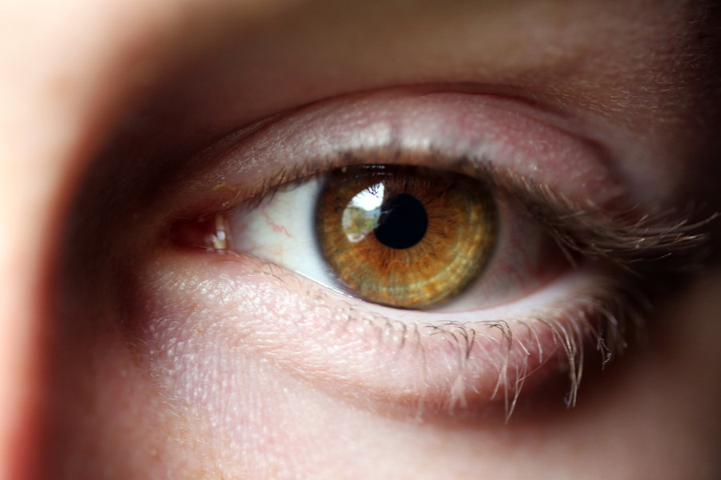
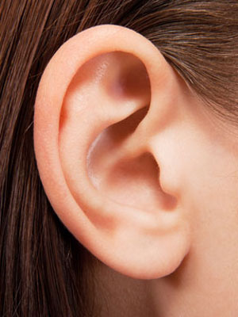
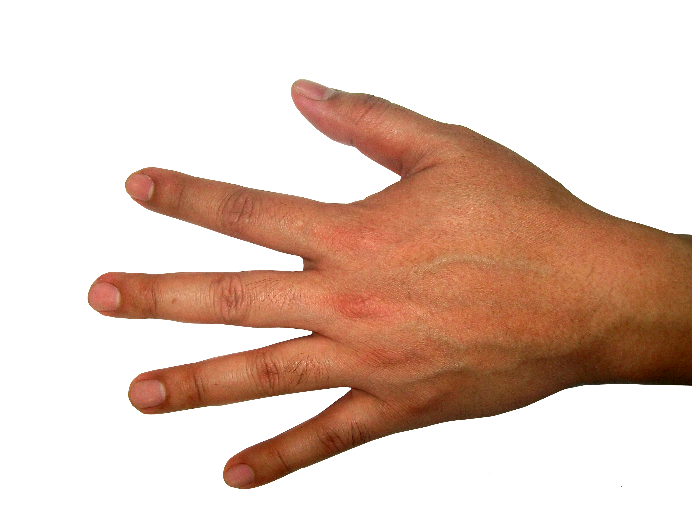
GOD
Notes:
1 John 1:1-4
What we have SEEN, HEARD, TOUCHED
‘looked upon – observe with continuity..
→ Important / reoccurring thoughts

Slide 3
Write (13x)
KNOW (37x)
Abide (
GOD
GOD
Notes:
Write – 13 times…
2:26 I write these things to you about those who are trying to deceive you.
KNOW – 37 times
Abide (23 times) –
Let what you heard from the beginning abide in you. If what you heard from the beginning abides in you, then you too will abide in the Son and in the Father.

Slide 4
Sin
GOD
GOD
27 times
Notes:
The problem then as well as now (and always) –
SIN and our relationship with God.
27 times in this book – in many different aspects..
→ False teachers…

Slide 5
False Teachers
GOD
They Do not sin
Doesn’t matter
GOD
Notes:
False Teachers …
They do NOT Sin…
It doesn’t matter (if they do)…
→ Defined - lawlessness

Slide 6
Sin is lawlessness
GOD
GOD
1 John 3:4
Notes:
1John 3:4 Everyone who makes a practice of sinning also practices lawlessness; sin is lawlessness.
KJ Whosoever committeth sin transgresseth also the law: for sin is the transgression of the law.
→ Unrighteousness 5:17

Slide 7
Sin is wrongdoing (unrighteousness)
GOD
GOD
1 John 5:17
Notes:
1 John 5:17 All wrongdoing is sin, but there is sin that does not lead to death.
NASB All unrighteousness is sin, and there is a sin not leading to death.
→ NO Sin with God 1:5

Slide 8
NO Sin with God
GOD
GOD
1 John 1:5
Notes:
1 John 1:5 This is the message we have heard from him and proclaim to you, that God is light, and in him is no darkness at all.
→ NO sin with Jesus - 3:5

Slide 9
No Sin with Jesus
GOD
GOD
1 John 3:5
Notes:
1 John 3:5 You know that he appeared in order to take away sins, and in him there is no sin.
→ Came to take away sins.. 3:5 again…

Slide 10
Came to take away sin
GOD
GOD
1 John 3:5
Notes:
1 John 3:5 You know that he appeared in order to take away sins, and in him there is no sin.
→ Propitiation ( turns away wrath)

Slide 11
Propitiation (turn away wrath)
GOD
GOD
1 John 2:1-2; 4:10
Notes:
1 John 2:1-2
He is the propitiation for our sins, and not for ours only but also for the sins of the whole world.
4:10
In this is love, not that we have loved God but that he loved us and sent his Son to be the propitiation for our sins.
→ Christians are FORGIVEN 2:1, 12

Slide 12
Christians are Forgiven
GOD
GOD
1 John 2:12
Notes:
Christians ARE Forgiven…
1 John 2:12
I am writing to you, little children,
because your sins are forgiven for his name’s sake.
→ Instructed NOT to sin…
1 John 2:1My little children, I am writing these things to you so that you may not sin. But if anyone does sin, we have an advocate with the Father, Jesus Christ the righteous.

Slide 13
Instructed to NOT Sin
GOD
GOD
1 John 2:1
Notes:
1 John 2:1 My little children, I am writing these things to you so that you may not sin. But if anyone does sin, we have an advocate with the Father, Jesus Christ the righteous.
This the GOAL – aspiration – intention –
As we strive, we fall short, but with forgiveness possible –
→ NOT live a ‘life of sin’ - 3:4,6,8,9

Slide 14
Christians do not live a life of Sin
GOD
Pracitice
GOD
Keeps on..
1 John 3:4, 6, 8, 9; 5:18
Notes:
Christians do not live a life of sin…
3:4, 6, 8, 9; 5:18
4 Everyone who makes a practice of sinning also practices lawlessness; sin is lawlessness.
6 No one who abides in him keeps on sinning; no one who keeps on sinning has either seen him or known him.
8 Whoever makes a practice of sinning is of the devil, for the devil has been sinning from the beginning. The reason the Son of God appeared was to destroy the works of the devil.
No one born of God makes a practice of sinning, for God’s seed abides in him, and he cannot keep on sinning because he has been born of God.
5:18 We know that everyone who has been born of God does not keep on sinning, but he who was born of God protects him, and the evil one does not touch him.
→ Christians do SIN…

Slide 15
Christians do commit sin
GOD
GOD
1 John 2:1-2; 1:7-10; 5:16-17
Notes:
Christians do commit sin –
1John 2:1-2
1:7-10
5:16-17
→

Slide 16
Blood of Jesus still brings forgiveness
GOD
GOD
1 John 1:8-9

Slide 17
GOD
GOD

Slide 18
GOD
GOD

Slide 19
GOD
GOD

Slide 20
GOD
GOD

