Slide 1
GOD
GOD

Slide 2
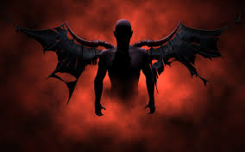
1 Peter 5:8-9
GOD
GOD
Our adversary / Satan
Notes:
1Peter 5:8-9
8 Be sober-minded; be watchful. Your adversary the devil prowls around like a roaring lion, seeking someone to devour.
9 Resist him, firm in your faith, knowing that the same kinds of suffering are being experienced by your brotherhood throughout the world.
Transliteration of Hebrew – ‘adversary / accuser’ –
NOT always of Satan – used of MEN –
BUT used of Satan – 13 times in Job 1 & 2 !...
→

Slide 3
Not REAL ?
Paul – Eph. 4:27; 6:11; etc.
James – 4:7
John – 1Jn. 3:8
Jude – 1:9
Jesus – Mtt. 25:41
Notes:
Not REAL? Movie this week – Bible believers portrayed as ‘superstitious and naïve’ –
Satan – a story, a personification of bad things – but NOT A REAL BEING.
Paul spoke of him as a being –
Give no opportunity to the devil – Eph. 4:27
Put on the whole armor of God, that you may be bale to stand against the schemes.. Eph. 6:11
James spoke of him –
Resist the devil, and he will flee from you – James 4:7
John spoke of him –
“the one who practices sin is of the devil; for the devil has sinned from the beginning. The Son of God appeared for this purpose, to destroy the works of the devil.”Now Peter speaks of him as a being - 1 John 3:8 NAS95
Jude spoke of him –
“But Michael the archangel, when he disputed with the devil and argued about the body of Moses, did not dare pronounce against him a railing judgment, but said, “The Lord rebuke you!”” Jude 1:9 NAS95
Jesus spoke of him as a being –
Hell prepared for him and his angels – Mtt. 25:41;
→ Devil / accuser / slanderer

Slide 4
Devil – Accuser / slanderer
GOD
GOD
Satan – 33 times
Notes:
‘The NT also calls him 'diabolos', which means one who accuses or slanders another.
This is usually translated 'the devil' and is found 30 times this way.
Accused JOB – slandered him before God !
SO thankful that Jesus is our friend, our savior, our mediator, our high-priest –
Jesus our ‘comforter’ (used of one called alongside as a lawyer… helper)...
In the NT, we find the corresponding Greek word, satanas, used 33 times and always refers to the devil.
→ The evil one

Slide 5
Evil one
GOD
GOD
Eph. 6:16
Notes:
The Evil one
Eph. 6:16 – stand against the evil one.. .
2 Thess. 3:3,
1John 2:13-14; 3:12; 5:18-19..
→ HOW we picture him…

Slide 6
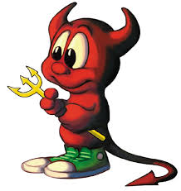
Enemy, evil-one ruler of this world OR
GOD
GOD
Notes:
Our Enemy, the evil-one, the rule of this world..
OF
Picture of ‘cute’ devil ☹
→ A Roaring Lion

Slide 7
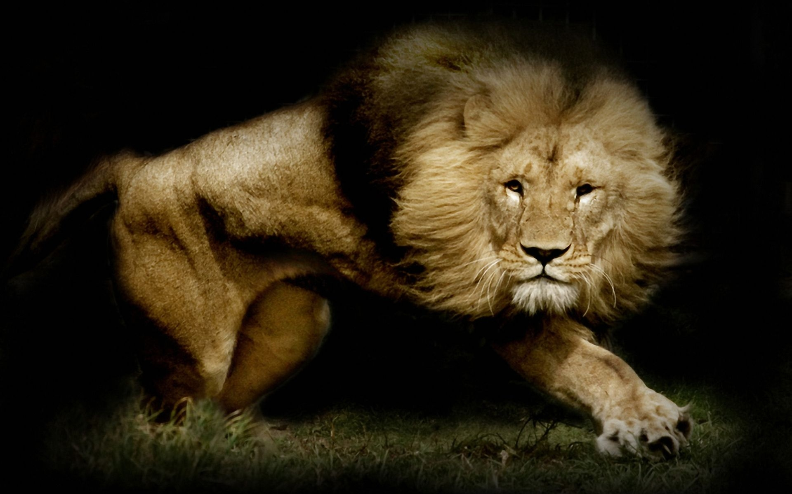
GOD
GOD
Notes:
Your adversary, the devil, prowls around like a roaring lion, seeking someone to devour.
→ Replace by thinking of him as a cute kitten… ?

Slide 8
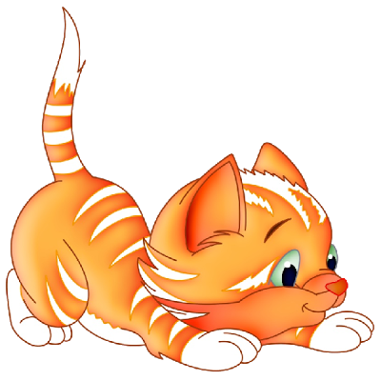
GOD
GOD
Notes:
Your adversary, the devil, prowls around like a roaring lion, seeking someone to devour.
Cute, adorable, controllable.. But NO…

Slide 9
GOD
GOD
Notes:
Your adversary, the devil, prowls around like a roaring lion, seeking someone to devour.
--. Peter’s warning! Be alert

Slide 10
GOD
Be alert
GOD
Notes:
Your adversary, the devil, prowls around like a roaring lion, seeking someone to devour.
“Be of sober spirit, be on the alert. Your adversary, the devil, prowls around like a roaring lion,
seeking someone to devour.
But resist him, firm in your faith,
knowing that the same experiences of suffering are being accomplished by your brethren who are in the world.”
→ sober-minded

Slide 11
GOD
Be alert
GOD
Sober-minded
Notes:
Your adversary, the devil, prowls around like a roaring lion, seeking someone to devour.
Sober-minded –
→ Resist

Slide 12
GOD
Resist
GOD
Notes:
Your adversary, the devil, prowls around like a roaring lion, seeking someone to devour.
But resist him, firm in your faith,
You CAN, but you must WANT TO – and there is the danger. ….
Both Peter and James encourage us to RESIST...
Peter explains – FIRM IN YOUR FAITH.... Trust of God and His word..
→ Whole Armor of God

Slide 13
GOD
Whole armor of God
GOD
Eph. 6:10-18
Notes:
Eph. 6:10-18
Be Strong –
Put on the whole armor of God
Able to stand against the schemes of the devil

Slide 14
GOD
Word of God
Abide in you
GOD
1John 2:14
Notes:
1John 2:14
“I have written to you, fathers, because you know Him who has been from the beginning.
I have written to you, young men, because you are strong,
and the word of God abides in you, and you have overcome the evil one.”
→ Not ignorant of his devises / schemes

Slide 15
GOD
Not ignorant of
His devices..
GOD
2 Cor. 2:11
Notes:
Eph. 6:11
Put on the whole armor of God, that you may be able to stand against the schemes of the devil.
2Cor. 2:11
so that we would not be outwitted by Satan; for we are not ignorant of his designs.
→ ‘devices’ - deception!

Slide 16
GOD
Deception
GOD
John 8; 2 Cor. 11:3
Notes:
Deception
John 8:44 – a liar from the beginning…
2 Cor. 11:3 But I am afraid that as the serpent deceived Eve by his cunning, your thoughts will be led astray from a sincere and pure devotion to Christ.
Evil = good, dangerous = fun, etc… pervert and change ...
→ Temptation to evil

Slide 17
GOD
Temptation
GOD
James 1:13-16
Notes:
Temptation - not forced!
James 1:13-16
“Let no one say when he is tempted, “I am being tempted by God”; for God cannot be tempted by evil, and He Himself does not tempt anyone. But each one is tempted when he is carried away and enticed by his own lust. Then when lust has conceived, it gives birth to sin; and when sin is accomplished, it brings forth death. Do not be deceived, my beloved brethren.”
NOT comes as an enemy – but as everything that we desire …
Not become , but as Reagan said: trust AND verify!
→ Evil in the world

Slide 18
GOD
Evil
GOD
Romans 1:24, 26, 28
Notes:
EVIL in this world is NOT from God..
Every good and perfect gift from God – James 3:
And God saw ‘it was good’… Gen. 1 – 3.
As men turn FROM God – God ‘gives them up’..
Romans 1:24, 26, 28
→ persecution

Slide 19
GOD
Persecution
GOD
1 Peter 1:5-7
Notes:
Persecution – 1 Peter 1:5-7
“who are protected by the power of God through faith for a salvation ready to be revealed in the last time. In this you greatly rejoice, even though now for a little while, if necessary, you have been distressed by various trials, so that the proof of your faith, being more precious than gold which is perishable, even though tested by fire, may be found to result in praise and glory and honor at the revelation of Jesus Christ;”

Slide 20
God cares for you!
GOD
GOD
1 Peter 5:6-7
Notes:
Peter introduces this thought about Satan –
With assurance from God…
Therefore humble yourselves under the mighty hand of God,
that He may exalt you at the proper time,
casting all your anxiety on Him, because He cares for you.”

Slide 21
GOD
GOD

Slide 22
GOD
GOD

