Slide 1
GOD
GOD

Slide 2
Authority in Religion
GOD
GOD
Notes:
WHY do we do what we DO?
→ Scriptures

Slide 3
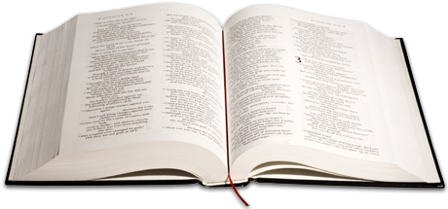
Scripture / Bible 2 Tim. 3:16-17
GOD
Teaching
Reproof
GOD
Correction
Instruction
Notes:
16 All Scripture is inspired by God and profitable for teaching, for reproof, for correction, for training in righteousness;
17 so that the man of God may be adequate, equipped for every good work.
We then must find our teaching and instruction from the scriptures.
An age old teaching that began in the Old Covenant time… with
→ Deut. 4:1-2

Slide 4
Deut. 4:1-2
GOD
Not ADD or Subtract
GOD
Notes:
Deuteronomy 4:1–2 ““Now, O Israel, listen to the statutes and the judgments which I am teaching you to perform, so that you may live and go in and take possession of the land which the Lord, the God of your fathers, is giving you. “You shall not add to the word which I am commanding you, nor take away from it, that you may keep the commandments of the Lord your God which I command you.”
→ Deut. 12:32

Slide 5
Deut. 12:32
GOD
Not ADD or Subtract
GOD
Notes:
Deuteronomy 12:32 ““Whatever I command you, you shall be careful to do; you shall not add to nor take away from it.”
→ Prov. 30:5-6

Slide 6
Prov. 30:5-6
GOD
Not ADD or Subtract
GOD
Notes:
Proverbs 30:5–6 “Every word of God is tested; He is a shield to those who take refuge in Him. Do not add to His words Or He will reprove you, and you will be proved a liar.”
→ Isa. 55:8-9 WE not have the mind of God

Slide 7
Isa. 55:8-9
GOD
WE not have or
KNOW the mind
Of God.
GOD
Notes:
Isaiah 55:8–9 ““For My thoughts are not your thoughts, Nor are your ways My ways,” declares the Lord. “For as the heavens are higher than the earth, So are My ways higher than your ways And My thoughts than your thoughts.”
→ Prov. 14:12…

Slide 8
Prov. 14:12
GOD
WE not have or
KNOW the mind
Of God.
GOD
Notes:
Proverbs 14:12 “There is a way which seems right to a man, But its end is the way of death.”
→ Jer. 10:23

Slide 9
Jeremiah 10:23
GOD
WE not have or
KNOW the mind
Of God.
GOD
Notes:
Jeremiah 10:23 “I know, O Lord, that a man’s way is not in himself, Nor is it in a man who walks to direct his steps.”
→ 1 Cor. 10: LESSONS for US

Slide 10
Lessons from Israel
GOD
GOD
1 Cor. 10:1-6, 11-12
Notes:
Lessons from Israel
1Cor. 10:1-6 -
6 Now these things took place as examples for us, that we might not desire evil as they did.
Vs. 11-12 Now these things happened to them as an example, but they were written down for our instruction, on whom the end of the ages has come. 12 Therefore let anyone who thinks that he stands take heed lest he fall.
→ Nadab & Abihu

Slide 11
Nadab and Abihu
GOD
GOD
Leviticus 10:1-3
Notes:
Nadab and Abihu – Lev. 10:1-3
Sons of Aaron – priests to God –
Offerings under their control and priesthood service..
→ Offering of incense part of their duties

Slide 12
Notes:
Correct priests - Ex. 28:1ff
“Then bring near to you Aaron your brother, and his sons with him, from among the people of Israel, to serve me as priests—Aaron and Aaron’s sons, Nadab and Abihu, Eleazar and Ithamar.
WERE to offer incense.. Lev. 10:1-3
→ FROM the altar of burnt offerings

Slide 13
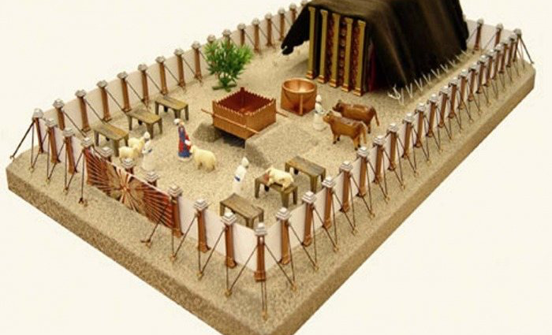
GOD
GOD
Numbers 16:46; Lev. 16:12
Notes:
Fire from the altar of burnt offerings…
Lev. 16:11-13 11 “Aaron shall present the bull as a sin offering for himself, and shall make atonement for himself and for his house. He shall kill the bull as a sin offering for himself.
12 And he shall take a censer full of coals of fire from the altar before the Lord, and two handfuls of sweet incense beaten small, and he shall bring it inside the veil
13 and put the incense on the fire before the Lord, that the cloud of the incense may cover the mercy seat that is over the testimony, so that he does not die.
→ NOW Lev. 10...

Slide 14
Strange fire “unauthorized”
GOD
which he had
not
commanded them.
GOD
Leviticus 10:1-3
Notes:
Nadab and Abihu – Lev. 10:1-3
Wrong day – ?
Wrong time –?
Wrong 'fire' – the most contextual – ESV / NIV – 'unauthorized fire'
Incense that was not made according to the prescription (Ex. 30:34-36).
Fire NOT taken from the altar of Burnt-offering (commanded! Num. 16:46; Lev. 16:12).
Wrong because it was NOT what God commanded. . whether wrong fire, wrong incense, wrong ANYTHING…
→ Korah – again about the priesthood….

Slide 15
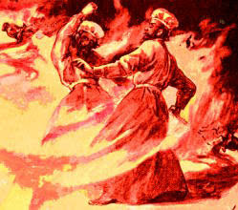
By those who come near Me
I will be treated as holy,
And before all the people
I will be honored.
Notes:
And fire came out from the presence of the Lord and consumed them, and they died before the Lord.
3 Then Moses said to Aaron, “It is what the Lord spoke, saying,
‘By those who come near Me I ^{bwill be treated as holy,}
And before all the people I will be honored.’ ”
So Aaron, therefore, kept silent.

Slide 16
Korah’s Rebellion
GOD
GOD
Numbers 16
Notes:
Korah's Rebellion – Num. 16
WHO gets to be priests? WHO choses? WHO says so?
→ Genealogy of Aaron and Korah!

Slide 17
Genealogy
Levi
Kohath
Amram
Izhar
Aaron
Korah
Notes:
Genealogy – Exodus 6: 16, 18, 20 -- 21
Levi – Kohath – Amram – Aaron Exod. 6:16, 18, 20
Levi – Kohath – Izhar – Korah… Exod. 6:21.
→ GOD chose Aaron and sons – Exod. 28:1

Slide 18
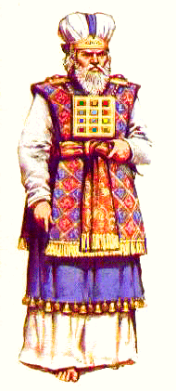
Aaron and sons Exod. 28:1
GOD
GOD
Notes:
Ex. 28:1 “Then bring near to yourself Aaron your brother, and his sons with him, from among the sons of Israel, to minister as priest to Me—Aaron, Nadab and Abihu, Eleazar and Ithamar, Aaron’s sons.
Ex. 28:1 – Aaron and sons…
Korah – although out of tribe of Levi, same as Aaron and Moses, NOT a descendant of Aaron!...
Now Korah the son of Izhar, the son of Kohath, the son of Levi, with Dathan and Abiram, the sons of Eliab, and On the son of Peleth, sons of Reuben, took action,
Demands that HE and HIS have as much ‘right’ to be priests… N. 16:3
They assembled themselves together against Moses and against Aaron and said to them, “You have gone too far! For all in the congregation are holy, every one of them, and the Lord is among them. Why then do you exalt yourselves above the assembly of the Lord?”
→ God’s response is swift and awesome

Slide 19
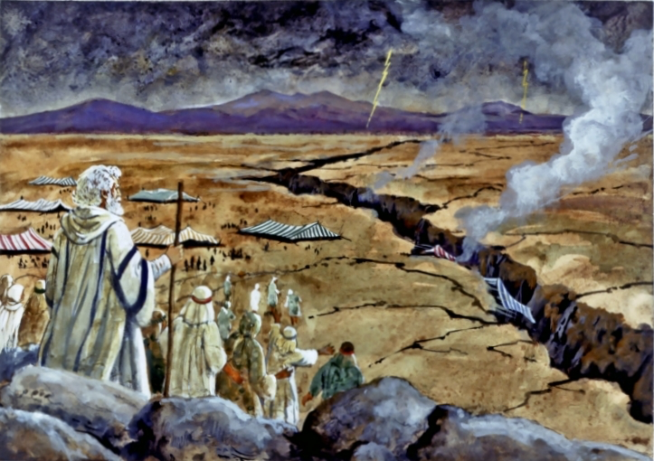
Notes:
Their rebellion against GOD – demanding to be priests EVEN THOUGH God had chosen…
Num. 16: Moses warns:
Despised what God HAD done for them – 9-11
Assembled together - 19
The LORD has chosen – 28 –
They DESPISED the LORD – 30
Earth opened up – ‘swallowed’ whole households – 31-33…
→ Moses and the Rock

Slide 20
Moses and the Rock
GOD
GOD
Notes:
Moses and the ROCK – Two episodes…
In BOTH, Israel in need of WATER in the desert --
1st – Exod. 17
2nd – Num. 10:1-13
→ The FIRST time – Ex. 17

Slide 21
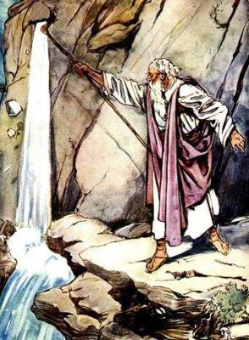
Strike the rock Exod. 17
GOD
GOD
Notes:
Exod. 17:1-7
Vs. 6 Behold, I will stand before you there on the rock at Horeb, and you shall strike the rock, and water shall come out of it, and the people will drink.” And Moses did so, in the sight of the elders of Israel.
And MOSES DID SO….vs. 6
→ NOW in Num. 20:1-13

Slide 22
Speak to the rock Num. 20
Struck
the rock
GOD
GOD
Notes:
NOW in Num. 20:8-13
Take the rod; and you and your brother Aaron assemble the congregation and speak to the rock before their eyes, that it may yield its water. You shall thus bring forth water for them out of the rock and let the congregation and their beasts drink.”
Vs. 9 So Moses took the rod from before the Lord, just as He had commanded him;
and Moses and Aaron gathered the assembly before the rock. And he said to them, “Listen now, you rebels; shall we bring forth water for you out of this rock?”
11 Then Moses lifted up his hand and struck the rock twice with his rod; and water came forth abundantly, and the congregation and their beasts drank.
But the Lord said to Moses and Aaron, “Because you have not believed Me, to treat Me as holy in the sight of the sons of Israel, therefore you shall not bring this assembly into the land which I have given them.”
The ark of the Covenant

Slide 23
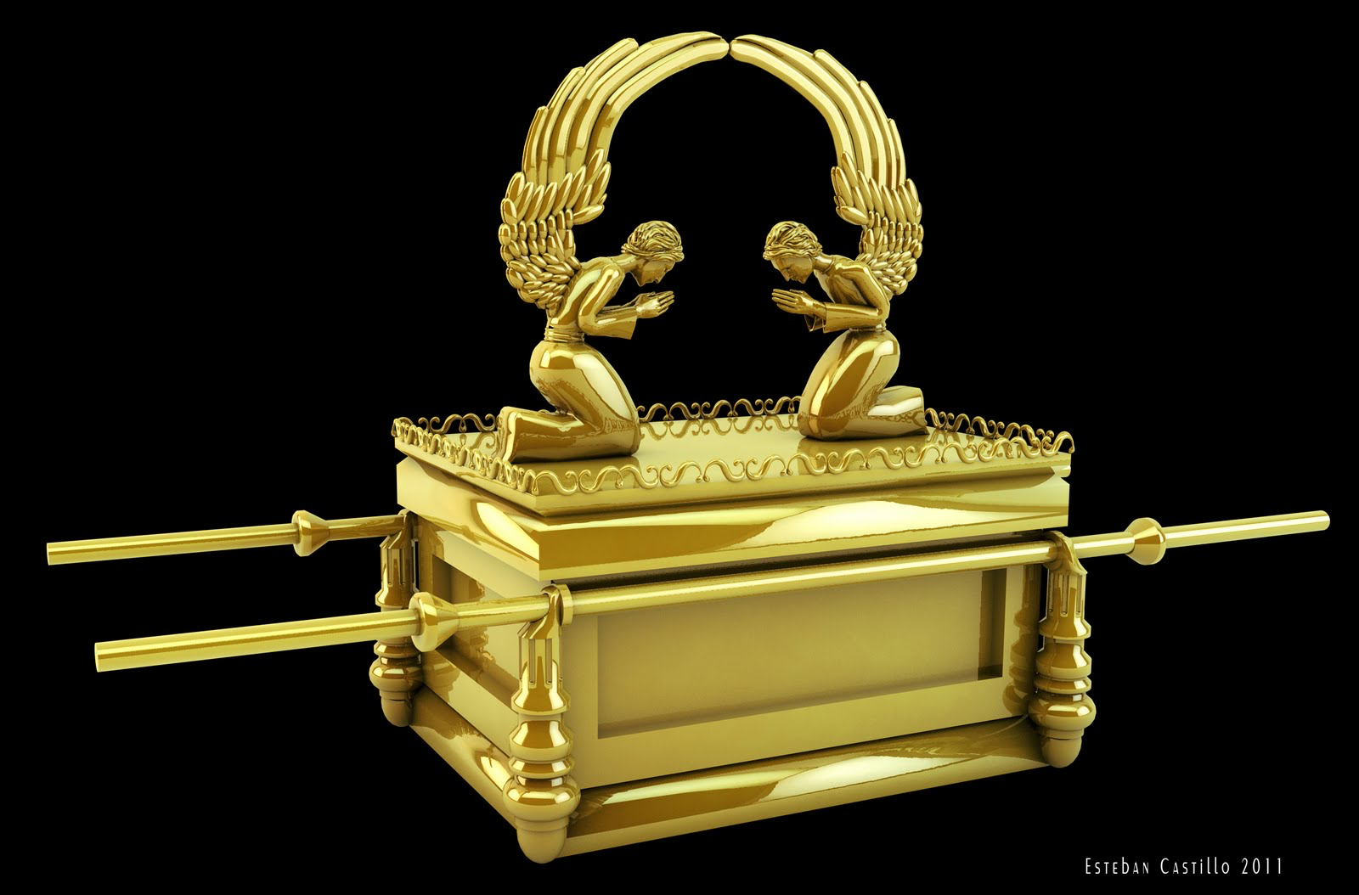
GOD
GOD
Notes:
Moving the Ark of the Covenant
Exod. 25:12-14 You shall cast four rings of gold for it and put them on its four feet, two rings on the one side of it, and two rings on the other side of it.
13 You shall make poles of acacia wood and overlay them with gold.
14 And you shall put the poles into the rings on the sides of the ark to carry the ark by them.
Only furniture in the Holy of Holies – blood of sacrifices offered here.
In This they placed tablets of the 10 commandments (Hebrews adds – the golden urn holding the manna, and Aaron’s staff that budded – 9:4)..
It was NOT to be touched…
Hence the POLES were provided, and it was CARRIED ....
→ David and the ARK

Slide 24
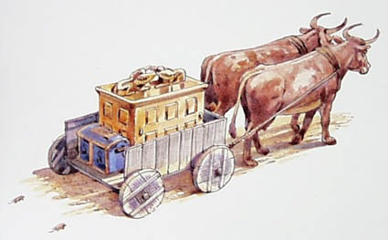
Uzzah – 2 Sam. 6:6-7
GOD
GOD
Notes:
Philistines captured the ark –
took it, then returned it in 1 Sam. 6 / cp. Ps. 132
Lord struck men of Beth-shemesh for ‘looking upon the ark’ –
Moved to Kiriath-jearim, - the house of Abinadab (6:20- 7:2) for 20 years…
David defeated the Philistines –
David captured Jerusalem –
2Samuel 6:6-7
David moves ark to Jerusalem
But... ON A CART... … that WAS how the Philistines returned it! – 1S 6:11...
Sons of Abinadab driving – Uzzah & Ahio... Vs. 3
Uzzah reached out and TOUCHED – and was struck DEAD immediately … 2Sam. 6:6-7
→ David’s understanding... 1Chron. 15:12-15

Slide 25
“because we did not seek him according to the rule.”
GOD
GOD
1 Chron. 15:12-15
Notes:
said to them, “You are the heads of the fathers’ houses of the Levites. Consecrate yourselves, you and your brothers, so that you may bring up the ark of the Lord, the God of Israel, to the place that I have prepared for it.
13 Because you did not carry it the first time, the Lord our God broke out against us, because we did not seek him according to the rule.”
14 So the priests and the Levites consecrated themselves to bring up the ark of the Lord, the God of Israel.
Application – our morning Bible Study…

Slide 26
9am Bible Study
Authority
Notes:
‘Advertisement’ –
Our study on Authority –
How we learn, know, show, and follow the teaching of the Scripture…
Matt. 28:18-20...

