Slide 1
GOD
GOD

Slide 2
GOD
GOD
John 10:22
Notes:
John 10:22
“At that time the Feast of the Dedication took place at Jerusalem;”
The story of the feast goes clear back to Alexander the Great
→ Alexander

Slide 3
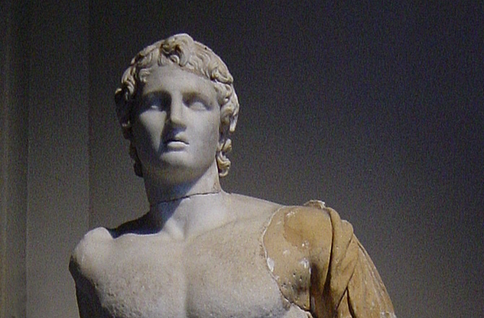
Alexander the Great
356 – 232 B.C.
GOD
GOD
Alexander the Great
Notes:
After Alexander the Great
introduced the whole Greek culture into the Jewish world (300s B.C.),
many Jews took up both the Greek customs and the Greek language
(hence the translation of the Hebrew text into the Septuagint).
The temple defiled
Born: July 356 BC, Pella, Greece / Died: June 323 BC, Babylon, Iraq

Slide 4
Temple defiled
GOD
GOD
Notes:
The extended period of such influence,
mixed with corrupt leaders among the Jewish people,
resulted in the defilement of the temple,
at one point even having pagan idols placed in it.
→ The Maccabees

Slide 5
Temple dedicated
GOD
GOD
165 B.C.
Notes:
With the uprising of the Maccabees,
they retook control of the temple, cleansed it, and rededicated it (165 B.C.).
This dedication became a yearly holiday called Hanukkah.
→ Feast of Dedication
This is Hebrew word for 'dedication' and thus the feast became known as 'the feast of dedication'.
It became part of the tradition to read and speak of WHY the temple needed this dedication:
the bad shepherds that led the people astray.
→ Shepherds and Sheep in Israel

Slide 6
Hanukkah = Feast of Dedication
GOD
GOD
Notes:
Feast of Dedication
This is Hebrew word for 'dedication' and thus the feast became known as 'the feast of dedication'.
It became part of the tradition to read and speak of WHY the temple needed this dedication:
the bad shepherds that led the people astray.
→ Shepherds and Sheep in Israel

Slide 7
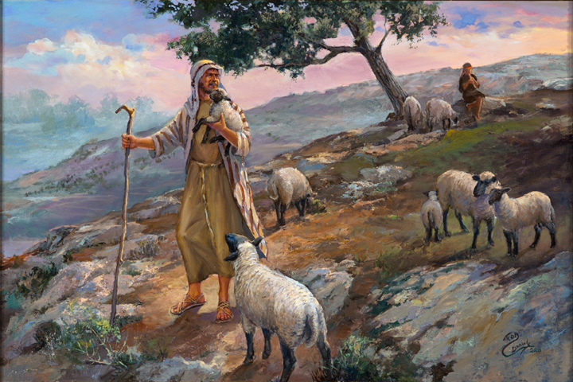
GOD
GOD
Shepherds and Sheep
Notes:
Sheep – part of the lives of the people clear back to early Genesis..
It was an integral part of their whole culture and history
→ GOD as Shepherd

Slide 8
God, the LORD is my Shepherd
GOD
GOD
Psalm 23
Notes:
God was often pictured this way:
Ps. 23; - read also…
(Gen. 49:24;
Psalm 78:52–53; 80:1, Isa. 40:10-11).
→ Leaders – Moses & David

Slide 9
Moses and David
GOD
GOD
Notes:
Both Moses and David were shepherds…
→ OTHER leaders then called shepherds

Slide 10
Israel’s leaders called shepherds
GOD
GOD
Notes:
other leaders were described with this figure
(Isa. 56:9–12; Jer. 23:1–4; 25:32–38; Ezek. 34; Zech. 11).
AS in Ezek. 34 – often were NOT good! Were ‘evil shepherds’…
→ Hannukah – a time to discuss such shepherds!

Slide 11
Hanukkah: a time to discuss Israel’s Shepherds!
GOD
GOD
Notes:
It became part of the tradition to read and speak of WHY the temple needed this dedication:
the bad shepherds that led the people astray.
Jesus at the feast of Dedication – chose to speak about Shepherds and sheep !
→ I am the good Shepherd

Slide 12
I am the good Shepherd
GOD
GOD
John 10:11, 14
Notes:
He is the good shepherd. 11, 14
2. He knows His sheep (14).
3. He calls the sheep by name (3)
4. He leads the sheep (3)
5. He goes before them (4).
6. He gives His sheep eternal life (28).
7. He protects to the uttermost those who are His sheep (28-29).
8. He will lay down His life for His sheep (11, 15, 17, 18).
9. He lays it down of his own accord (18).
10. He will 'take it up again', i.e., He will rise from the dead to continue being their shepherd (18).

Slide 13
I know my sheep (4)
GOD
GOD
Notes:
1. He is the good shepherd.
2. He knows His sheep (14).
3. He calls the sheep by name (3)
4. He leads the sheep (3)
5. He goes before them (4).
6. He gives His sheep eternal life (28).
7. He protects to the uttermost those who are His sheep (28-29).
8. He will lay down His life for His sheep (11, 15, 17, 18).
9. He lays it down of his own accord (18).
10. He will 'take it up again', i.e., He will rise from the dead to continue being their shepherd (18).

Slide 14
I call my sheep by name (3)
GOD
GOD
Notes:
3. He calls the sheep by name (3)
4. He leads the sheep (3)

Slide 15
I lead my sheep (3)
GOD
GOD
Notes:
4. He leads the sheep (3)
5. He goes before them (4).

Slide 16
I go before them (4)
GOD
GOD
Notes:
5. He goes before them (4).
→ 6. He gives His sheep eternal life (28).

Slide 17
I give them eternal life (28)
GOD
GOD
Notes:
6. He gives His sheep eternal life (28).
→ 7. He protects to the uttermost those who are His sheep (28-29).

Slide 18
I keep my sheep (28-29)
GOD
GOD
Notes:
He keeps HIS Sheep -
7. He protects to the uttermost those who are His sheep (28-29).
→ 8. He will lay down His life for His sheep (11, 15, 17, 18).

Slide 19
I lay down my life for my sheep (11, 15, 17, 18)
GOD
GOD
Notes:
8. He will lay down His life for His sheep (11, 15, 17, 18).
9. He lays it down of his own accord (18).
→ 10. He will 'take it up again', i.e., He will rise from the dead to continue being their shepherd (18).

Slide 20
I take up my life again (18)
GOD
GOD
Notes:
10. He will 'take it up again', i.e.,
He will rise from the dead to continue being their shepherd (18).
He LET them crucify HIM, and He arose from the GRAVE…
SO – what about HIS SHEEP ? The shepherd is only ½ the story!
→ My Sheep KNOW ME - 27

Slide 21
My sheep know ME (27)
GOD
GOD
Notes:
As for the sheep that are HIS:
They KNOW Him as their shepherd (27)
→ They know HIS voice (4)

Slide 22
My sheep know my Voice (4)
GOD
GOD
Notes:
As for the sheep that are HIS:
They know HIS voice (4)
→ They HEAR His voice (3, 27)

Slide 23
My sheep HEAR my voice (3, 27)
GOD
GOD
Notes:
As for the sheep that are HIS:
They HEAR His voice (3, 27)
→ They follow HIM (4, 27)

Slide 24
My sheep follow me (4, 27)
GOD
GOD
Notes:
As for the sheep that are HIS:
They follow HIM (4, 27)
→ They WILL NOT follow any other (5)

Slide 25
My sheep do NOT follow another (5)
GOD
GOD
Notes:
As for the sheep that are HIS:
They WILL NOT follow any other (5)
→ They will not listen to others (8)

Slide 26
My sheep do NOT listen to another (8)
GOD
GOD
Notes:
As for the sheep that are HIS:
They will not listen to others (8)
→ OTHER Sheep

Slide 27
OTHER sheep but -- ONE Flock ONE Shepherd
GOD
GOD
John 10:16
Notes:
The good shepherd has OTHER sheep that are not of 'this flock',
i.e., those who make up this flock will not only be from among the Jewish people,
And I have other sheep that are not of this fold. I must bring them also,
and they will listen to my voice.
So there will be one flock, one shepherd.
but from all nations (cp. Matt. 11:50-51; 28:18; Mark 16:15-16; Acts 10:34-35, 43; 1Pet. 2:25).
They will be combined so that there is only ONE flock and ONE shepherd (16).
→ WHOSE Sheep are YOU

Slide 28
Whose sheep are YOU?
GOD
GOD
Notes:
Whose sheep are YOU?

Slide 29
GOD
GOD
Notes:
As for the sheep that are HIS:
They KNOW Him as their shepherd (27)
They know HIS voice (4)
They HEAR His voice (3, 27)
They follow HIM (4, 27)
They WILL NOT follow any other (5)
They will not listen to others (8)

Slide 30
GOD
GOD
Notes:
1. He is the good shepherd.
2. He knows His sheep (14).
3. He calls the sheep by name (3)
4. He leads the sheep (3)
5. He goes before them (4).
6. He gives His sheep eternal life (28).
7. He protects to the uttermost those who are His sheep (28-29).
8. He will lay down His life for His sheep (11, 15, 17, 18).
9. He lays it down of his own accord (18).
10. He will 'take it up again', i.e., He will rise from the dead to continue being their shepherd (18).

Slide 31
GOD
GOD

Slide 32
GOD
GOD

Slide 33
GOD
GOD

Slide 34
GOD
GOD

Slide 35
GOD
GOD

Slide 36
GOD
GOD

Slide 37
GOD
GOD

Slide 38
GOD
GOD

Slide 39
GOD
GOD

Slide 40
GOD
GOD

Slide 41
GOD
GOD

Slide 42
GOD
GOD

Slide 43
GOD
GOD

Slide 44
GOD
GOD

Slide 45
GOD
GOD

