Slide 1
GOD
GOD
Notes:
Overview of 1 Thessalonians

Slide 2
Thessalonians
GOD
GOD
Notes:
Tucson, Nov 15, 2015
Reading thru the NT – this week reading 1 Thessalonians
→ Ancient City

Slide 3
Ancient city
GOD
GOD
Notes:
The ancient City
One of the principle cities of Macedonia during the Hellenistic and Roman periods,
Thessalonica was named for a step-sister of Alexander the Great.
It was founded around 315 BC by King Cassander of Macedonia and
later became a free city of the Roman Republic in 41 BC.
It served as an important trade hub within the Roman Empire.
Thessalonica today is the second largest city in modern Greece after Athens, with the result that there are fewer archaeological excavations as compared to other ancient Greek sites.
The apostle Paul visited Thessalonica during his second missionary journey and established a strong church there before being forced to move on (Acts 17:1-10). He later wrote two epistles to the church at Thessalonica (1 Thessalonians 1:1; 2 Thessalonians 1:1).
It Begins

Slide 4
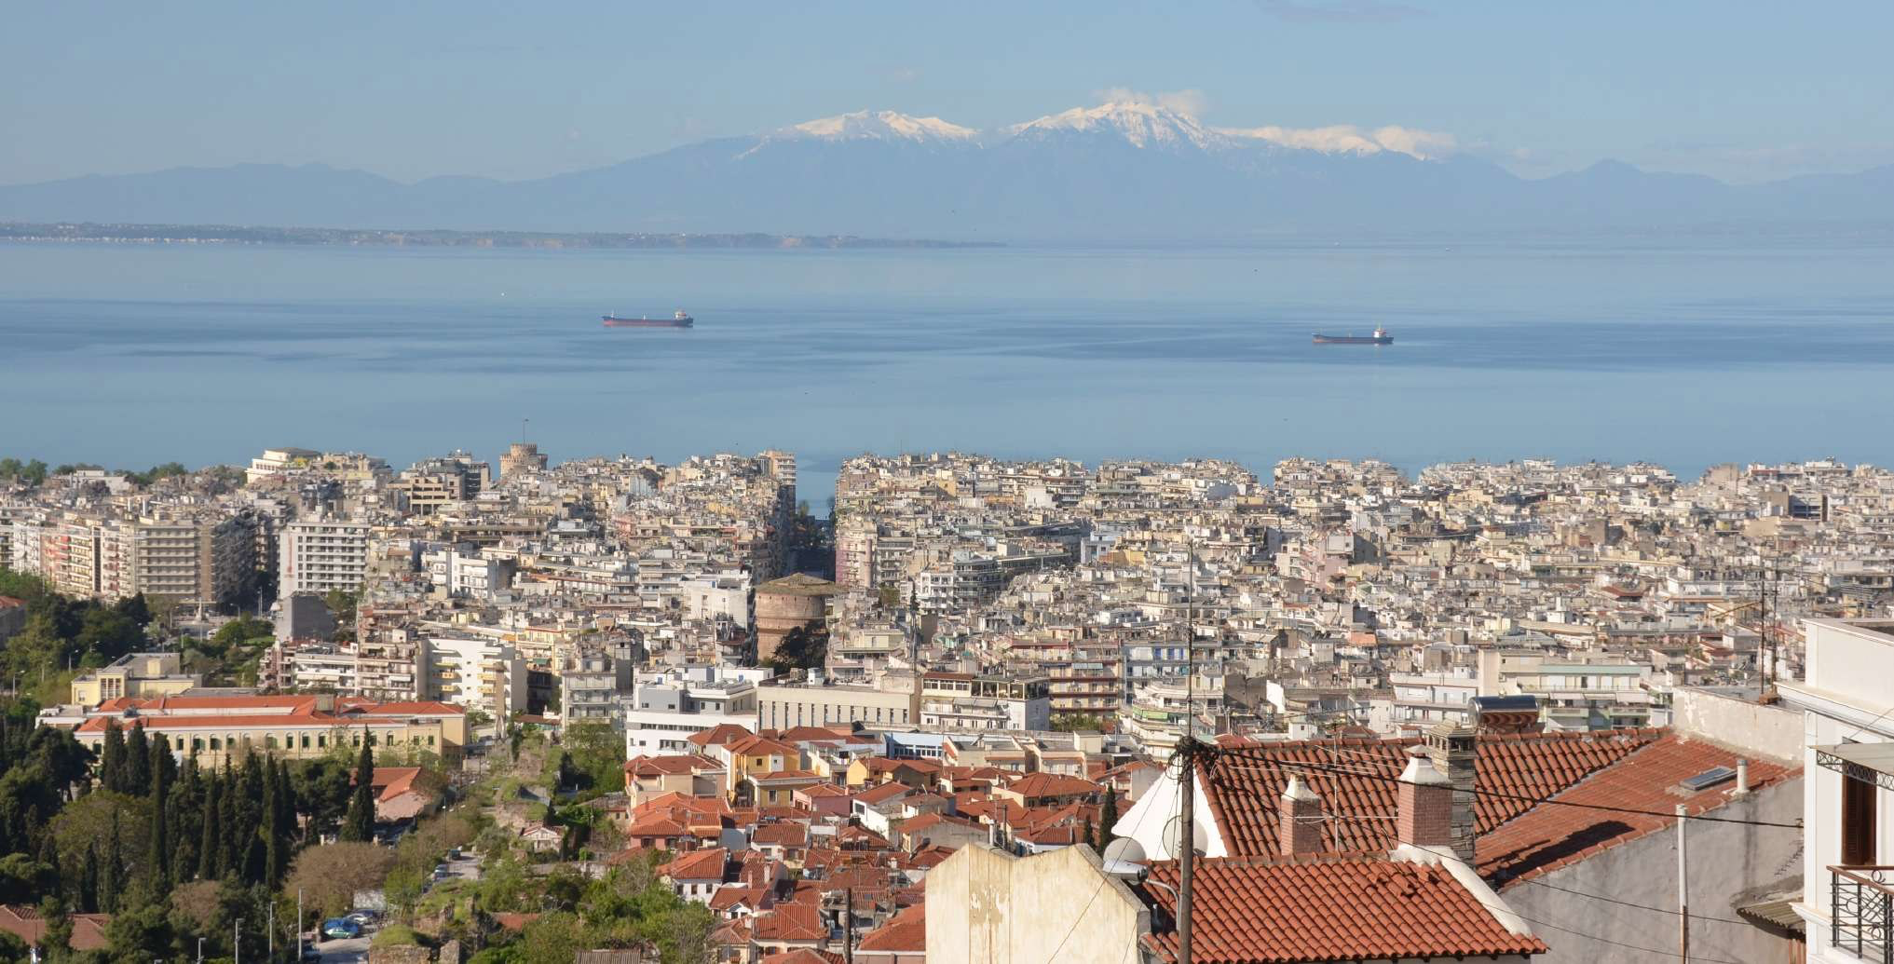
Today
Notes:
Today – a very large city, looking over towards Mt. Olympus…
Thessalonica today is the second largest city in modern Greece after Athens,
with the result that there are fewer archaeological excavations as compared to other ancient Greek sites.
→ MAP

Slide 5
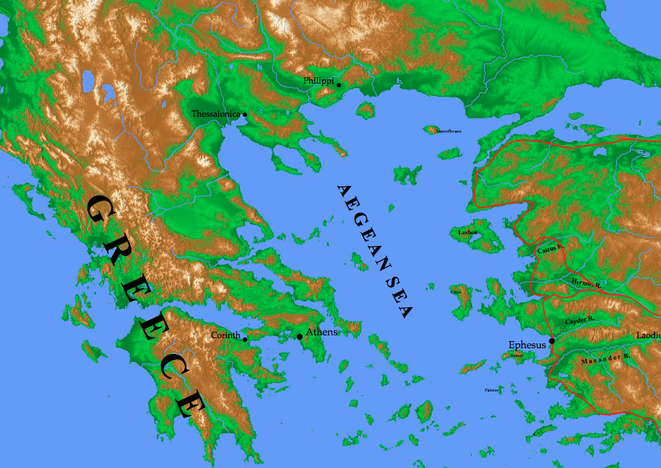
Notes:
From Asia (Turkey) –
to Philippi –
arrested – left…
to Thessalonica – 100 miles
→ Over the Egnatian Way

Slide 6
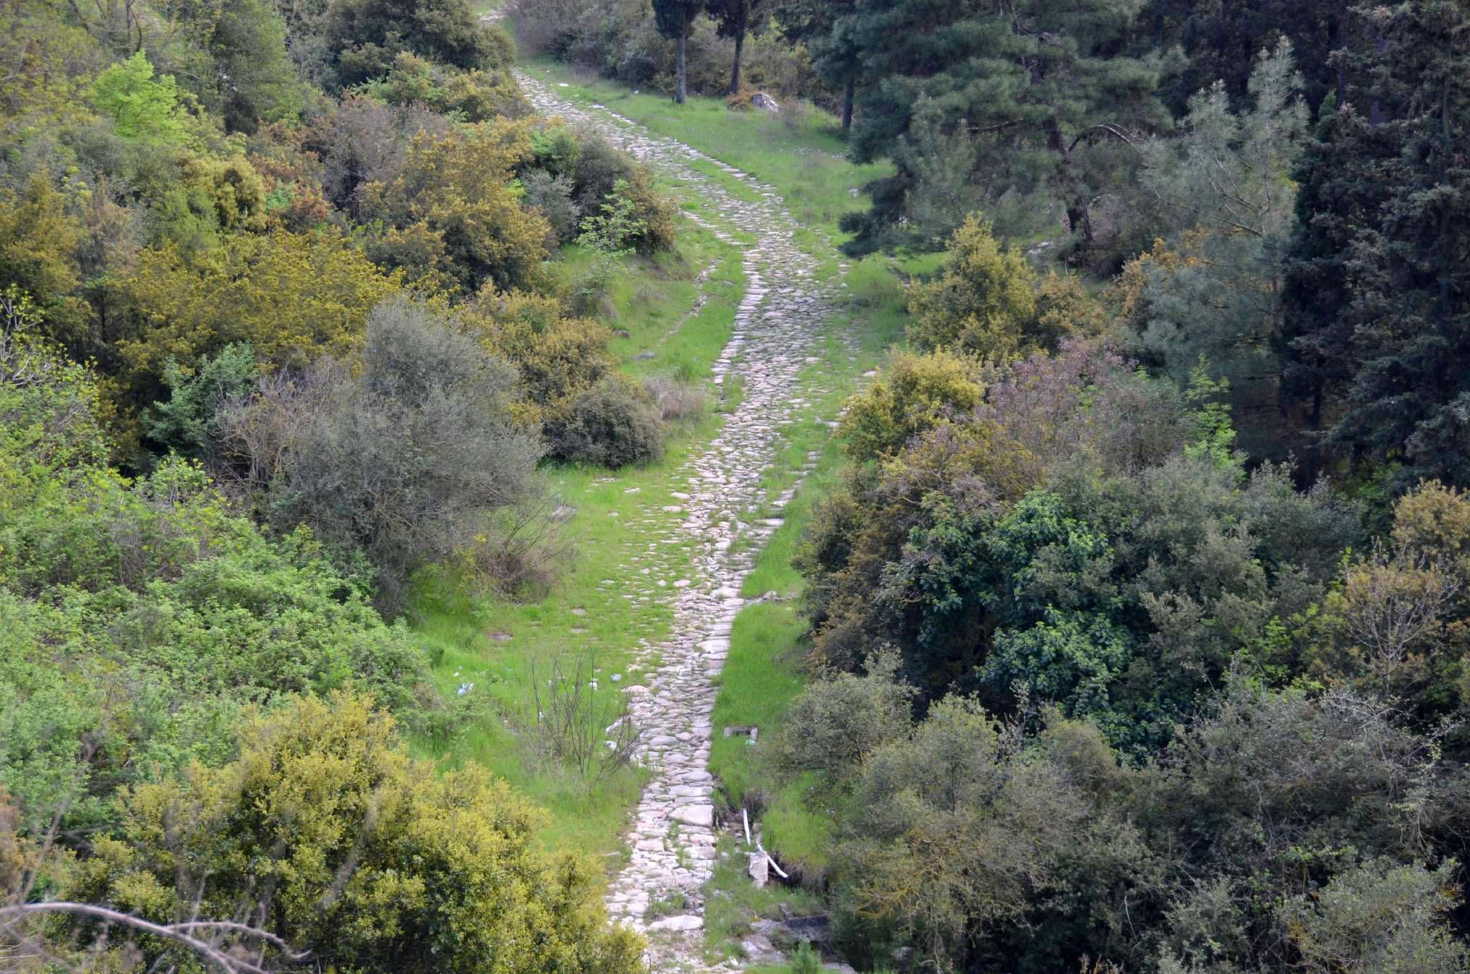
Egnatian Way
Notes:
Figure 19: The Egnatian Way. In order to secure their hold over Macedonia and the Eastern empire, the Romans built the Via Egnatia,
a military highway stretching from the west coast of Macedonia all the way to the border of Asia.
The apostle Paul would have followed this road from the port city of Neapolis to Philippi, Amphipolis, Apollonia, Thessalonica, and Berea.
→ It Begins – Acts 17

Slide 7
It Begins
GOD
GOD
Notes:
It Begins
Acts 17:1-3
Synagogue – 3 Sabbaths – then stayed longer OUT of the synagogue!
Reasoned from the scriptures
Christ must suffer, die , rise again…
Jesus is the Christ.
1 Thess. 1:10 / 3

Slide 8
Work of Faith Labor of Love Steadfastness of hope
GOD
GOD
1 Thess. 1:3, 10
Notes:
SOME were persuaded – joined themselves to Paul and Silas
your work of faith and labor of love and steadfastness of hope in our Lord Jesus Christ
turned to God from idols to serve the living and true God,
10 and to wait for His Son
→ The WORD of God

Slide 9
The Word of God
GOD
GOD
Notes:
The Word of God
The authority of the apostles and their word. (see Word of God in Thessalonians)
The gospel - 1:5, 2:4;
NOT word only, but in power and Holy Spirit
The Gospel of God - 2:2, 8, 9,
The Gospel of Christ - 3:2
The word - 1:6
The word of the LORD - 1:8
The WORD of God - 2:13
The word received from us (the apostles)
NOT the word of men
performs its work in you who believe -
The message of salvation - 2:16
These are "the instructions as to how you ought to walk and please God" 4:1
These commands are by the authority of the Lord Jesus - 4:2
This is the revelation of 'the will of God' for us - 4:3
This word = holiness / sanctification, particularly in sexual conduct - 4:3-6
Rejecting this writing is rejecting GOD - 4:8
This revealed 'by the word of the Lord' - 4.15
I adjure you by the Lord to have this letter read to all the brethren. 5:27
→ 2nd coming

Slide 10
2nd Coming of Jesus
GOD
GOD
Every Chapter !
Notes:
2nd coming –
2nd coming - It is mentioned in every chapter of the book (1:10; 2:19–20; 3:13; 4:13–18; 5:1–11, 23–24).
→ events
He IS coming again.
That DAY comes as a thief - not know when, but we are prepared! ch. 5
The dead in Christ will be raised, the living caught up -
EVER be with the LORD..
Comfort one another with these words...
We then to live in anticipation and hope of THAT world. It MUST change how we view our life in THIS world!
→ Tribulation / suffering

Slide 11
2nd Coming
He IS coming
NOT know the day
Dead in Christ will rise
Alive – caught up in the air
SO - Ever be with Him
Comfort with these words
Notes:
events
He IS coming again.
That DAY comes as a thief - not know when, but we are prepared! ch. 5
The dead in Christ will be raised, the living caught up -
EVER be with the LORD..
Comfort one another with these words...
We then to live in anticipation and hope of THAT world. It MUST change how we view our life in THIS world!
→ Tribulation / suffering

Slide 12
Tribulation and Suffering
GOD
GOD
Notes:
Tribulation and suffering - Suffering in Thessalonica
1:6 - received the word in much tribulation with the joy of the Holy Spirit !
2:2 - the apostles suffered! - setting the example
2:14 - they became imitators of the churches of God… for also endured the same sufferings.
3:3 … not to be disturbed by these afflictions; for you yourselves know that we have been destined for THIS.
3:4 - we kept telling you in advance that we were going to suffer affliction; and so it came to pas, as you know.
3:5 - NOTE - this is the work of ‘the tempter’ and it CAN effect our faith!
3:7 - the apostles continued in distress and affliction, but were comforted by the faith of the brethren!
→ Holiness of God’s People

Slide 13
Holiness of God’s people
GOD
GOD
Notes:
Holiness of God’s people in an unholy world.
Holiness of God's people in an unholy world!
sex – 4:1-7
freeloading - 4:11-12
→ Tucson? US?

Slide 14
Tucson?
GOD
GOD
Notes:
The only thing that really has changed, and that may not be for long –
Persecution / tribulation
→ TODAY
Jesus is STILL raised…
Jesus is STILL to come again ...
Bible still inspired
We are YET to be holy people...
We yet SUFFER ...
Like them we need to turn to God, Serve the living and true God, and wait for His son...

Slide 15
Today
Jesus still raised – the Lord
Jesus still coming
Bible still inspired
We to be Holy
We yet suffer
Notes:
Jesus still raised – the Lord
Jesus still coming
Bible still inspired
We to be Holy
We yet suffer

Slide 16
GOD
GOD

