Slide 1
Church Activities

Slide 2
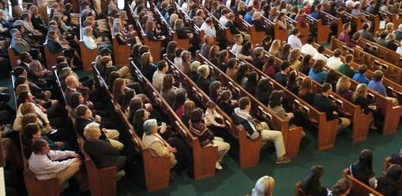
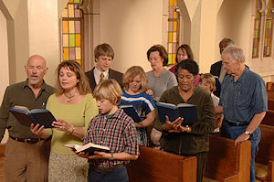
“but if I am delayed, I write so that you may know how you ought to conduct yourself in the house of God, which is the church of the living God, the pillar and ground of the truth.”
1 Tim. 3:15

Slide 3
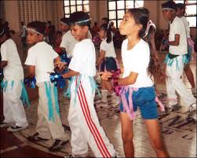
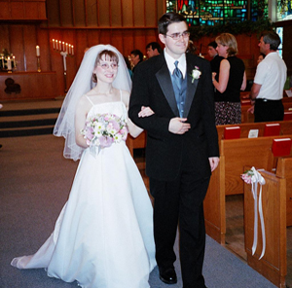
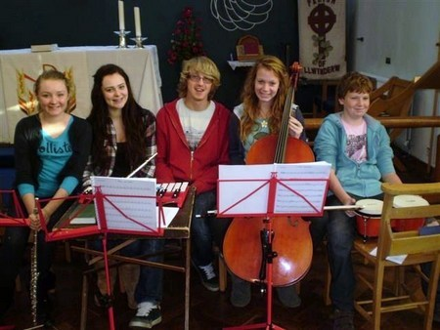
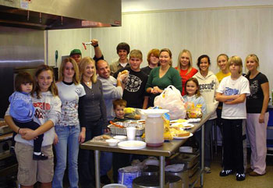

Slide 4
B. C. Goodpasture, Gospel Advocate, 1948, pg. 484 –
“It is not the mission of the church to furnish amusement for the world, or even for its own members. For the church to turn aside from its divine work to furnish amusement and recreation is to pervert its mission. If the church will discharge its duty in preaching the gospel, in edifying its members, and in helping the worthy poor, it will not have the desire or the time to amuse and entertain."

Slide 5
N.B. Hardeman, “Hardeman’s Tabernacle Sermons,” Vol. V, p. 50, 1942 –
“Again I say unto you, with caution and thought, that it is not the work of the church to furnish entertainment for its members. And yet many churches have drifted into such an effort. They enlarge their basements, put in all kinds of gymnastic apparatus, and make every sort of an appeal to the young people of the congregation. I have never read anything in the Bible that indicated to me that such was a part of the work of the church. I am wholly ignorant of any Scripture that even points in that direction."

Slide 6
For the church to Act Without Authority is Sin
Matt. 28:18- “And Jesus came and spoke to them, saying, ‘All authority has been given to Me in heaven and on earth.’”
Col. 3:17- “And whatever you do in word or deed, do all in the name of the Lord Jesus, giving thanks to God the Father through Him.”

Slide 7
For the church to Act Without Authority is Sin
1 Cor. 4:6- “Now these things, brethren, I have figuratively transferred to myself and Apollos for your sakes, that you may learn in us not to think beyond what is written, that none of you may be puffed up on behalf of one against the other.”

Slide 8
For the church to Act Without Authority is Sin
2 Jn. 9- “Whoever transgresses and does not abide in the doctrine of Christ does not have God. He who abides in the doctrine of Christ has both the Father and the Son.”

Slide 9
In this Lesson I Want to:
MAKE FOUR OBSERVATIONS
ASK THREE QUESTIONS
MAKE TWO IRREFUTABLE STATEMENTS

Slide 10
The Purpose of this Lesson:
To bring us all to the “Unity of the Faith
John 17:21
Eph. 4:11-13
1 Cor. 1:10

Slide 11
First Observation
“And whatever you do in word or deed, do all in the name of the Lord Jesus, giving thanks to God the Father through Him.”
Col. 3:17
Recreation, gymnasiums, kitchens, and various forms of entertainment are not a part of “the things of God.”

Slide 12
“And whatever you do in word or deed, do all in the name of the Lord Jesus, giving thanks to God the Father through Him.”
Col. 3:17
Matt. 16:23- “But He turned and said to Peter, ‘Get behind Me, Satan! You are an offense to Me, for you are not mindful of the things of God, but
the things of men.’"

Slide 13
“And whatever you do in word or deed, do all in the name of the Lord Jesus, giving thanks to God the Father through Him.”
Col. 3:17
Isaiah 55:8-9 “For My thoughts are not your thoughts, Nor are your ways My ways," says the Lord. 9 "For as the heavens are higher than the earth, So are My ways higher than your ways, And My thoughts than your thoughts.”

Slide 14
Second Observation
“And Jesus came and spoke to them, saying, ‘All authority has been given to Me in heaven and on earth.’”
Matt. 28:18
Recreation, gymnasiums, kitchens, and various forms of entertainment and social activities are not part of “godliness.”

Slide 15
“And Jesus came and spoke to them, saying, ‘All authority has been given to Me in heaven and on earth.’”
Matt. 28:18
1 Tim. 4:8- “For bodily exercise profits a little, but godliness is profitable for all things, having promise of the life that now is and of that which is to come.”

Slide 16
“And Jesus came and spoke to them, saying, ‘All authority has been given to Me in heaven and on earth.’”
Matt. 28:18
Bodily exercise:
Is not profitable for all things,
Does not have the promise of the life that now is and of that which is to come.
1 Tim. 4:8

Slide 17
Third Observation
“…that you may learn in us not to think beyond what is written…”
1 Cor. 4:6
Recreation, gymnasiums, kitchens, and various forms of entertainment and social activities are not part of ’’the kingdom of God.”

Slide 18
“…that you may learn in us not to think beyond what is written…”
1 Cor. 4:6
Rom. 14:17- "for the kingdom of God is not eating and drinking, but righteousness and peace and joy in the Holy Spirit."

Slide 19
Fourth Observation
“Whoever transgresses and does not abide in the doctrine of Christ does not have God.”
2 John 9(a)
Recreation, gymnasiums, kitchens, and various forms of entertainment and social activities are not part of “the work of Christ.”

Slide 20
“Whoever transgresses and does not abide in the doctrine of Christ does not have God.”
2 John 9(a)
Phil. 2:30- “Receive him therefore in the Lord with all gladness, and hold such men in esteem; (30) because for the work of Christ he came close to death, not regarding his life, to supply what was lacking in your service toward me.”

Slide 21
First Question
“Preach the word! Be ready in season and out of season. Convince, rebuke, exhort, with all longsuffering and teaching.”
1 Tim. 4:2
Where in the Bible do we find authority for making recreation, amusements, and entertainment a part of the work of the church?

Slide 22
“Preach the word! Be ready in season and out of season. Convince, rebuke, exhort, with all longsuffering and teaching.”
2 Tim. 4:2
Phil. 4:15- “Now you Philippians know also that in the beginning of the gospel, when I departed from Macedonia, no church shared with me concerning giving and receiving but you only. (16) For even in Thessalonica you sent aid once and again for my necessities.”

Slide 23
Second Question
“but we preach Christ crucified, to the Jews a stumbling block and to the Greeks foolishness,”
1 Cor. 1:23
If a church can make social activities a part of its work, why can’t a church make social activities a part of its worship?

Slide 24
“but we preach Christ crucified, to the Jews a stumbling block and to the Greeks foolishness,”
1 Cor. 1:23
Sometimes the claim is made that “we’re just using these social activities to get people to come in so that we may teach them."
1 Cor. 1: 21- “For since, in the wisdom of God, the world through wisdom did not know God, it pleased God through the foolishness of the message preached to save those who believe.”

Slide 25
Third Question
“And whatever you do in word or deed, do all in the name of the Lord Jesus, giving thanks to God the Father through Him.”
Col. 3:17
If social activities are a work of the church, then isn’t it true that the church MUST support social activities?

Slide 26
The Church Must:
“And whatever you do in word or deed, do all in the name of the Lord Jesus, giving thanks to God the Father through Him.”
Col. 3:17
Support evangelism
Must edify
Must do benevolent work

Slide 27
1st IRREFUTABLE STATEMENT
Jesus Christ has all authority.
And Jesus came and spoke to them, saying, "All authority has been given to Me in heaven and on earth.”

Slide 28
2nd IRREFUTABLE STATEMENT
Jesus Christ has not authorized churches to provide social activities, recreation, amusements, and entertainment.

Slide 30
While it is true that many churches need to repent, it is also true that many individuals need to repent for the same reason – disobedience and conduct that is contrary to God’s law. Luke 13:3

Slide 31
God’s Conditions For Salvation:
Believe – John 8:24
Repent – Acts 2:38
Confess Christ – Rom. 10:9-10
Baptism – Mark 16:16
Remain Faithful – Rev. 2:10

Slide 32
If the Lord, on the day of Judgment, asked you to give a Biblical argument for church involvement in recreation, gymnasiums, kitchens, and various forms of entertainment, could you do it…to save your soul?

