Slide 2
And I said, "O LORD God of heaven, the great and awesome God who keeps covenant and steadfast love with those who love him and keep his commandments, Nehemiah 1:5
GOD
GOD
Notes:
And I said, "O LORD God of heaven, the great and awesome God who keeps covenant and steadfast love with those who love him and keep his commandments, Nehemiah 1:5

Slide 3
God’s Covenants
GOD
Noah – Gen. 6:18; 9:11-17
Abraham – Gen. 15:18
Isaac – Gen. 17:21
Israel – Ex. 19:6; 34:27;\ Deut. 5:2
GOD
Notes:
God’s Covenants
Noah – Gen. 6:18; 9:11-17
Abraham – Gen. 15:18
Isaac – Gen. 17:21
Israel – Ex. 19:6; 34:27;\ Deut. 5:2

Slide 4
Jeremiah 34:13 "Thus says the Lord God of Israel, 'I made a covenant with your forefathers in the day that I brought them out of the land of Egypt, from the house of bondage, saying…
GOD
GOD

Slide 5
Nature of God’s covenants
‘Suzerian’ – covenant of Kings
NOT ‘will’ –
NOT ‘negotiated contract’
Notes:
Nature of God’s covenants
‘Suzerian’ – covenant of Kings
NOT ‘will’ –
NOT ‘negotiated contract’
→ 3 usual components

Slide 6
Three usual components:
promised blessings
demands of King
consequences for rejecting / breaking
Notes:
Three usual components:
promised blessings
demands of King
consequences for rejecting / breaking

Slide 7
Israel was unfaithful to THIS covenant!
GOD
GOD
Jer. 11:6-10
Notes:
Our Foundation:
And the Lord said to me, “Proclaim all these words in the cities of Judah and in the streets of Jerusalem, saying, ‘Hear the words of this covenant and do them.
7 ‘For I solemnly warned your fathers in the day that I brought them up from the land of Egypt, even to this day, cwarning persistently, saying, “Listen to My voice.”
8 ‘Yet they did not obey or incline their ear, but walked, each one, in the stubbornness of his evil heart; therefore I brought on them all the words of this covenant, which I commanded them to do, but they did not.’ ”
9 Then the Lord said to me, “A conspiracy has been found among the men of Judah and among the inhabitants of Jerusalem.
10 They have turned back to the iniquities of their ancestors who refused to hear My words, and they have gone after other gods to serve them; the house of Israel and the house of Judah have broken My covenant which I made with their fathers.”

Slide 8
A NEW covenant promised
GOD
GOD
Jer. 31:31-34
Hebrews 8:7-12
Notes:
Hebrews 8:7-12 ⁷ For if that first covenant had been faultless, there would have been no occasion sought for a second. ⁸ For finding fault with them, He says, "Behold, days are coming, says the Lord, When I will effect a new covenant With the house of Israel and with the house of Judah; ⁹ Not like the covenant which I made with their fathers On the day when I took them by the hand To lead them out of the land of Egypt; For they did not continue in My covenant, And I did not care for them, says the Lord. ¹⁰ "For this is the covenant that I will make with the house of Israel After those days, says the Lord: I will put My laws into their minds, And I will write them on their hearts. And I will be their God, And they shall be My people. ¹¹ "And they shall not teach everyone his fellow citizen, And everyone his brother, saying, 'Know the Lord,' For all will know Me, From the least to the greatest of them. ¹² "For I will be merciful to their iniquities, And I will remember their sins no more."

Slide 9
Jesus IS the mediator of this new covenant
GOD
GOD
Heb. 8:6
Hebrews 9:15-16
Notes:
Hebrews 9:15-16 ¹⁵ For this reason He is the mediator of a new covenant, so that, since a death has taken place for the redemption of the transgressions that were committed under the first covenant, those who have been called may receive the promise of the eternal inheritance. ¹⁶ For where a covenant is, there must of necessity be the death of the one who made it.
→ We have come to Jesus the mediator of a new covenant – Heb. 12:22-24

Slide 10
We “have come to Jesus, the mediator of a new covenant, and to the sprinkled blood, which speaks better than the blood of Abel… Heb. 12:22-24
Notes:
Hebrews 12:22-24 ²² But you have come to Mount Zion and to the city of the living God, the heavenly Jerusalem, and to myriads of angels, ²³ to the general assembly and church of the firstborn who are enrolled in heaven, and to God, the Judge of all, and to the spirits of the righteous made perfect, ²⁴ and to Jesus, the mediator of a new covenant, and to the sprinkled blood, which speaks better than the blood of Abel.
Blood = the sacrificial death of Jesus… needed for the covenant, the appointed sacrifice,

Slide 11
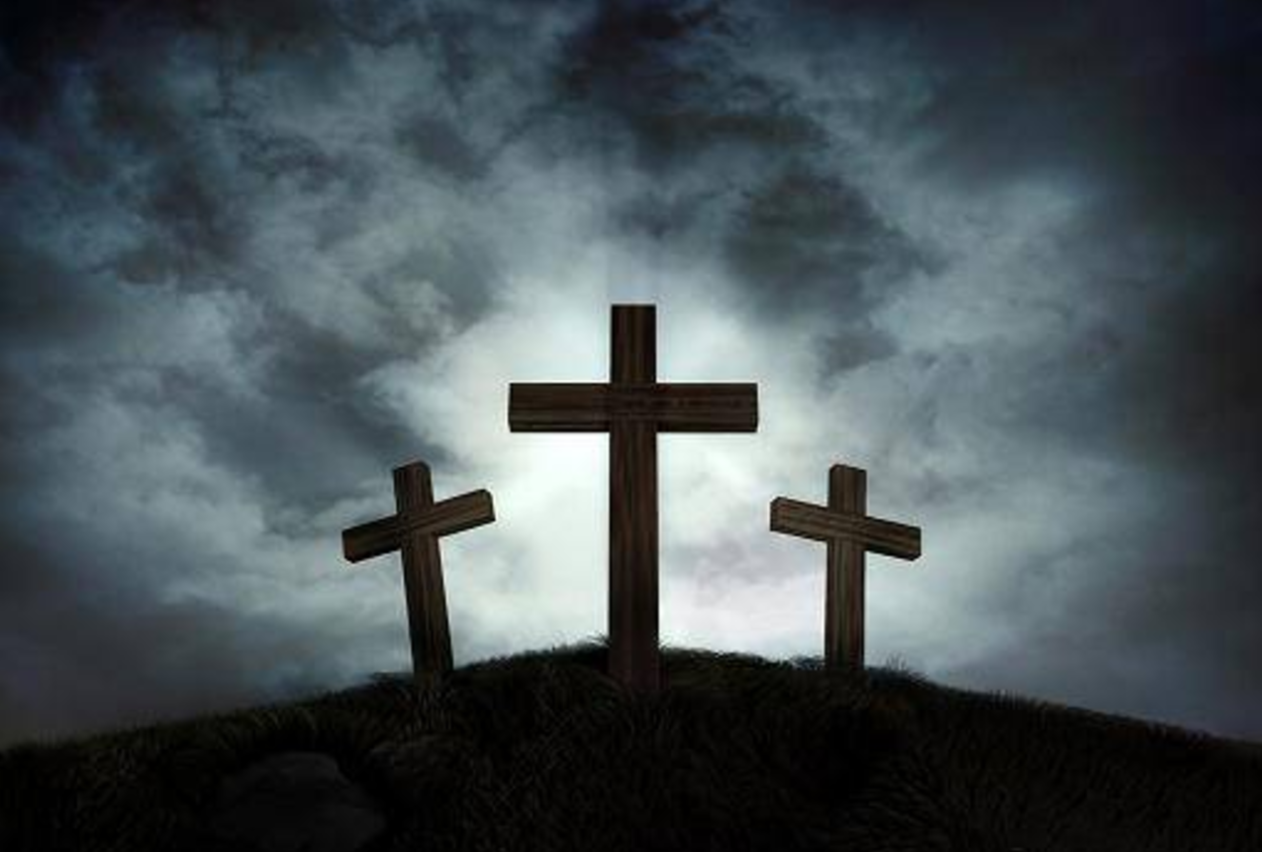
Blood of Jesus Sacrificial Death of Jesus
GOD
GOD

Slide 12
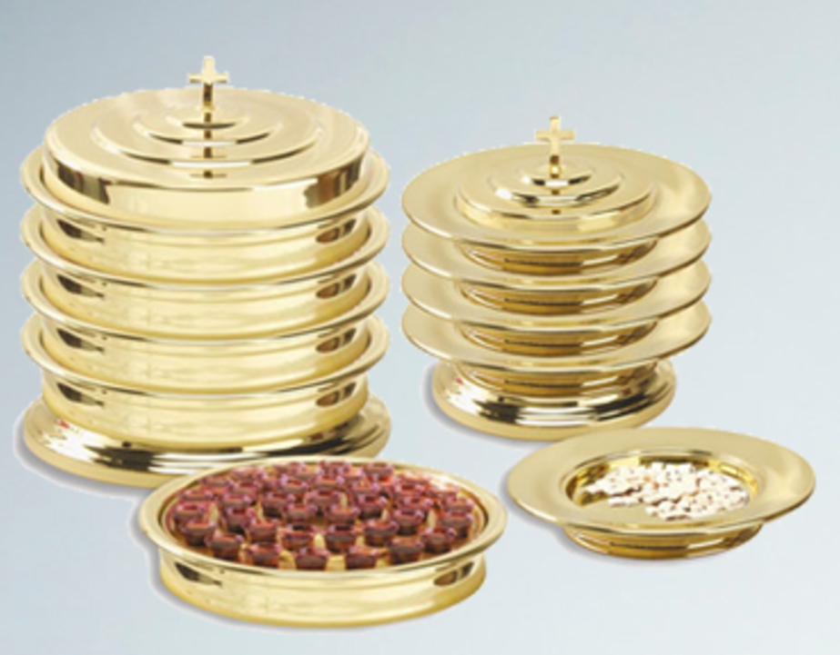
“This is the blood of the covenant…” Matt. 26:28
GOD
GOD

Slide 13
We are in covenant relationship with God thru Jesus…
GOD
GOD
Notes:
We are in covenant relationship with God thru Jesus…
There are contingencies, applications, consequences…
→ God will be faithful!

Slide 14
God Will BE FAITHFUL
GOD
GOD
Notes:
God will be FAITHFUL
That is is nature –
That is HIS response to covenants!
→ Nehemiah 1:5 AGAIN…

Slide 15
And I said, "O LORD God of heaven, the great and awesome God who keeps covenant and steadfast love with those who love him and keep his commandments, Nehemiah 1:5
GOD
GOD
Notes:
And I said, "O LORD God of heaven, the great and awesome God who keeps covenant and steadfast love with those who love him and keep his commandments, Nehemiah 1:5
→ WE are to be faithful

Slide 16
WE ARE TO BE FAITHFUL
GOD
GOD
Matt. 28:18-20; Rev. 2:10
Notes:
Matthew 28:18-20 ¹⁸ And Jesus came up and spoke to them, saying, "All authority has been given to Me in heaven and on earth. ¹⁹ "Go therefore and make disciples of all the nations, baptizing them in the name of the Father and the Son and the Holy Spirit, ²⁰ teaching them to observe all that I commanded you; and lo, I am with you always, even to the end of the age."
Rev. 2:10 – be thou FAITHFUL unto death…
→ We are to be HOLY -

Slide 17
We are to be HOLY
GOD
GOD
1Peter 1:14-19; 2 Cor. 6:14-18
Notes:
1 Peter 1:14-19
14 As obedient children, do not be conformed to the former lusts which were yours in your ignorance,
15 but alike the Holy One who called you, be holy yourselves also in all your behavior;
16 because it is written, “You shall be holy, for I am holy.”
17 If you address as Father the One who impartially judges according to each one’s work, conduct yourselves in fear during the time of your stay on earth;
18 knowing that you were not redeemed with perishable things like silver or gold from your futile way of life inherited from your forefathers,
19 but with precious blood, as of a lamb unblemished and spotless, the blood of Christ.
2 Cor. 6:14-18
→ We are to be TRANSFORMED - Rom. 12:1-2

Slide 18
We are to be transformed from the world
GOD
GOD
Rom. 12:1-2
Notes:
Romans 12:1-2 ¹ Therefore I urge you, brethren, by the mercies of God, to present your bodies a living and holy sacrifice, acceptable to God, which is your spiritual service of worship. ² And do not be conformed to this world, but be transformed by the renewing of your mind, so that you may prove what the will of God is, that which is good and acceptable and perfect.
We are to have crucified our old self – Rom. 6

Slide 19
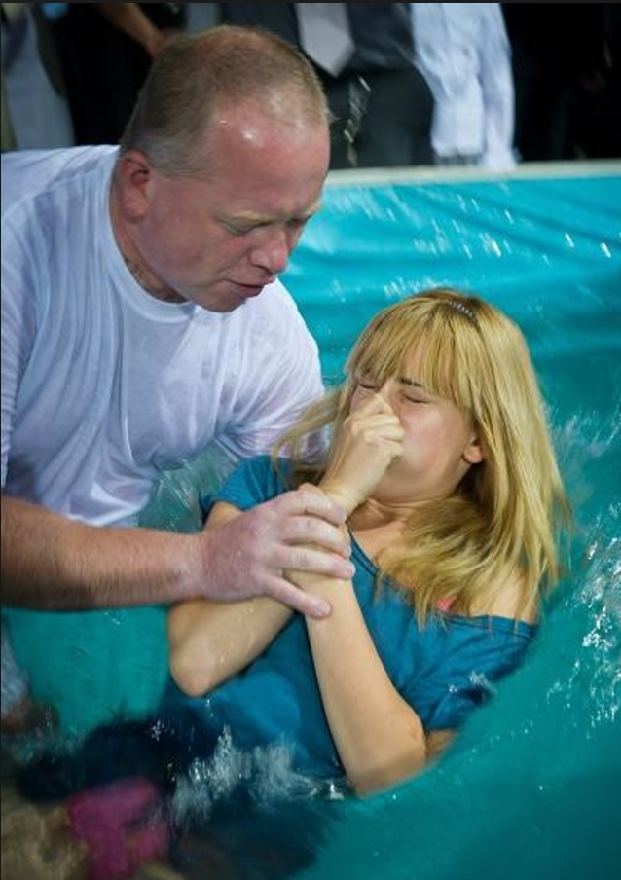
We are to have crucified our old self- are dead to sin.
GOD
GOD
Notes:
Romans 6:3-4 ³ Or do you not know that all of us who have been baptized into Christ Jesus have been baptized into His death? ⁴ Therefore we have been buried with Him through baptism into death, so that as Christ was raised from the dead through the glory of the Father, so we too might walk in newness of life.
Romans 6:6 knowing this, that our old self was crucified with Him, in order that our body of sin might be done away with, so that we would no longer be slaves to sin;
Romans 6:11-12 ¹¹ Even so consider yourselves to be dead to sin, but alive to God in Christ Jesus. ¹² Therefore do not let sin reign in your mortal body so that you obey its lusts,

Slide 20
GOD
GOD

Slide 21
GOD
GOD

