Slide 1
Right Things About the Rich Young Ruler
Churchofchristtucson.org

Slide 2
Rich Young Ruler
Came to the right person:
His words contain all that we need John 6:68; John 17:17
They’re perfect. Dealing with all things 2 Timothy 3:16-17; 2 Peter 1:3
He is the only path to salvation, peace, and a hope in everlasting life

Slide 4
Rich Young Ruler
Asked the right question:
Some questions are asked to make others look foolish Matthew 22:23-28
Others are asked to get others in a bind Matthew 21:23-27
And even others are asked to change subjects John 4:17-20

Slide 5
Rich Young Ruler
Asked the right question:
However there are other questions. One’s asked from sincere hearts.
Please tell me… or someone else? – Acts 8:34
What prevents me from being baptized?- Acts 8:36
What must I do to be saved? – Acts 16:30
Why do you delay – Acts 22:16

Slide 6
Matthew 16:26

Slide 7
Rich Young Ruler
Made right life choices:
Youth is a time to enjoy but… Ecclesiastes 11:9, 12:13-14
The great characters of faith did not become great over night
Paul Acts 26:4-7
Timothy 2 Timothy 1:5, 3:15
Daniel Daniel 1:8

Slide 8
Rich Young Ruler
But lacked one thing:
Jesus was moved by love Mark 10:21
Sell everything and follow me
Jesus requires complete commitment Luke 17:26-27; Matthew 10:39

Slide 9
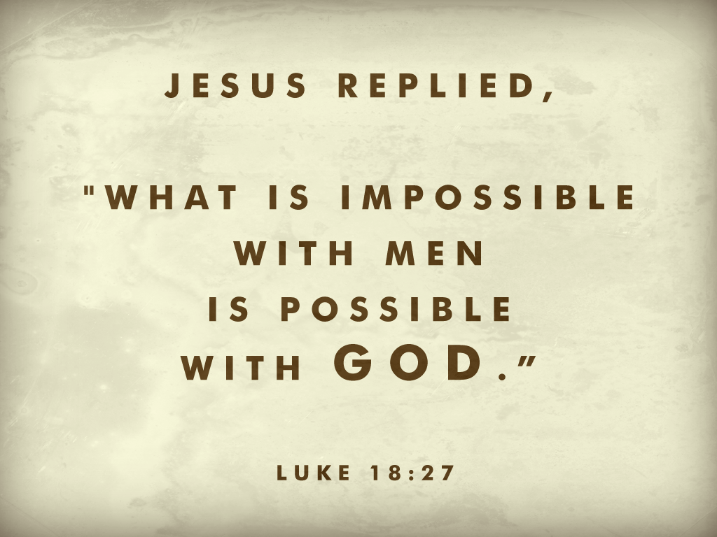

Slide 10
Romans 6

