Slide 1
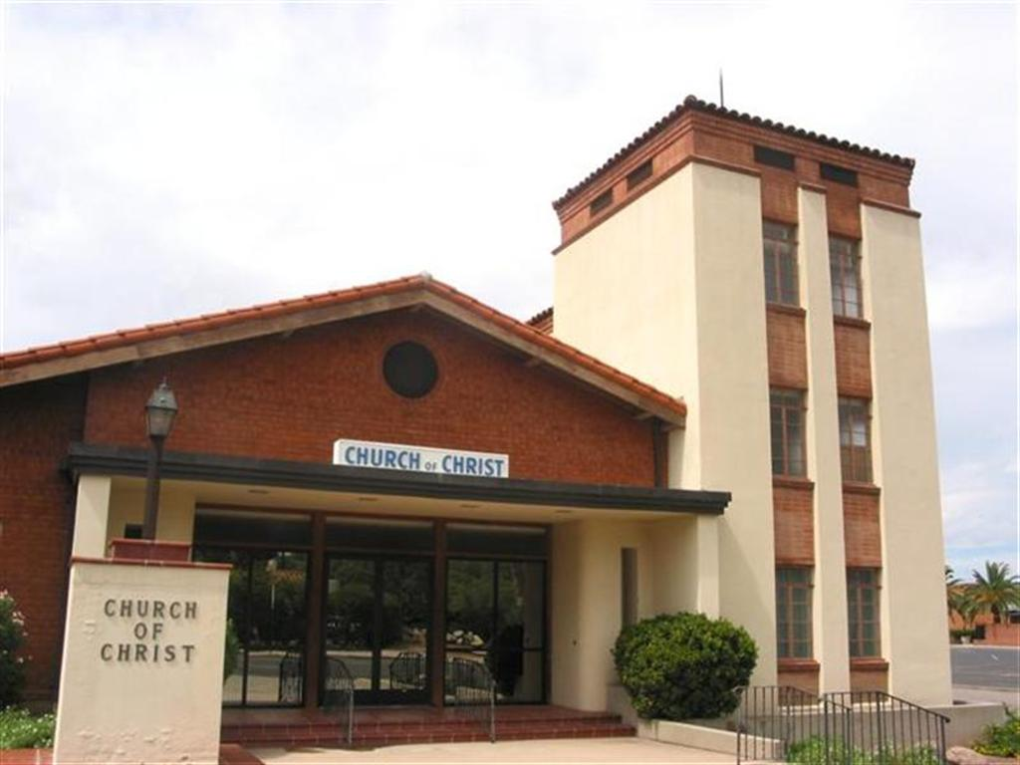
The Deacon and His Work 1 Timothy 3:8-13
Churchofchristtucson.org

Slide 2
The Deacon and His Work
What is a Deacon?
Diakonos – Servant, attendant, or waiter.
Translated two ways
Minister – Colossians 1:25
Servant – Matthew 20:26
All Christians are to be servants Romans 16:1-2; Colossians 4:7; 1 Corinthians 3:5
There is an official office 1 Timothy 3:8, 12; Philippians 1:1

Slide 3
The Deacon and His Work
His Qualifications:
1 Timothy 3:8-12
Men of dignity 1 Timothy 4:12
Not Doubled tonged James 3:9-10
Not addicted to much wine
Not fond of sordid gain
Holding to the mystery of the faith Ephesians 4:14

Slide 4
The Deacon and His Work
His Qualifications:
1 Timothy 3:8-12
First be tested
Beyond reproach Titus 2:7-8
Of one wife Matthew 19:6
Good manager of his house Joshua 24:15
Their wives must be good Christians 1 Timothy 3:11

Slide 5
The Deacon and His Work
His Work:
Deacons do not have a specific work detailed in scripture
Elders Acts 20:28; 1 Timothy 3:2
So, then, what is their work?
Acts 6:1-6
What are the needs of the church which can be met by men with these qualifications?
1 Timothy 3:13

