Slide 1
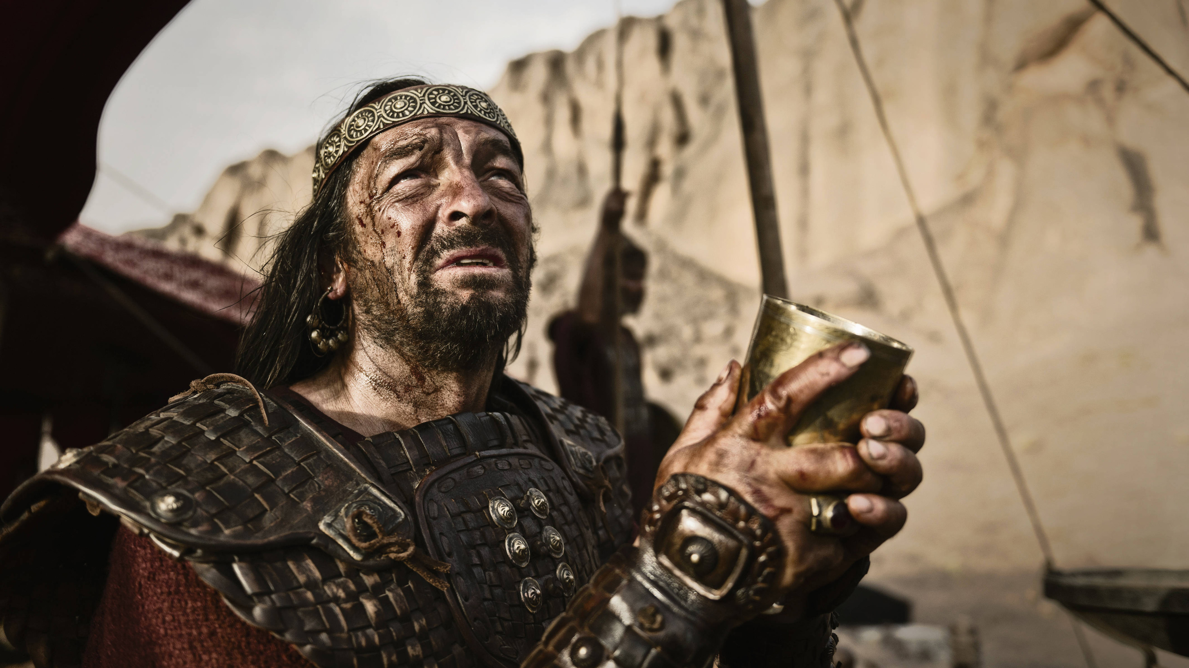
To Obey is Better Than Sacrifice
Churchofchristtucson.org

Slide 2
1 Samuel 15:1-6
God’s Sovereignty and Justice
Samuel reminds Saul how he got here
Saul had a history of being prideful 1 Sam.13:8-12, 14
God is just and merciful
Amalekites, not a new problem Exo.17:8-16; Deut. 25:17-16; Judges 6:3
Kenites were merciful to Israel
God’s will be done (Exo. 17:14)

Slide 3
1 Samuel 15:7-16
Saul’s Partial Obedience
Captured Agag alive
He and the people kept the choice spoils
Not what God had commanded vs.3
Partial obedience = full disobedience
Malachi 1:6-7
They destroyed (obeyed) when it was convenient
His action had consequences Esther 3:1

Slide 4
1 Samuel 15:7-16
Saul’s Partial Obedience
Saul’s True Colors
Proverbs 16:18
Creates a monument to himself
He was convinced that he did what God had commanded
Made two mistakes Matthew 7:21-22

Slide 5
1 Samuel 15:17-22
To Obey is Better than Sacrifice
Saul’s Second Reminder vs. 17-19
It was God that made you great
Why did you not listen?
Saul’s Delusion vs. 20-21
God’s Rebuke vs. 22
Jeremiah 7:22-23

