Slide 1
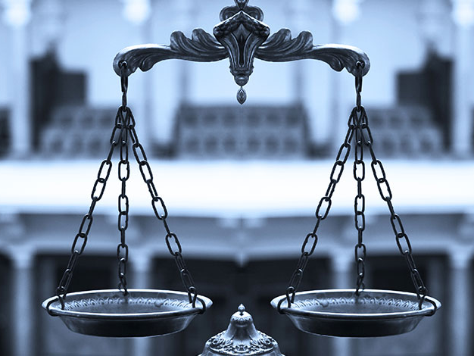
Prepare to Meet Your God
Churchofchristtucson.org

Slide 2
Prepare to Meet Your God Amos 4:4-13
Why must we prepare?
Because such a meeting is unavoidable Matthew 25:31-33
Many will not be prepared Luke 12:16-20
It will be a time for justice 2 Corinthians 5:10
Nothing we can do of our own can help us Titus 3:5
We must choose the narrow way Matthew 7:13-14

Slide 3
Prepare to Meet Your God Amos 4:4-13
How to prepare for such a meeting?
Not according to our way Jeremiah 10:23; Proverbs 14:12; Isaiah 55:8-9
God’s way is the only way Isaiah 55:10-11
Jesus is The Way John 14:6; 6:68; Acts 4:12

Slide 4
Prepare to Meet Your God Amos 4:4-13
When should we prepare?
During this life Luke 16:19-31
Yesterday is gone and tomorrow is not promised James 4:13-14
Now is the time to prepare Hebrews 9:27; 2 Corinthians 6:2; Acts 22:16

