Slide 1
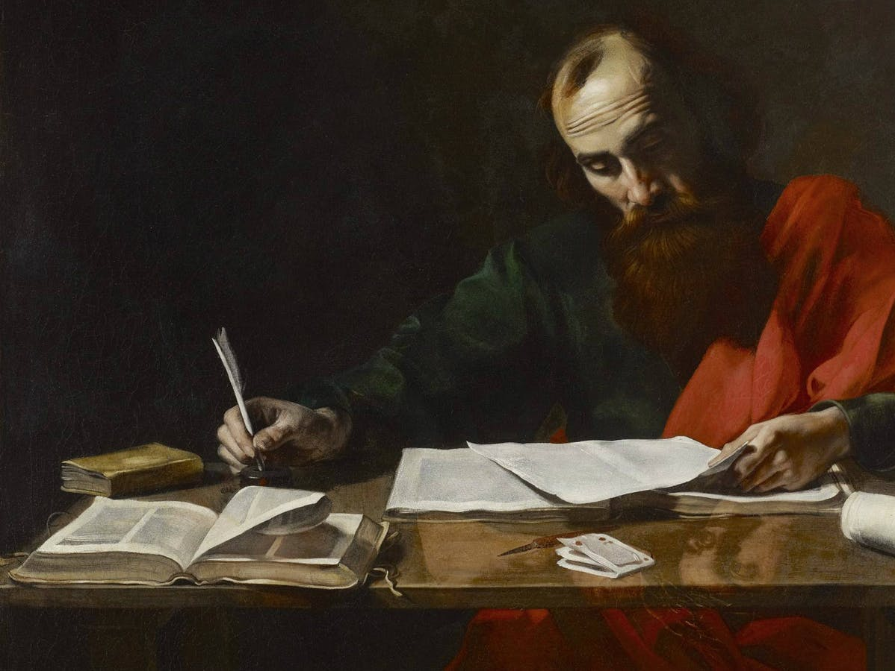
All Scripture
Churchofchristtucson.org

Slide 2
All Scripture
What does the bible claim for itself?
All scripture is inspired 2 Tim. 3:16-17; Matthew 5:18; Gal. 3:16; Mark 12:24-27
The Old Testament 2 Sam. 23:1-2; Jer. 10:1; Num. 22:18
These writers were guided 2 Peter 1:20-21

Slide 3
All Scripture
Prophesy
Duet. 13:1-5
A Few Messianic Prophesies
Tribe of Judah Gen. 49:10; Luke 3:23, 30
Existed before creation Micah 5:2; John 1:1-2
Sold for 30 pieces of silver Zech. 11:12; Matthew 26:15
Thirst on the cross Ps. 69:21; John 19:28

Slide 4
All Scripture
Prophesy
300 + prophecies that deal with Jesus alone
To fulfill 8 of them – 1 in 10¹⁷ power
1 in 100,000,000,000,000,000
To fulfill all of them…
84,000,000,000,000,000,000,000,000,000,000,000,000,000,000,000,000,000,000,000,000,000,000,000,000,000,000,000,000,000,000,000,000,000,000,000,000,000,000,000,000,000th of 1% chance

Slide 5
All Scripture
The Amazing Unity
Marriage Gen. 20:2ff; Hosea 2:1ff, Matt. 19:10; Hebrews 13:4
Following the details Lev. 10:1-3; Matt. 7:21-23; 1 Cor. 4:6
Not altering God’s Word Duet. 4:2; Prov. 30:6; Rev. 22:19

