Slide 1
The Fullness of Time
Churchofchristtucson.org

Slide 2
No Accident
God’s plan happened exactly as He had intended it to (Acts 2:22-23, 4:27-28)

Slide 3
The Fullness of Time
Galatians 4:4
It was the right time for God to send His Son to become the sacrifice for all of mankind
There are some questions that arise in connection to the phrase “the fullness of time.”
What made the first century the time for the greatest event in history to happen?

Slide 4
The Fullness of Time
For centuries this time had been in preparation
A need is identified Gen. 3:14-15
It was necessary for humanity to grasp the basic concepts of truth and error Gen. 8:21; Judges 25:25
The Law was a necessary next step
It taught man about sin Romans 7:7
But it was not a means to an end Gal. 3:19-24

Slide 5
The Fullness of Time
The Law made it clear that people cannot save themselves by right action Eph. 2:1-9
But it, again, was not what would save mankind
It was weak Romans 8:1-4
It was limited Hebrews 10:1-4
It intensified our knowledge of sin Romans 7:13
Truth was revealed in a progressive manner Eph. 3:1-7; Heb. 1:1

Slide 6
Romans 5:6
What was it about the first century that it made it the right time for the gospel?

Slide 7
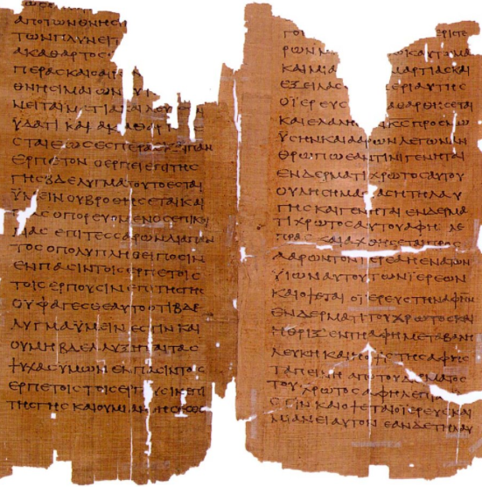
At the Right Time
Romans – Unequaled in wealth, power, safety, etc. Had been a power since 509 BC unlike other empires who only lasted a few generations
Greeks – Provided a language (Koine) that was exact beyond our language and easily memorized
Social – Rome was a stratified society of rich and poor (not really a middle). There were almost as many slaves as free persons.

Slide 8
At the Right Time
Contempt for life – Abortion, suicide, and divorce were very common. Blood-sport was common. Christ provided a true alternative. He showed that life is inherently valuable and revealed a God who takes a personal interest in His creation.
Acceptance – Rome allowed religious freedom in the empire. This made it possible for Christians to practice and evangelize under the safety of Roman “law and order.”

