Slide 1
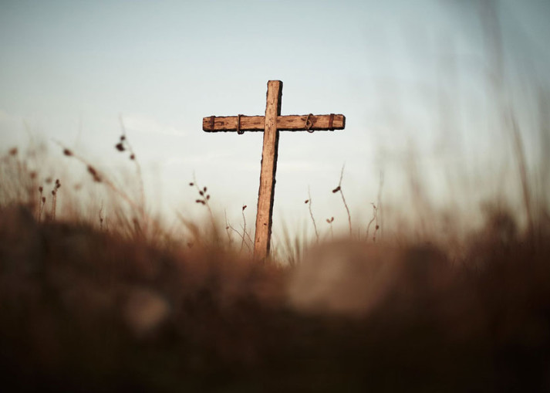
“If Christ Be Not Raised”
Churchofchristtucson.org

Slide 2
If Christ Be Not Raised
The Fact of The Resurrection
The Empty Tomb
His death was publicly witnessed Luke 22:33-38, 44-49
Multiple witnesses saw His burial Luke 23:50-56
Multiple witnesses saw the empty tomb Luke 24:1-12

Slide 3
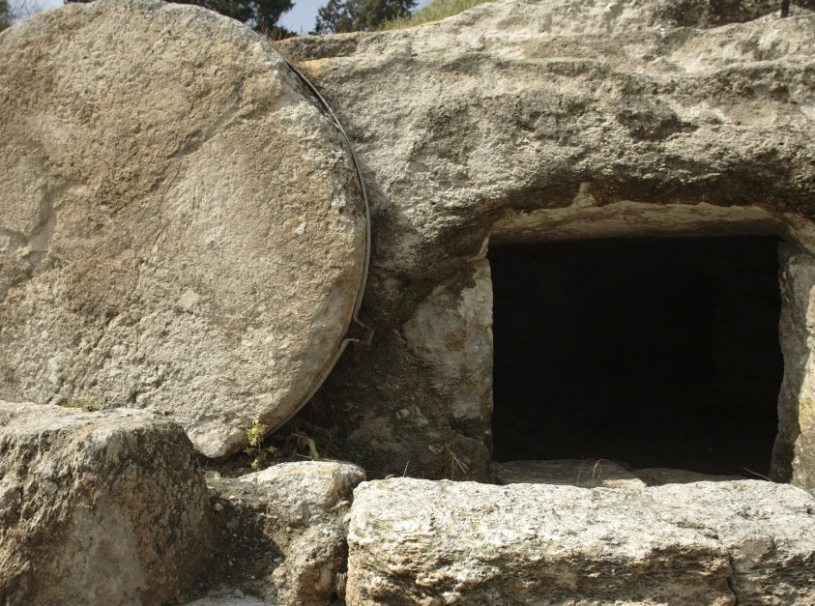

Slide 4
If Christ Be Not Raised
The Post-Mortem Appearances
1 Corinthians 15:3-8
Most are still living – Go ask them yourself vs.6
The Conversion of Saul
What can account for such a change?
Acts 22:1-16; 9:15-16

Slide 5
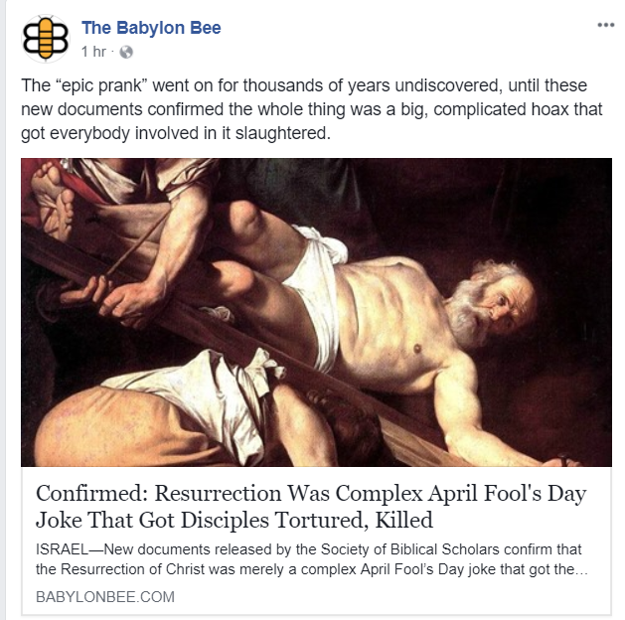

Slide 6
If Christ Be Not Raised
The Boldness of the Disciples Acts 4:12-31; 7:51-60; 8:1-4
James – Sword
Thomas – Speared
Matthew – Speared
Philip – Crucified
Bartholomew – Crucified
Andrew, James, Thaddaeus, Simon - Crucified

Slide 9
If Christ Be Not Raised
The Impact of the Resurrection 1 Corinthians 15:12-19
Jesus is who He said He Is Romans 1:4
The call to repentance is real Acts 17:30
Judgement is real 1 Peter 4:5
Salvation and Hope are real 1 Corinthians 15:20-22 cf. Romans 6:4-7

