Slide 2
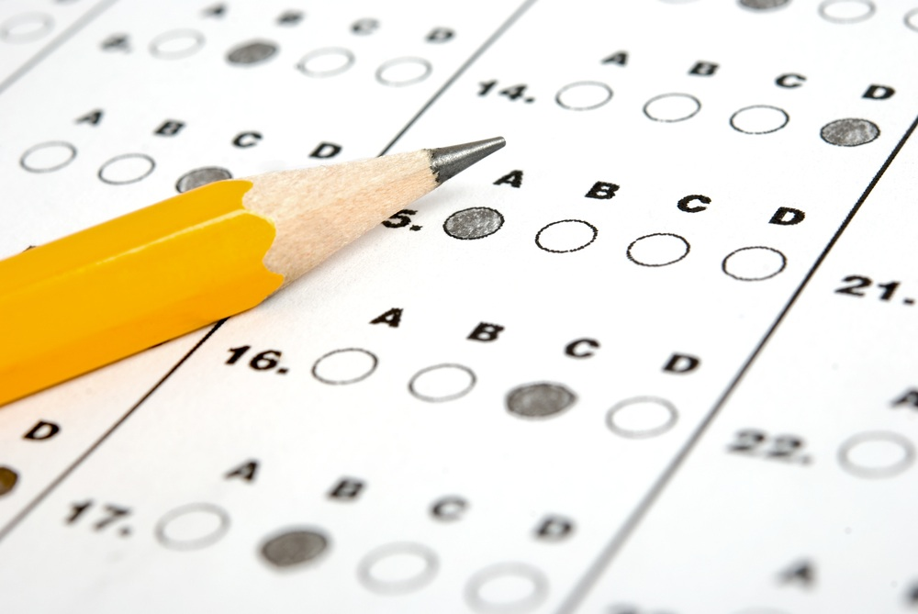
Resisting Temptation
Temptation:
It will happen Gen. 4:7; 1 Pet. 5:8
It comes from within Jas. 1:13-16; 1 Jn. 2:16
It can be overcome Matt. 4:1-11; Heb. 2:18, 4:15; 1 Pet. 5:8-9

Slide 3
Resisting Temptation
Overcoming Temptation:
Realize the cost Jas. 1:15; Heb. 12:1, 11:25
Need to be merciless Acts 19:18-20; Rom. 13:14
Need a plan of action Dan. 1:8
Need to develop new desires Matt. 4:4; Eph. 4:22-24; Rom. 12:1; Phil. 4:8
It takes effort 1 Cor. 9:24-27

Slide 4
Resisting Temptation
After Temptation:
Successfully resisted Jas. 1:12
Gave in to sin Prov. 24:16; 1 Jn. 1:9

