Slide 1
Notes:
Mark 3, 5/28/2018 class Green Meadow, San Angelo

Slide 2
Enticed
2 Peter 2:14, 18; James 1:14
Notes:
2 Peter 2:14 having eyes full of adultery that never cease from sin, enticing unstable souls, having a heart trained in greed, accursed children;
2 Peter 2:18 For speaking out arrogant words of vanity they entice by fleshly desires, by sensuality, those who barely escape from the ones who live in error,
James 1:14 But each one is tempted when he is carried away and enticed by his own lust.

Slide 3
2Peter 2:14
They are stains and blemishes, reveling in their deceptions, as they carouse with you,
14 having eyes full of adultery that never cease from sin, enticing unstable souls, having a heart trained in greed, accursed children;

Slide 4
James 1:14
Let no one say when he is tempted, “I am being tempted by God”; for God cannot be tempted by evil, and He Himself does not tempt anyone.
14 But each one is tempted when he is carried away and enticed by his own lust.

Slide 5
Entice?
δελεάζω: to lure or entice someone to sin
to lead astray, to lure into sin.’
Notes:
Louw Nida: δελεάζω: to lure or entice someone to sin (compare δέλεαρ ‘bait,’ not occurring in the NT
)—‘to lead astray, to lure into sin
→ ??? Fish/hook
.’ ἕκαστος δὲ πειράζεται ὑπὸ τῆς ἰδίας ἐπιθυμίας ἐξελκόμενος καὶ δελεαζόμενος ‘a person is tempted when he is drawn away and enticed by his own evil desires’ Jas 1:14. δελεάζω may often be translated as ‘to make sinning look attractive’ or ‘to make sin taste good’ or ‘to wave sin in front of a person’s nose.’

Slide 6
Enticed ??
Notes:
Enticed! Fish / Hook / WORM
→ Rest of quote…

Slide 7
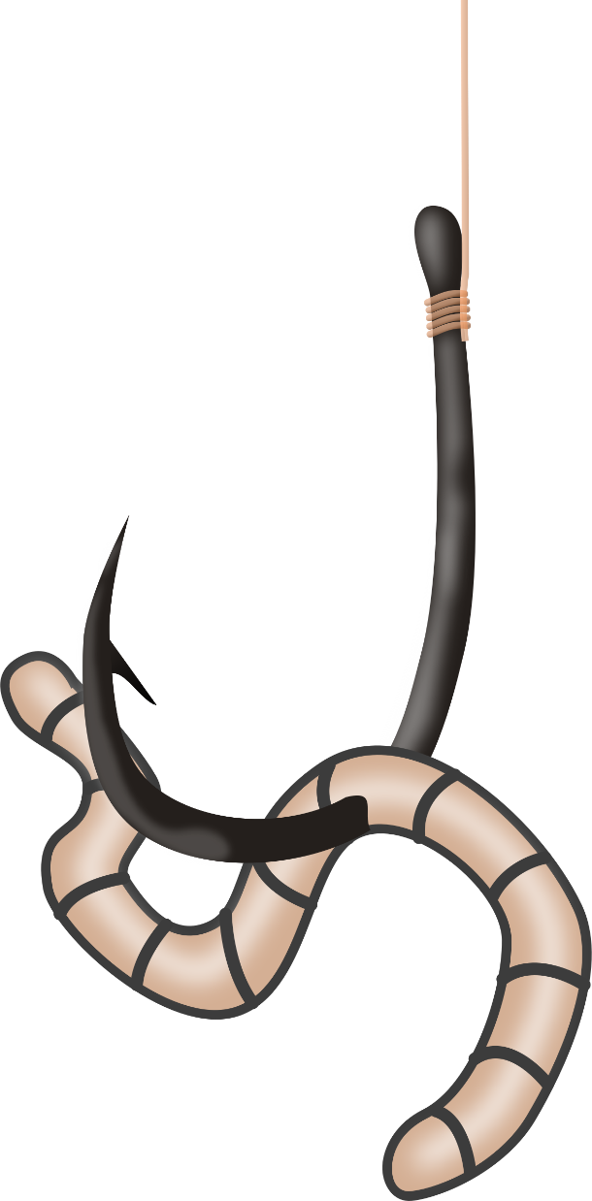
Enticed!

Slide 8
Entice?
δελεάζω may often be translated as
‘to make sinning look attractive’
or ‘to make sin taste good’
or ‘to wave sin in front of a person’s nose.’
Notes:
Louw Nida: δελεάζω:
‘a person is tempted when he is drawn away and enticed by his own evil desires’ Jas 1:14.
δελεάζω may often be translated as
‘to make sinning look attractive’
or ‘to make sin taste good’
or ‘to wave sin in front of a person’s nose.’
→ EVE and Gen. 3:6

Slide 9
When the woman saw that the tree was good for food, and that it was a delight to the eyes, and that the tree was desirable to make one wise, she took from its fruit and ate; and she gave also to her husband with her, and he ate. (Gen. 3:6)
Notes:
Genesis 3:6 When the woman saw that the tree was good for food, and that it was a delight to the eyes, and that the tree was desirable to make one wise, she took from its fruit and ate; and she gave also to her husband with her, and he ate.
→ 1John 2:16

Slide 10
For all that is in the world, the lust of the flesh and the lust of the eyes and the boastful pride of life, is not from the Father, but is from the world.
(1John 2:16)
Notes:
1 John 2:16 For all that is in the world, the lust of the flesh and the lust of the eyes and the boastful pride of life, is not from the Father, but is from the world.
→ 2 Tools of Satan

Slide 11
2 Tools of Satan
Deception – James 1:14-16
Tempted – sin – death (14-15)
1:16 - Do not be deceived, my beloved brethren.
Notes:
2 Tools of Satan
Deception
14 But each one is tempted when he is carried away and enticed by his own lust.
15 Then when lust has conceived, it gives birth to sin; and when sin is accomplished, it brings forth death.
16 Do not be deceived, my beloved brethren.
Tempted – sin – death (14-15)
James 1:16 - Do not be deceived, my beloved brethren.
→ EVE AGAIN – from NT – 1Tim. 2:14

Slide 12
“For it was Adam who was first created, and then Eve. And it was not Adam who was deceived, but the woman being deceived, fell into transgression. (1Tim. 2:14)
Notes:
“For it was Adam who was first created, and then Eve. And it was not Adam who was deceived, but the woman being deceived, fell into transgression. (1Tim. 2:14)
→ 2 Cor. 11:3

Slide 13
But I am afraid that, as the serpent deceived Eve by his craftiness, your minds will be led astray from the simplicity and purity of devotion to Christ. (2Cor. 11:3)
Notes:
But I am afraid that, as the serpent deceived Eve by his craftiness, your minds will be led astray from the simplicity and purity of devotion to Christ. (2Cor. 11:3)
→ 2 Tools of Satan DESIRE

Slide 14
2 Tools of Satan
Deception
Desire
‘lust’ –
“to greatly desire to do or have something—‘to long for, to desire very much.’ “
Notes:
Deception
Desire
‘lust’ –
“to greatly desire to do or have something—‘to long for, to desire very much.’ “
→ Desire + Deception – work together!

Slide 15
2 Tools of Satan
Desire + Deception
‘make sin look attractive’
Make sin taste good’
To wave sin in front of a person’s nose’
Notes:
Remember the 2nd part of Louw Nida:
Desire + Deception
‘make sin look attractive’
Make sin taste good’
To wave sin in front of a person’s nose’
→ Example: Joseph and Potiphar’s wife

Slide 16
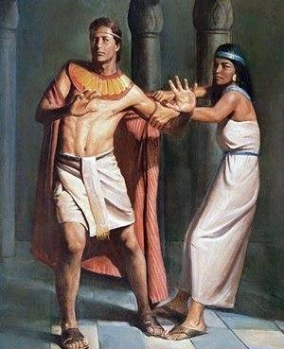
Joseph
and
Potiphar’s wife
How then could I do this great evil and sin against God?” (Gen. 39:9)
Notes:
Joseph and Potiphar’s wife – Gen. 39:6-10 (vs. 9)
Now Joseph was handsome in form and appearance.
7 It came about after these events that his master’s wife looked with desire at Joseph, and she said, “Lie with me.”
8 But he refused and said to his master’s wife, “Behold, with me here, my master does not concern himself with anything in the house, and he has put all that he owns in my charge.
9 “There is no one greater in this house than I, and he has withheld nothing from me except you, because you are his wife. How then could I do this great evil and sin against God?”
10 As she spoke to Joseph day after day, he did not listen to her to lie beside her or be with her.
11 Now it happened one day that he went into the house to do his work, and none of the men of the household was there inside.
THUS – his GREATER desire was to please God rather the lusts of the flesh!
→ TWO ASPECTS OF AVOIDING TEMPTATION

Slide 17
Two Aspects of Avoiding Temptation
Change my KNOWLEDGE
Learn what the will of God IS
→ Ephesians 5 -
Notes:
Change my KNOWLEDGE
Learn what the will of God IS
→ Ephesians 5 -

Slide 18
Ephesians 5
FACT – vs. 5
For this you know with certainty, that no immoral or impure person or covetous man, who is an idolater, has an inheritance in the kingdom of Christ and God.
Notes:
FACT – vs. 5
Admonition:
let no one deceive you with empty words (6)
So then do NOT be foolish, but understanding what the will of the Lord is! (17)
→ Changing KNOWLEDGE – 2 aspects
For this you know with certainty, that no immoral or impure person or covetous man, who is an idolater, has an inheritance in the kingdom of Christ and God.

Slide 19
Ephesians 5
Admonition: vs. 6
let no one deceive you with empty words (6)
Notes:
FACT – vs. 5
Admonition:
let no one deceive you with empty words (6)
So then do NOT be foolish, but understanding what the will of the Lord is! (17)
→ Changing KNOWLEDGE – 2 aspects
For this you know with certainty, that no immoral or impure person or covetous man, who is an idolater, has an inheritance in the kingdom of Christ and God.

Slide 20
Ephesians 5
LESSON – vs. 17Admonition:
So then do NOT be foolish, but understanding what the will of the Lord is! (17)
Notes:
FACT – vs. 5
Admonition:
let no one deceive you with empty words (6)
So then do NOT be foolish, but understanding what the will of the Lord is! (17)
→ Changing KNOWLEDGE – 2 aspects
For this you know with certainty, that no immoral or impure person or covetous man, who is an idolater, has an inheritance in the kingdom of Christ and God.

Slide 21
Two Aspects of Avoiding Temptation
Change my KNOWLEDGE
Learn what the will of God IS
Learn what the REAL cost of sin is
Notes:
Learn what the REAL COST OF SIN IS
John Clayton –
Drunk tank
Cancer center
→ 2nd aspect – change my DESIRES

Slide 22
Two Aspects of Avoiding Temptation
Change my KNOWLEDGE
Change my DESIRES
Notes:
Change my KNOWLEDGE
Change my DESIRES

Slide 23
We struggle with will-power when the problem is wrong desires.
Notes:
Key aspect of avoiding Sin - Change your DESIRES we struggle with will-power when the problem is wrong desires.
→ Working this out – seeing the END result of sin Psalm 73

Slide 24
Psalm 73
1 Surely God is good to Israel,
To those who are pure in heart!
But as for me, my
feet came close to stumbling,
My steps had almost slipped.
3 For I was envious of the arrogant
As I saw the prosperity of the wicked.

Slide 25
Psalm 73
¹⁶ When I pondered to understand this,
It was troublesome in my sight
¹⁷ Until I came into the sanctuary of God;
Then I perceived their end.

Slide 26
Psalm 73
²⁴ With Your counsel You will guide me,
And afterward receive me to glory.
²⁵ Whom have I in heaven but You?
And besides You, I desire nothing on earth.

Slide 27
Key aspects of avoiding Sin -
Change your knowledge Change your DESIRES
Notes:
Conclusion: Key aspects of avoiding SIN:
Change your knowledge Change your DESIRES
→ BUT there is FORGIVENESS IN JESUS while we WORK ON THIS…

Slide 28
In Jesus there is FORGIVENESS
Notes:
In Jesus There is FORGIVENESS
WHILE we are changing! –

Slide 31
Psalm 73
Feet almost slipped - vs. 1-3
THEN – saw their END vs. 16-17
REALIZE – Know - Understand
greater end is to live WITH God – vs. 24
THUS verse 25:
Beside God, I desire nothing on earth”
Notes:
Feet ALMOST slipped – seeing the ‘comfort of the wicked’ – vs. 1-3
THEN – saw THEIR END – vs. 16-17
Realized the GREATER END is to live with God – vs. 24
THUS – beside God, I desire nothing on earth! – vs. 25
→ CONCLUSION -

