Slide 1
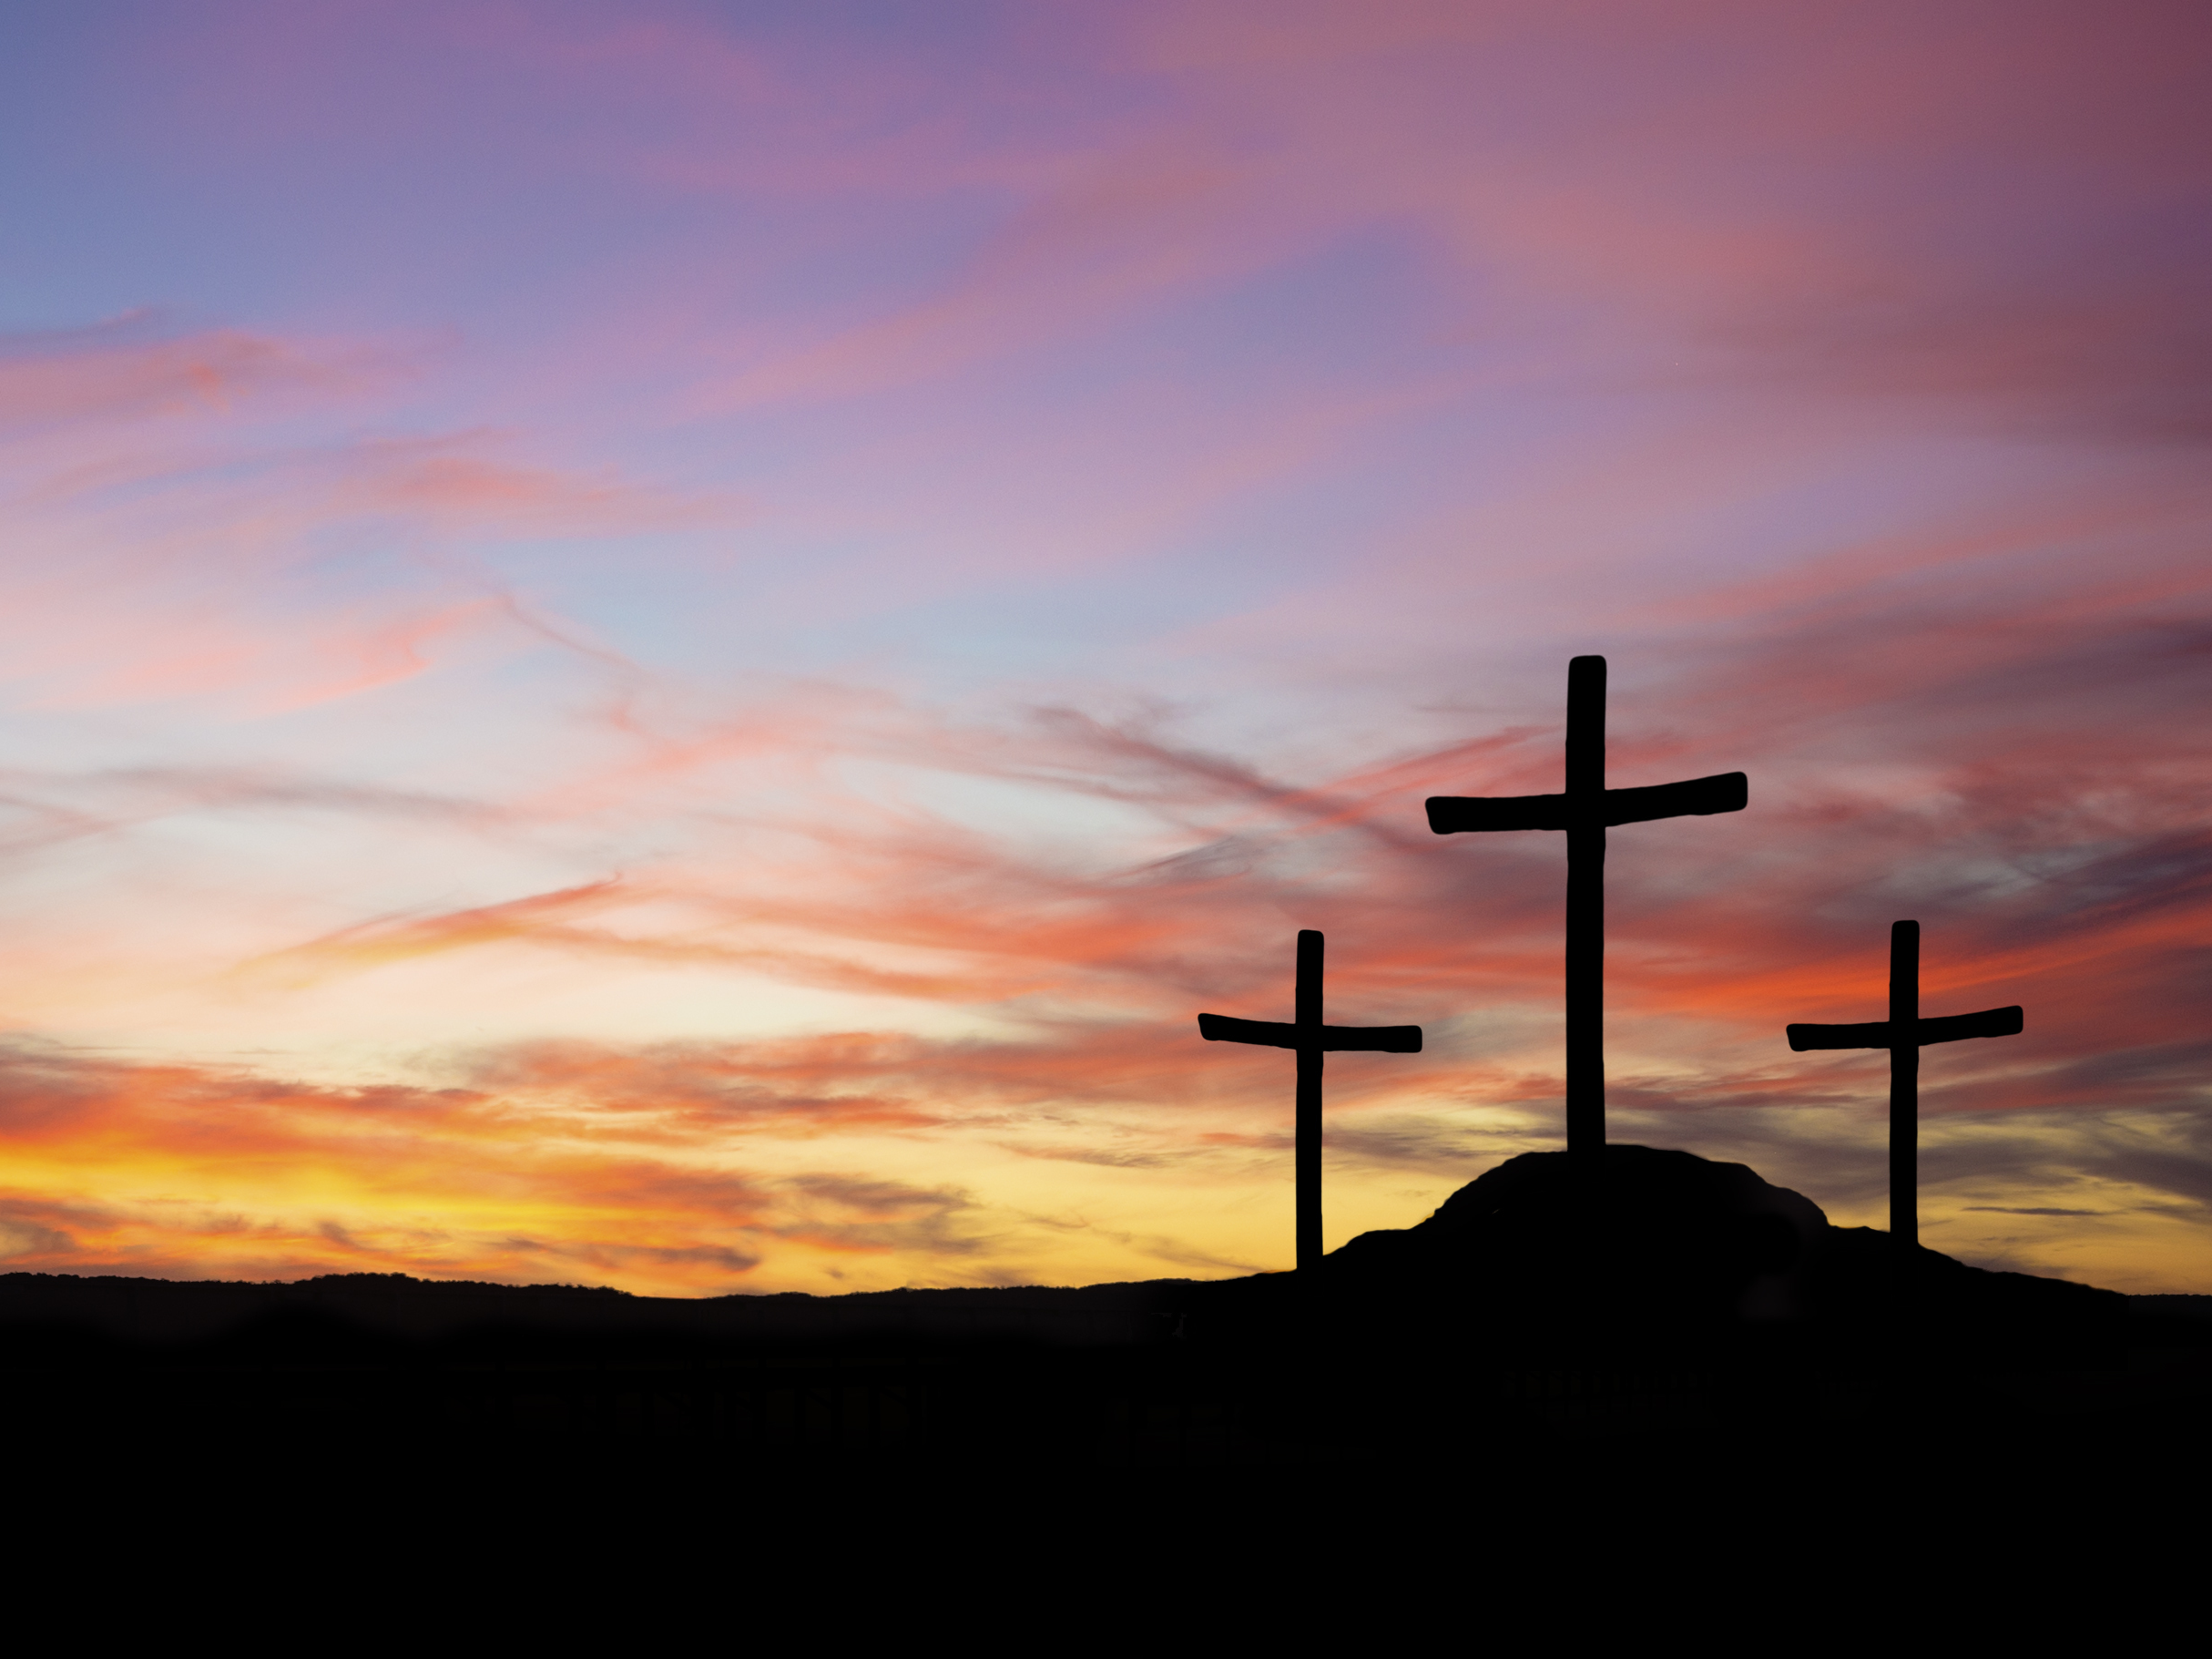
The Rejected Christ
Isaiah 53:3
Churchofchristtucson.org

Slide 2
The Rejected Christ
Isa. 53:3
People would and do reject Him today Acts 7:51-53
How do people reject Him?
  His Name Phil. 2:9-10; Acts 4:9-12; Acts 11:26
  His Authority Matt. 28:18-19; 8:5-9
  His church Matt. 16:13-18; Eph. 4:4; 1:22-23; Acts 20:28

Slide 3
The Rejected Christ
Isa. 53:3
How do people reject Him?
  His Gospel Gal. 1:7-9
  His worship Acts 20:7; 1 Cor. 16:2; Rom. 10:14-15; 1 Tim. 2:1-2; Eph. 5:19
  His teaching Mark 7:1-13

Slide 4
What must I do to be saved? Acts 16:30
Believe in Jesus; John 8:24
  Repent of Sins; Luke 13:3; 5
    Confess our Faith in Christ; Matt. 10:32-33
      Be Baptized for the Remission Of Sins; Mark 16:16; Acts 2:38
        Live Faithfully; Rev. 2:10

