Slide 1
Resist The Devil
Churchofchristtucson.org

Slide 2
Strategies for Fighting Temptation
Temptation:
Desire for something that sinful or takes away from my relationship with God.
Comes from within James 1:13-15
Three categories 1 John 2:16

Slide 3
Strategies for Fighting Temptation
Avoid:
Avoid as much as it is possible and reasonable the sights and situations that tempt you.
2 Timothy 2:22; Genesis 39:6b-12; Romans 13:14

Slide 4
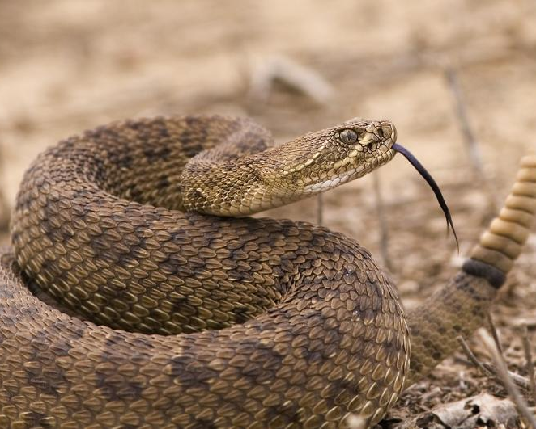

Slide 5
Strategies for Fighting Temptation
Say “No”:
Say “no” within 5 seconds
James 4:7 cf. Ephesians 6:12
Matthew 4:3-4
Notes:
James 4:7 – Resist, to stand opposed. This is not simply just saying “no.” It is saying no and acting no. That is, it can take some effort. This is spiritual warfare.

Slide 6
Strategies for Fighting Temptation
Turn to Christ:
Saying no alone will not do.
Sin is deceptive and from ignorance Ephesians 4:22; 1 Peter 1:14
Hebrews 11:25
Notes:
Choosing rather to suffer affliction with the people of God, than to enjoy the pleasures of sin for a season Hebrews 11:25 KJV

Slide 7
Now flee youthful lust and purse righteousness, faith, love, and peace, with those who call on the Lord from a pure heart. – 2 Tim. 2:22

Slide 8
Strategies for Fighting Temptation
Hold:
Short term: Hebrews 12:1-3; Galatians 6:9
Don’t give up!
Long term: We must pursue righteousness
Notes:
Pursue – not something passive but active. Very active!
Hebrews 12:1-3 – Meditate, hold that image of Jesus, that knowledge of what He went through and why He did it when you are tempted.
Gal. 6:9 – the doing good includes resisting temptation! Resisting the thing that will be destruction to my soul.

Slide 9
Strategies for Fighting Temptation
Enjoy:
I need to develop new and better desires
1 Peter 3:10-12
Long term a change of desires (from ungodly to godly) will mean fewer temptations.
Notes:
These next two are long term strategies for defeating sin and resisting temptation.
Attitude shift: When you say no to temptation you are actually saying yes to a better life.
What this can look like: Spending more time with the brethren (Heb. 10:25), working diligently to build a prayer life, drinking deeply from God’s word (1 Peter 2:1-3).

Slide 10
Notes:
“An idle man’s brain is the devil’s workshop.” – John Bunyan

Slide 11
Strategies for Fighting Temptation
Move:
For the sake of your soul don’t be the slothful man Proverbs 21:25
Romans 12:10-13; 1 Corinthians 15:58
Notes:
Part of my long term strategy in fighting sin and resisting temptation should involve me become more and more involved with the work of the Lord. There is plenty to do each day for me to stay busy. Even if it is just me growing as a Christian.

Slide 12
Strategies for Fighting Temptation
A - avoid
N – “no”
T - turn
H - hold
E - enjoy
M - move

