Slide 1
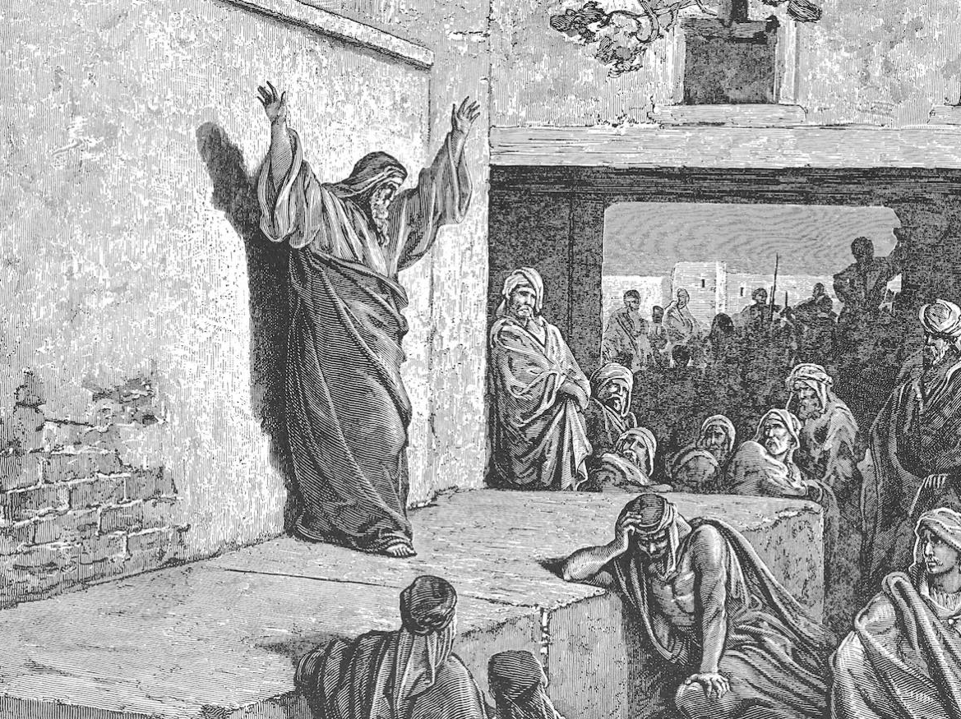
Who is like Jehovah
Churchofchristtucson.org

Slide 2
Micah:
Part one (1-3):
Destruction is coming
Because of your wickedness
Part two (4-5):
There’s hope
A king is coming
Notes:
Part 3 (6-7):

Slide 3
Micah 6: god’s case against Israel
Ungrateful Israel 6:1-5
What does the LORD require? 6:6-8
Condemnation of the nations wickedness and threat of Judgement 6:9-14
Notes:
Chapter 6 is that of a court room. God call’s Israel before the bar as He makes His case before all.
4:6-8 – They ask, hypothetically, what shall they offer to atone for their sins. It goes from the most minimal to the drastic. But note, none of what they offer is what God requires of man.

Slide 4
Micah 7: Repentant prayer and divine promise
Confession of the nations guilt 7:1-6
Confession of faith and prayer of repentance 7:7-13
Prayer for grace and God’s answer 7:14-17
Praise of Jehovah 7:18-20
Notes:
v. 1-2: “The harvest is past and there are no gleanings; she hungers for the first-ripe fig of spring, the return of righteousness.” – Homer Hailey
The remnant will wait on Him who will hear and save His faithful.

Slide 5
