Slide 1
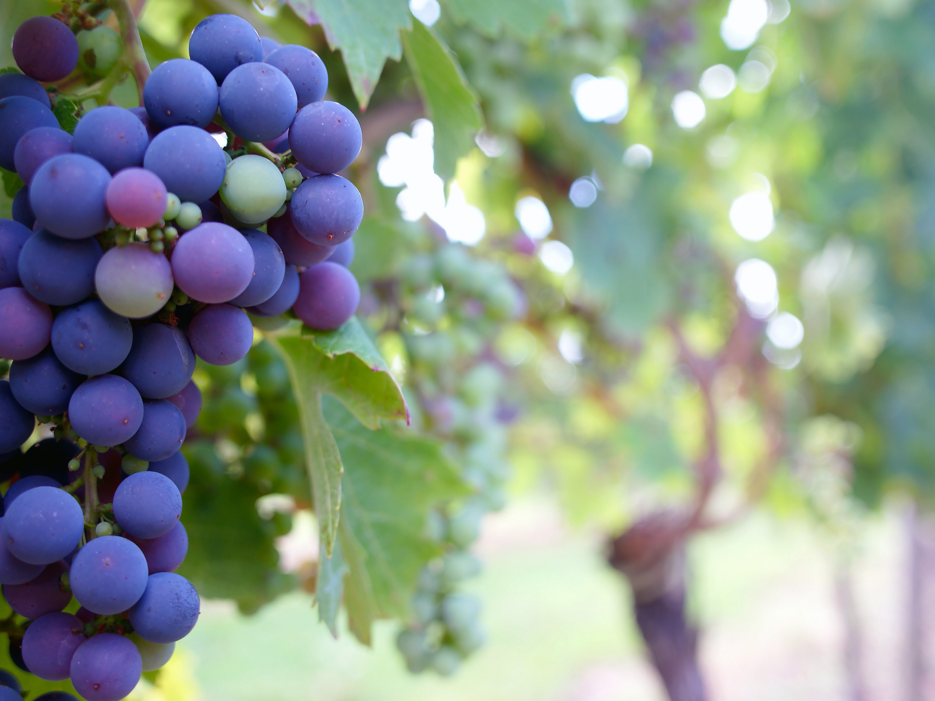
From the Roots Up
Churchofchristtucson.org

Slide 2
Fruitless Religion:
Mark 11:12-20
The fig tree gave all the signs of fruit, just like the temple.
The tree was cursed, the temple cleansed.
Spiritual decay or spiritual life all starts from the same place v.20

Slide 3
Conditions That Lead to Fruitfulness:
Cultivating Deep Roots John 15:1-5; Ps. 1; 119:36
Eliminate Weeds Luke 8:14; Matt. 5:29-30
Embrace God’s Pruning John 15:2;Heb. 12:11; Rev. 3:19
Notes:
Weeds:
There are 205 varieties of weeds in North America and even more of the spiritual variety.
Even harmless things can become weeds.
“Whenever I throw myself into something on Friday or Saturday so that I am too drained to worship Him on Sunday – there is a big weed growing in my life. Weeds are signs of neglect. They are signs that prayer, Bible study, evangelism, helping others, and worship are being neglected.” – Mark Dunagan

Slide 4
What Am I Producing?
Leaves James 2:14-17; Matt. 19:16-22
Fruit Rom. 16:1-2; Acts 9:36-39
Notes:
“We can look really good from a distance if we are nothing but all leaves. We might look fruitful, but it is all leaves. “Hey, I got leaves, I look together, I look spiritual, I look good.” – Mark Dunagan

Slide 5
What Am I Producing?
Leaves
Fruit
I merely attend
I’m in and out
I read the Bible
I talk the Christian life
I worship
I stay to encourage
I apply the Bible
I live it
Notes:
Leaves are good when they produce fruit…
John 15:8-11

Slide 6
Notes:
John 15:5

