Slide 1
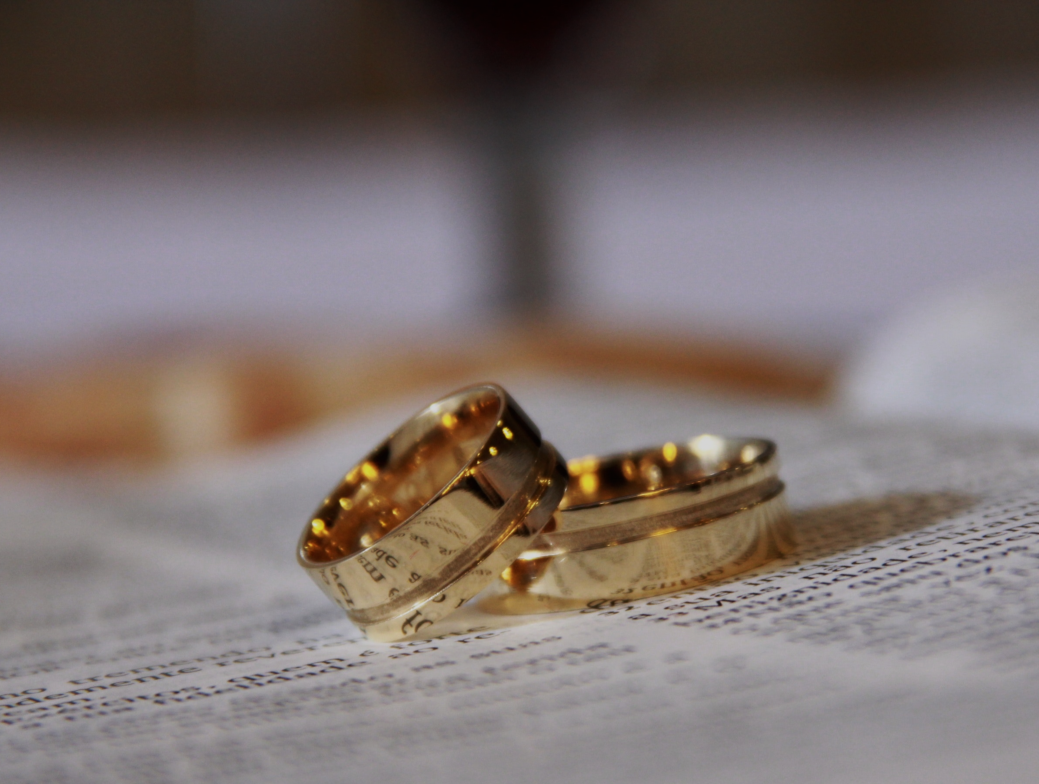
From The Beginning
Churchofchristtucson.org
Notes:
Read Matthew 19:1-12

Slide 2

“Some Pharisees came to Jesus, testing Him and asking, “Is it lawful for a man to divorce his wife for any reason at all?”
Matthew 19:3
Notes:
The question: Is it lawful for any reason?

Slide 3
“Have you not read that He who ‘made them from the beginning made them male and female’, and said, ‘For this reason a man shall leave his father and mother and be joined to his wife, and the two shall become one flesh’?
Matthew 19:4-5

Slide 4
From the Beginning:
Matthew 19:1-12
From the Beginning:
  Christ goes back to The beginning vs. 4-5
  God’s design for marriage [Genesis 2:24]
  Marriage is a covenant Malachi 2:14
Notes:
God is the originator and creator of marriage.
He alone has the right to determine what is and is not a marriage.
God’s law is universal. Applying to the believer and the unbeliever alike.
McNeile quote.

Slide 5
“They said to Him, “Why then did Moses command to give her a certificate of divorce and send her away?” He said to them, “because of your hardness of heart Moses permitted you to divorce your wives; but from the beginning it has not been this way.”
Matthew 19:7-8
Notes:
God through Moses did NOT command them to divorce. It was permitted because of their perversion of the marriage covenant.

Slide 6
“And I say to you, whoever divorces his wife, except for immorality, and marries another woman commits adultery; and he who marries a divorced woman commits adultery.”
Matthew 19:7-8

Slide 7
From the Beginning:
Matthew 19:1-12
Except:
  Divorce was and is not God’s intent for marriage v.8
  God has provided only one reason why a divorce would be permitted; adultery v.9a
  Consequences of adultery v.9b (cf. Malachi 2:14)
Notes:
Consequences:
Those who are divorced because of they committed adultery have no right to be remarried or else they would be in a adulterous relationship. And those who marry individuals who divorced for reasons other than adultery or are the guilty party commit adultery.

Slide 8
One man, one woman, until death, except for the cause of adultery.

Slide 9
From the Beginning:
Matthew 19:1-12
This is God’s Standard:
  The disciples shock v.10
  Does not change the standard vs.11-12
  This is the only standard Hebrews 13:4
Notes:
Does not change the standard: Not all want to be married or should be married. One does not have to be married to go to heaven. However, Jesus is not teaching here that it is better not to be married. He is simply laying it out on the table that if you are going to go that path know the high standard God has for it.
“If you're going to be a good and faithful judge, you have to resign yourself to the fact that you're not always going to like the conclusions you reach. If you like them all the time, you're probably doing something wrong.” – Antonin Scalia. Speech at Chapman Law School (August 2005).

Slide 10
What must I do to be saved? Acts 16:30
Believe in Jesus; John 8:24
  Repent of Sins; Luke 13:3; 5
    Confess our Faith in Christ; Matt. 10:32-33
      Be Baptized for the Remission Of Sins Mark 16:16; Acts 2:38

