Slide 1
What If I Sin After I’m Saved?
Churchofchristtucson.org

Slide 2
What If I Sin After I’m Saved?
What Not to Do When Christians Sin:
Don’t give up and stay in sin. Proverbs 24:26; 2 Peter 2:20-22
Don’t make excuses for your sin. Proverbs 30:20; Psalm 51:2-4
Don’t wait to correct the problem. Hebrews 3:12-14

Slide 3
What If I Sin After I’m Saved?
What To Do When Christians Sin:
Confess the wrong before God. 1 John 5:5-10
Learn from it. Isaiah 1:3; 1 Corinthians 10:5-6, 11
Teach others to abstain from it. Psalm 51:13; 1 Timothy 1:12-16

Slide 4
What If I Sin After I’m Saved?
The Blessings of Confession:
To ignore sin is welcome destruction. Psalm 32:1-6
Confession will bring healing. James 5:14-16
It will restore our fellowship with God. Luke 15:20-24
It helps us to remain faithful. Hebrews 11:8-12

Slide 5
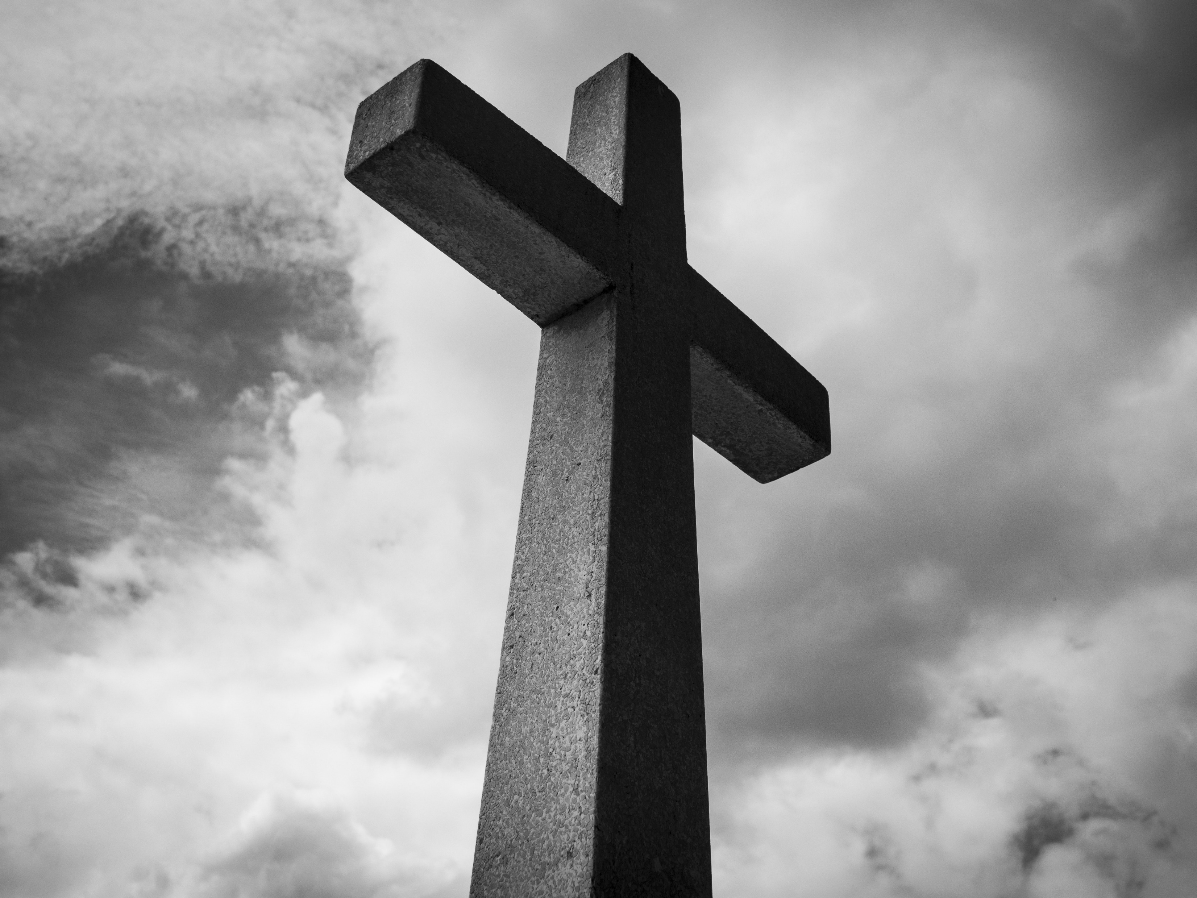
Are You Saved?

