Slide 1
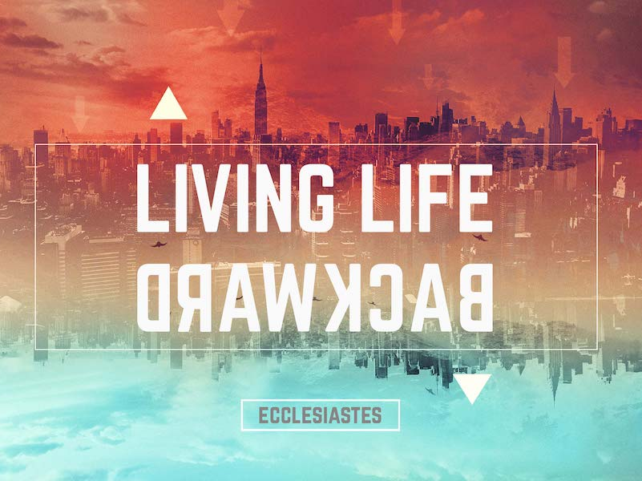
Churchofchristtucson.org

Slide 2
Living life backwards:
The Author:
King Solomon, The Preacher:
Internal facts about the author:
King in Jerusalem Eccl. 1:1
Son of David Eccl. 1:1
Great wisdom Eccl. 1:16
Great wealth Eccl. 2:4-9
Wrote many proverbs Eccl. 12:9
Corresponds with the external facts found elsewhere in Scripture. 1 Kings 3:7-14

Slide 3
Living life backwards:
Repeating Ideas:
“All is vanity” or “This is vanity” Eccl. 1:2, 14; 2:1; 7:6; 12:8
Vanity – Hebrew: Habel – Emptiness. Fig. something transitory and unsatisfactory. A.V. Vapor or breath.
Common Biblical idea: Psalm 39:5-6, 11 (Same word used); James 4:14 (N.T. idea)
“Under the Sun” Eccl. 1:3; 2:11; 8:9; 10:5
Not physical location but a philosophical viewpoint.

Slide 4
Living life backwards:
Repeating Ideas:
“Under the Sun” Eccl. 1:3; 2:11; 8:9; 10:5
Not physical location but a philosophical viewpoint.
“For as long as the earth last, in this period of time, this is how things are.” – David Gibson

Slide 5
Living life backwards:
The Purpose of Ecclesiastes:
The writer will show us reality. How life is unpredictable and uncontrollable.
And throughout the book we struggle to make sense of it all (just as we do in everyday life).
But life, and the book, make sense when we reach the end Ecclesiastes 12:9-14.
When we know the goal, the destination, then all the twist and turns, ups and downs of life are put in perspective.

Slide 6
Living life backwards:
What Does it Mean to Live Life Backwards?
Well, what does it mean to live life forward? Luke 12:16-21

Slide 7
“Left to our own devices, we tend to live life forward. One day follows another, and weeks turn into months, and months into years. We do not know the future, but we plan and hope and dream of where we will be, and what we would like to be doing, and whom we might be with. We live forward.”
-David Gibson, “Living Life Backwards” pg. 12

Slide 8
Living life backwards:
What Does it Mean to Live Life Backwards?
Well, what does it mean to live life forward? Luke 12:16-21
Ecclesiastes helps us to live backwards.
To acknowledge the one commonality among all living beings – death – and then live aware of that fact. Eccl. 1:3; 12:6-8
The book is God’s gift to help us live fully in the present.

