Slide 1
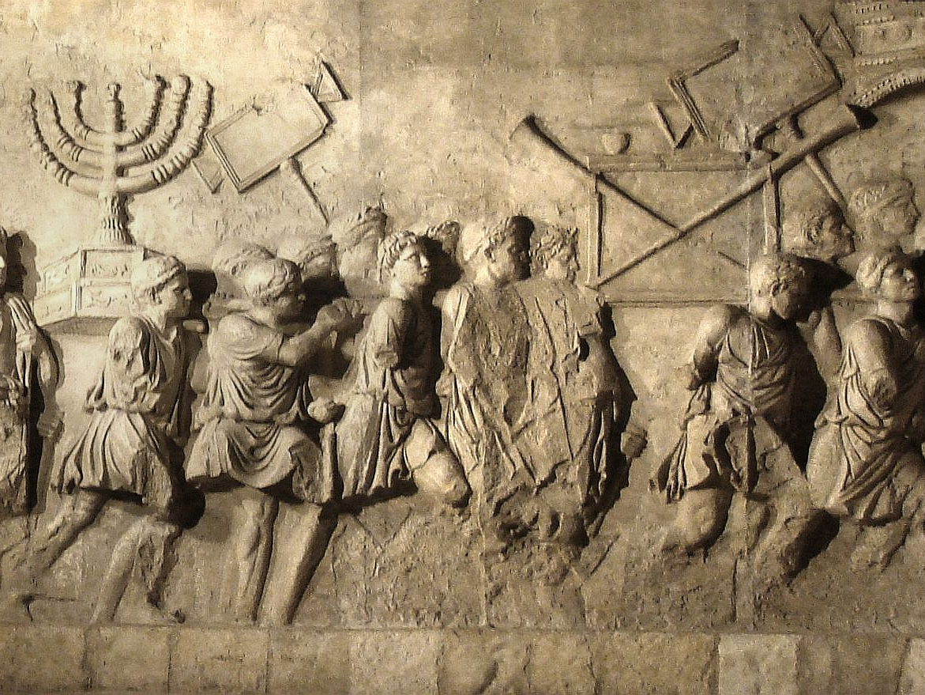
The Days of Matthew 24
Churchofchristtucson.org

Slide 2
The Days of Matthew 24:
The Context:
Matthew 21: Kingdom taken from the Jewish leaders (vv.43-45).
Matthew 23:29-39
Mistreated the prophets. v.34
This generation will not escape.
Upon them was the blood of the prophets. v.35
Upon that generation. v.36
Their house left desolate. v.38

Slide 3
The Days of Matthew 24:
The Timetable:
Matthew 24:34 “This generation.”
Setting for the discussion Matthew 24:1-3:
Look how great the temple is!
It’s going to be destroyed.
When is that going to happen?
Don’t misread the signs Matthew 24:4b-8

Slide 4
Matthew 24 is the answer Jesus gives to the disciples' question about the destruction of the temple and by extension Jerusalem.

Slide 5
The Days of Matthew 24:
The Destruction of Jerusalem:
The Gospel first must be preached Matthew 24:9-14 (Colossians 1:23)
The Abomination of Desolation Matthew 24:15-28 (Luke 21:20-21)
The Sign of Judgement Matthew 24:29-31 (Isaiah 13:6-11; Joel 2:28-32)
Will Happen to That Generation Matthew 24:32-35

