Slide 1
What Must I Do To Be Saved?
Churchofchristtucson.org

Slide 2
What Must I Do To Be Saved? Acts 16:25-34
The Question:
“what must...” Hebrews 11:7
“I do…” Acts 9:1-9
“to be saved.” Romans 3:23; 1 John 3:4

Slide 3
What Must I Do To Be Saved? Acts 16:25-34
The Answer:
“Believe in the Lord Jesus, and you will be saved.” Romans 10:14, 17; Acts 17:2-4, 11
“And they spoke the word of the Lord to him.” 1 Corinthians 15:1-6
“And he washed their wounds.”
“Immediately was baptized.” Acts 2:36-38, 41; 22:12-16

Slide 4
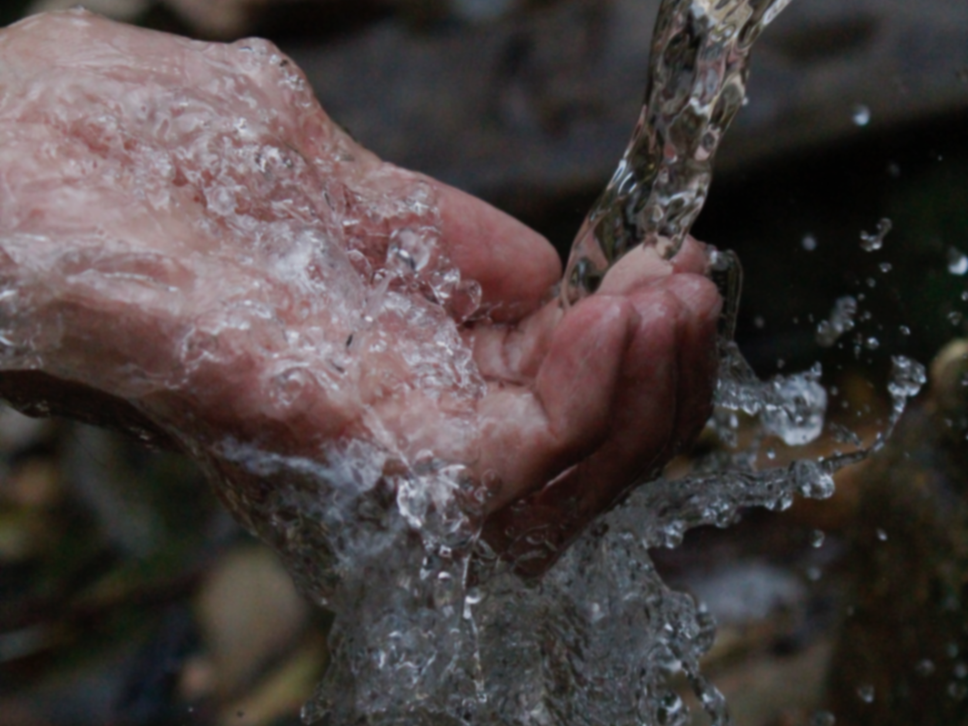
Blessed is the one whose transgression is forgiven; whose sin is covered.
Psalm 32:1

