Slide 1

Pressing on to the goal
Churchofchristtucson.org

Slide 2

“I press on toward the goal for the prize of the upward call of God in Christ Jesus.”
Philippians 3:14

Slide 3
Pressing on to the goal:
Philippians 3:14
Can I Make It?
  Consider Joshua’s warning Joshua 24:19
  Consider the Lord’s warning Luke 14:27-30
  The short answer is yes!

Slide 4
Pressing on to the goal:
Philippians 3:14
The Tools God Has Given Us:
  The Bible. (Deut. 29:29; Eph. 3:4) 2 Timothy 3:16-17 ESV
  God hears our prayers. 1 John 5:14 (James 1:5; 1 Peter 5:7; Luke 22:40)
  Access to forgiveness. 1 John 1:5-10
  The church. Acts 2:47 (KJV)

Slide 5

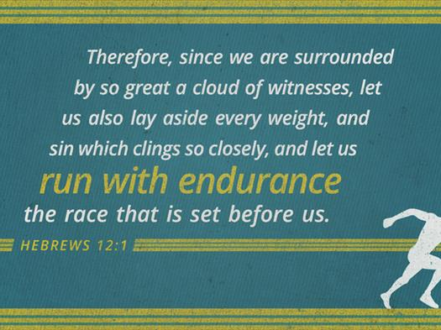

Slide 6
Pressing on to the goal:
Philippians 3:14
Three ways to run with endurance:
  Make the most of every opportunity: Hebrews 10:19-25; Ephesians 5:15; 1 Peter 5:9
  Do everything I can to grow: 1 Timothy 4:15-16
  Focus on Christ: Hebrews 12:1-2

Slide 7
What must I do to be saved? Acts 16:30
Believe in Jesus; John 8:24
  Repent of Sins; Luke 13:3; 5
    Confess our Faith in Christ; Matt. 10:32-33
      Be Baptized for the Remission Of Sins; Mark 16:16; Acts 2:38

