Slide 1
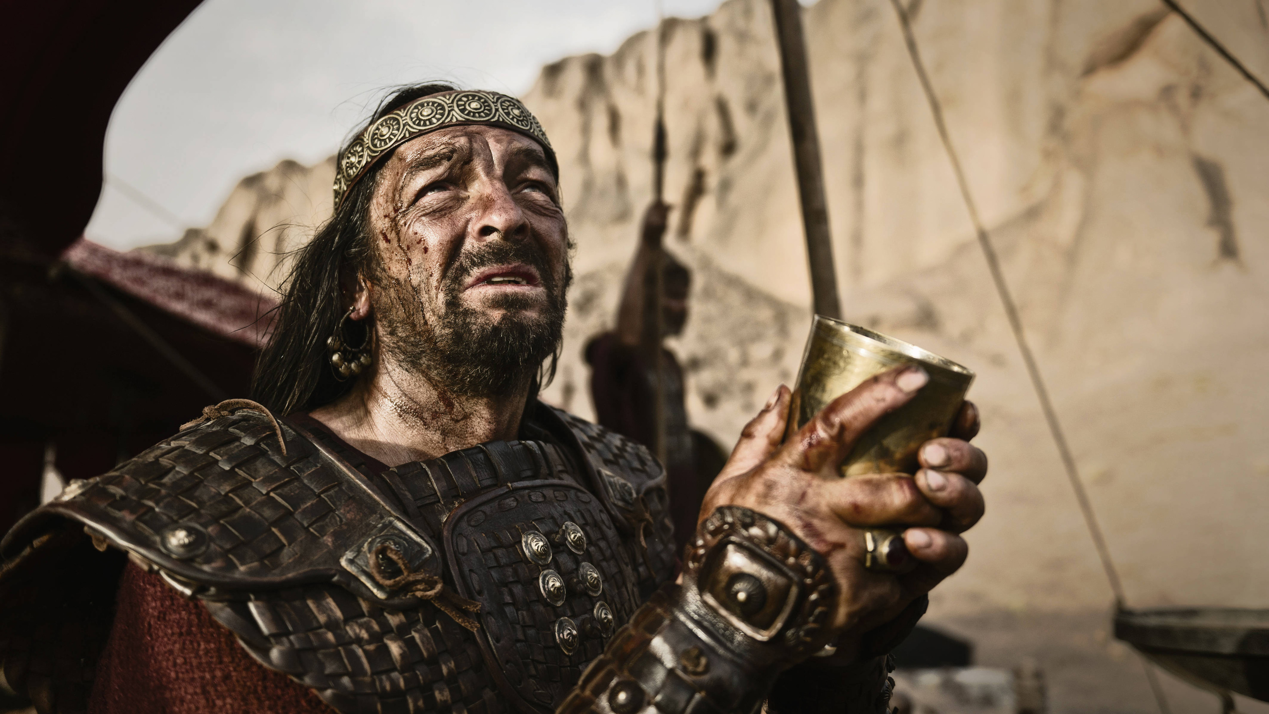
Did you obey?
Churchofchristtucson.org

Slide 2
Did you obey? 1 Samuel 15:1-22
The Setting:
The Amalekites Deuteronomy 25:17-19; [Judges 6:3]
Saul on Probation 1 Samuel 13:8-12, 14

Slide 3
Did you obey? 1 Samuel 15:1-22
The Order vv.1-3:
The Amalekites inequity is complete v.2 [Exodus 17:14]
Saul’s orders v.1
The simple command v.3

Slide 4
Did you obey? 1 Samuel 15:1-22
Saul’s Partial Obedience vv.5-11:
Agag captured alive
Partial obedience = full disobedience vv10-11
The consequences vv.24-31

Slide 5
Did you obey? 1 Samuel 15:1-22
To Obey is Better than Sacrifice vv.13-23:
Saul’s second reminder vv.13-19
Saul’s delusion vv.20-21
To obey is better vv.22-23

Slide 6
Did you obey? 1 Samuel 15:1-22
To Obey is Better than Sacrifice vv.13-23:
Why does God hate disobedience?
Shows misplaced fear v.24
Shows misplaced treasure v.19
Shows misplaced praise v.12 [1 Samuel 9:21]

Slide 7
Did you obey? 1 Samuel 15:1-22
To Obey is Better than Sacrifice vv.13-23:
The Blessings of Obedience:
God delights in obedience v.22
God’s commands are for our good Deuteronomy 10:12-13
His commands are not impossible 1 John 5:3

Slide 8
