Slide 1
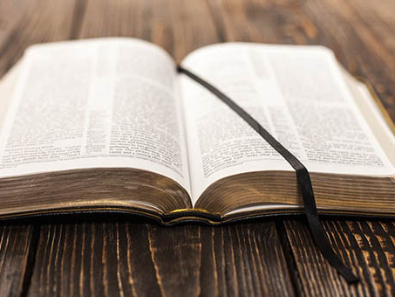
Great promises about prayer
Churchofchristtucson.org

Slide 2
Great promises about prayer:
God hears our prayers Ps.66:17-20; Matt. 6:9-15
God answers our prayers Matt. 7:7-11; 1 John 5:14-15
Our prayers are powerful Zeph. 3:17; Ps. 28:7; James 1:5-8

Slide 3
Great promises about prayer:
Our prayers are effective James 5:13-18
Our prayers are understood Romans 8:26-27

