Slide 1
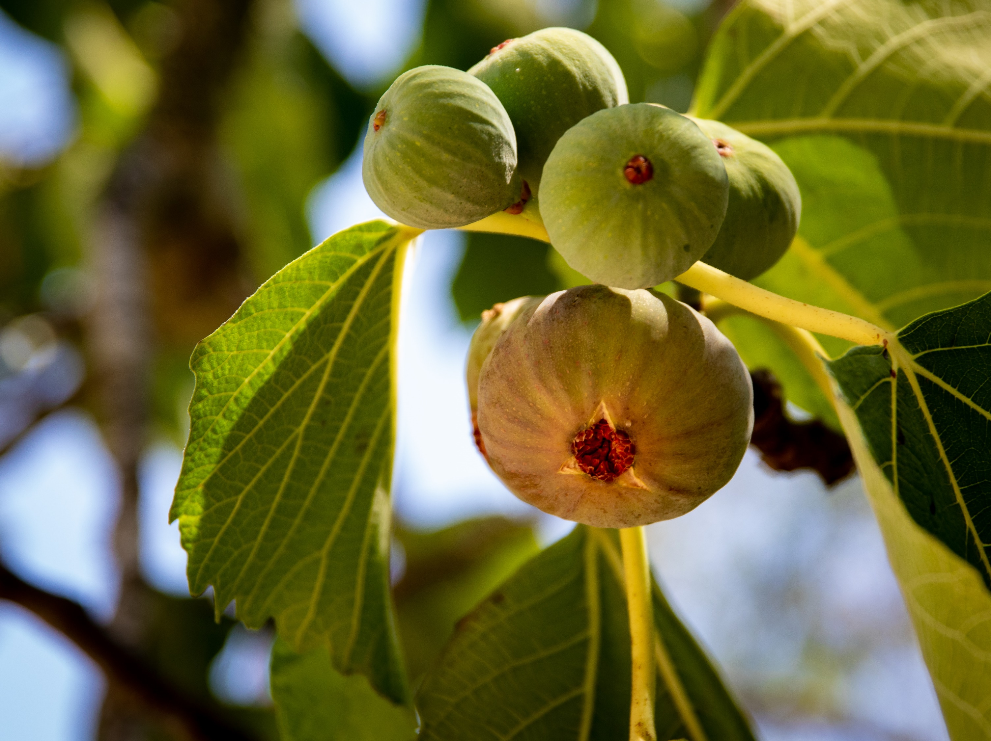
Cursing a fig tree
Churchofchristtucson.org

Slide 2
Cursing a fig tree Mark 11:11-21
Take a Look Around (Mark 11:11):
No Fruit (Mark 11:12-14):
The fig tree was used representatively of Israel in the Old Testament by God through the Prophets. Hosea 9:10
We are to connect the fig tree to the event that is to follow.

Slide 3
Cursing a fig tree Mark 11:11-21
Fruitless Religion (Mark 11:15-18):
This cleansing of the temple was a judgement from God and a foreshadow of further judgment (Mark 13).
What made their religion fruitless?
It was fruitless. Isaiah 5:1-7
It was irreverent. v.16
It was selfish. vv.17-18

Slide 4
Cursing a fig tree Mark 11:11-21
The Lessons of the Fig Tree:
I can be the “good-looking” fig tree.
If I have boiled down my relationship with Christ to a list of do’s and don’ts, then I am that fig tree with no fruit. Malachi 1:6-10
Bear fruit. John 15:8-10

