Slide 1
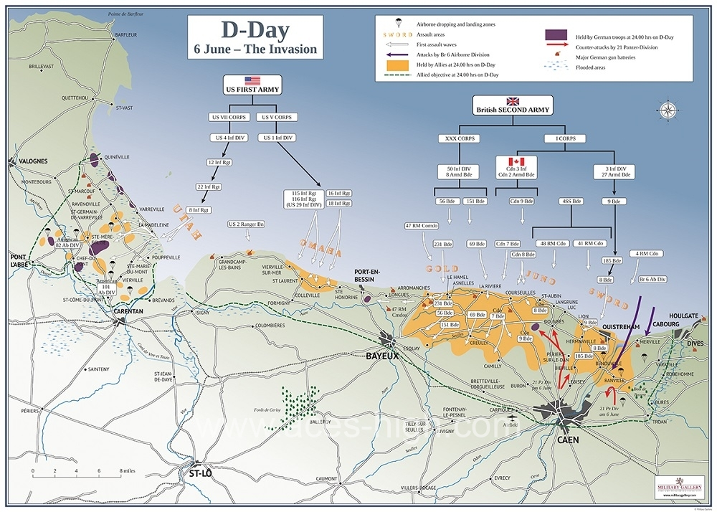
Battle tactics
Churchofchristtucson.org

Slide 2
Battle tactics
Before the battle:
Daily prayer. Eph. 6:18
Daily Sparring. Eph. 6:17; Ps. 119:11; 2 Cor. 10:3-5
Have a plan. Rom. 13:14

Slide 3
Battle tactics
In The trenches:
Fight big and little battles. Lk. 16:10; ex. 16:1-3; num. 11:1; Jam. 1:2-4
Resist quickly. Matt. 4
Fight one battle at a time. Jam. 1:13-15

Slide 4
Battle tactics
In The trenches:
Be decisive. Jam. 4:7
Call in reinforcements. 1 thess. 5:14

Slide 5
Battle tactics
After a battle:
Lear from the battle. 1 jn. 1:9; Matt. 5:29-30
Double down on your resolve. Prov. 24:16; Heb. 4:16

