Slide 1
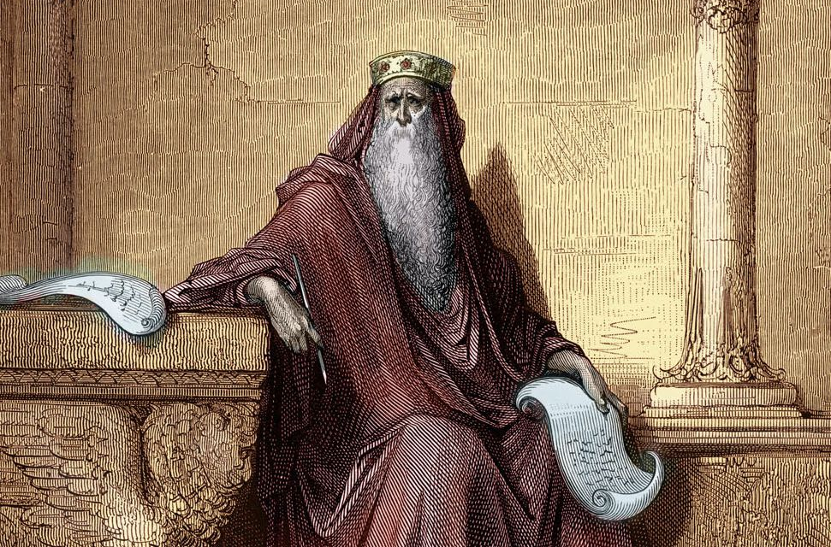
The Words of the Preacher
Churchofchristtucson.org

Slide 2
The Words of the Preacher: Eccl. 12:9-14
He Taught the People:
“And moreover, because the Preacher was wise, he still taught the people knowledge; yes, he pondered and sought out and set in order many proverbs” (Eccl. 12:9).
4 things we should walk away with from Ecclesiastes:

Slide 3
The Words of the Preacher: Eccl. 12:9-14
Pleasure:
“The Preacher sought to find delightful words and to write words of truth correctly” Eccl. 12:10 NASB ’95.
How does Ecclesiastes bring us pleasure or delight? Eccl. 5:1; Ps. 19:7-10; Eccl. 3:12-13

Slide 4
The Words of the Preacher: Eccl. 12:9-14
Pain:
Eccl. 12:11-12, “The words of the wise are like goads, and the words of scholars are like well-driven nails, given by one Shepherd. And further, my son, be admonished by these. Of making many books there is no end, and much study is wearisome to the flesh.”

Slide 5
The Words of the Preacher: Eccl. 12:9-14
Perspective:
“Let us hear the conclusion of the whole matter: Fear God and keep His commandments, for this is man’s all” Eccl. 12:13.
Prov. 9:10; Eccl. 1:8

Slide 6
The Words of the Preacher: Eccl. 12:9-14
Preparation:
Eccl. 12:14 “For God will bring every work into judgment, Including every secret thing, Whether good or evil.”

