Slide 2
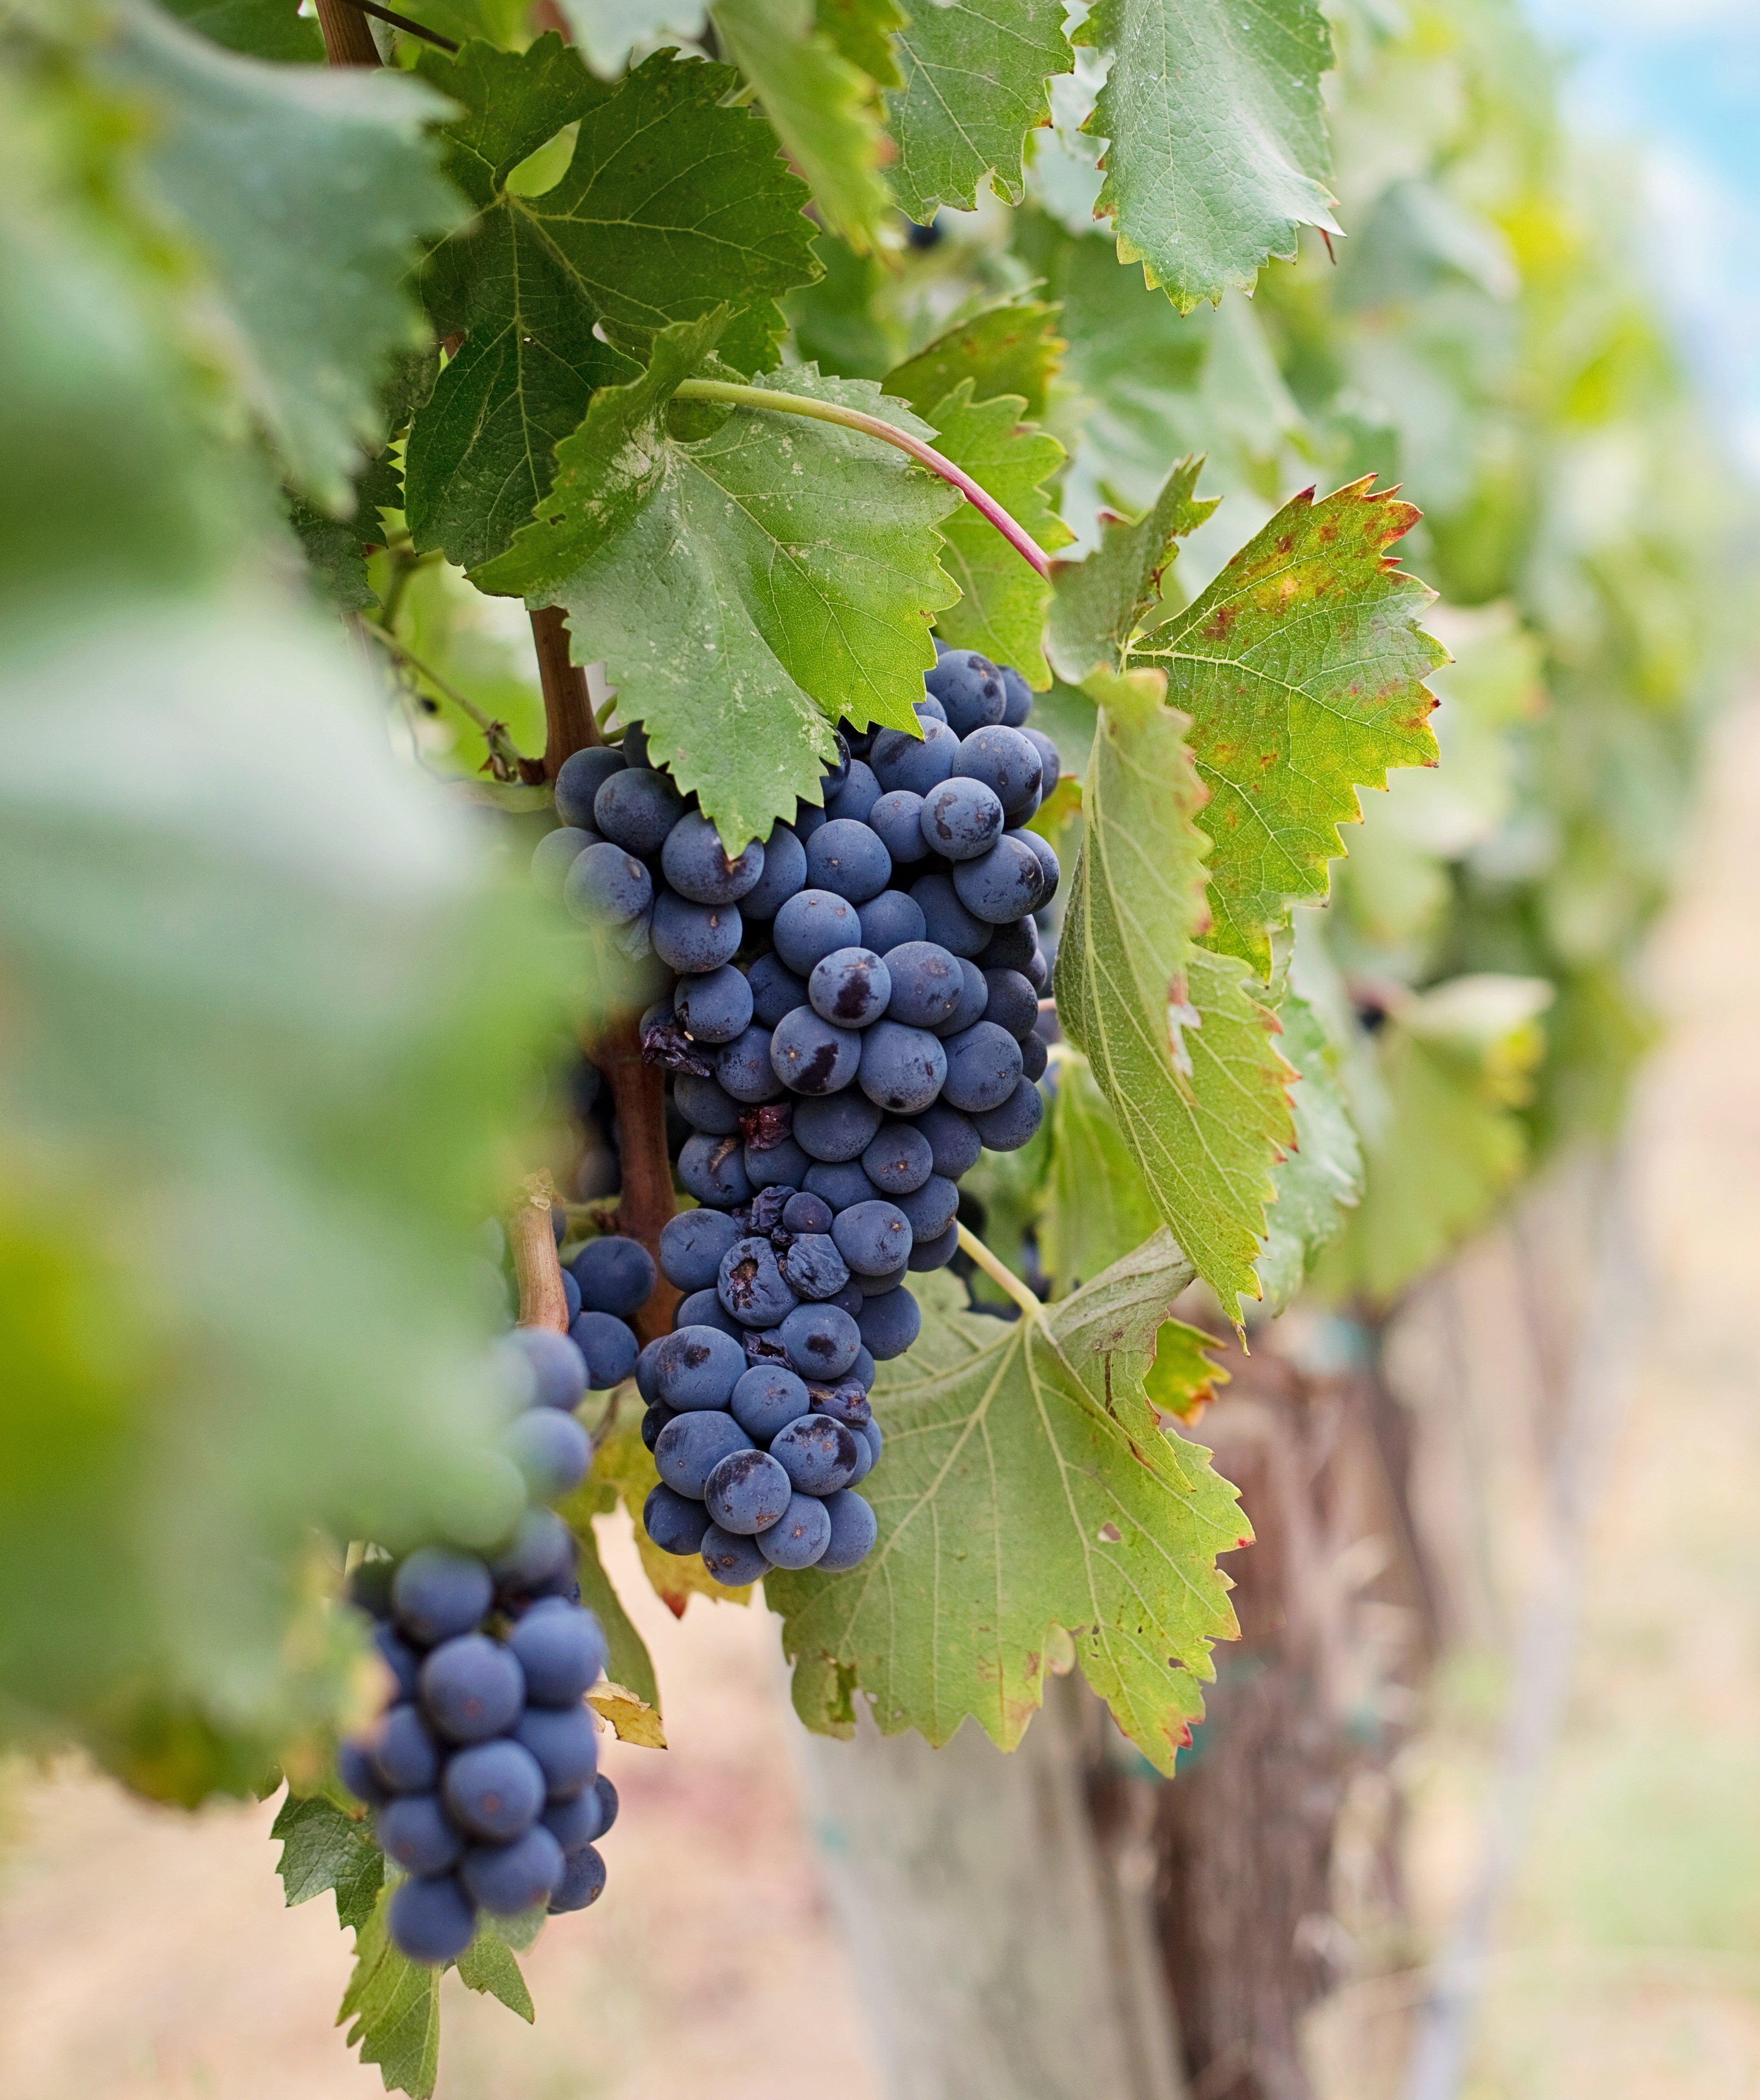
Five Secrets of Living

Slide 3
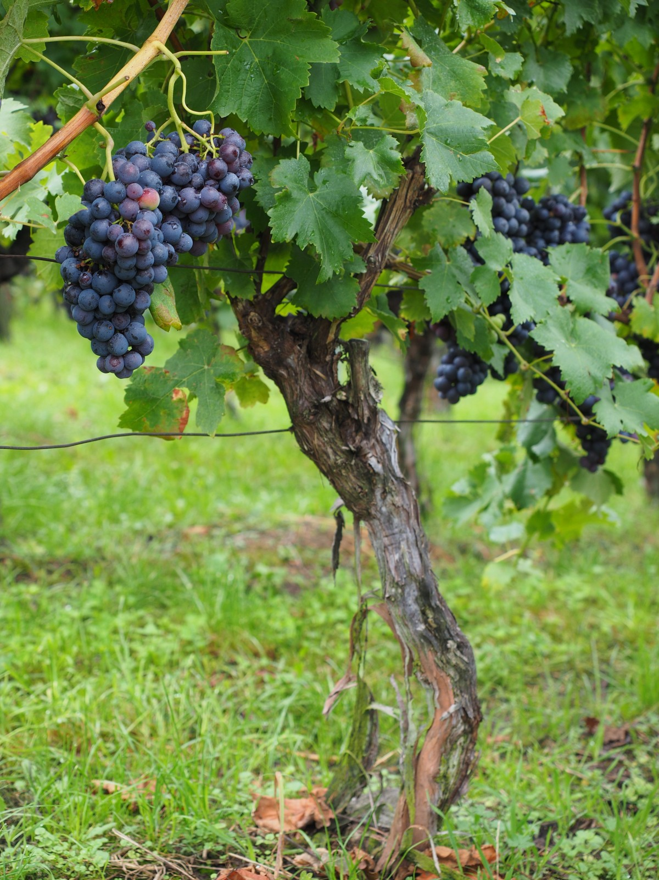
The Secret of Living is…..
John 15:1-17

Slide 4
Fruitbearing
Verses 2, 8, 16

Slide 5
We are the branches
z
We live to bear fruit
We can’t bear fruit if we’re not in the Vine
There are different fruits we bear

Slide 6
Kinds of fruit we bear
z
Salvation of souls
Holiness of life
Branches give to live and live to give
Praise and worship

Slide 7
Fruit is to increase

