Slide 1
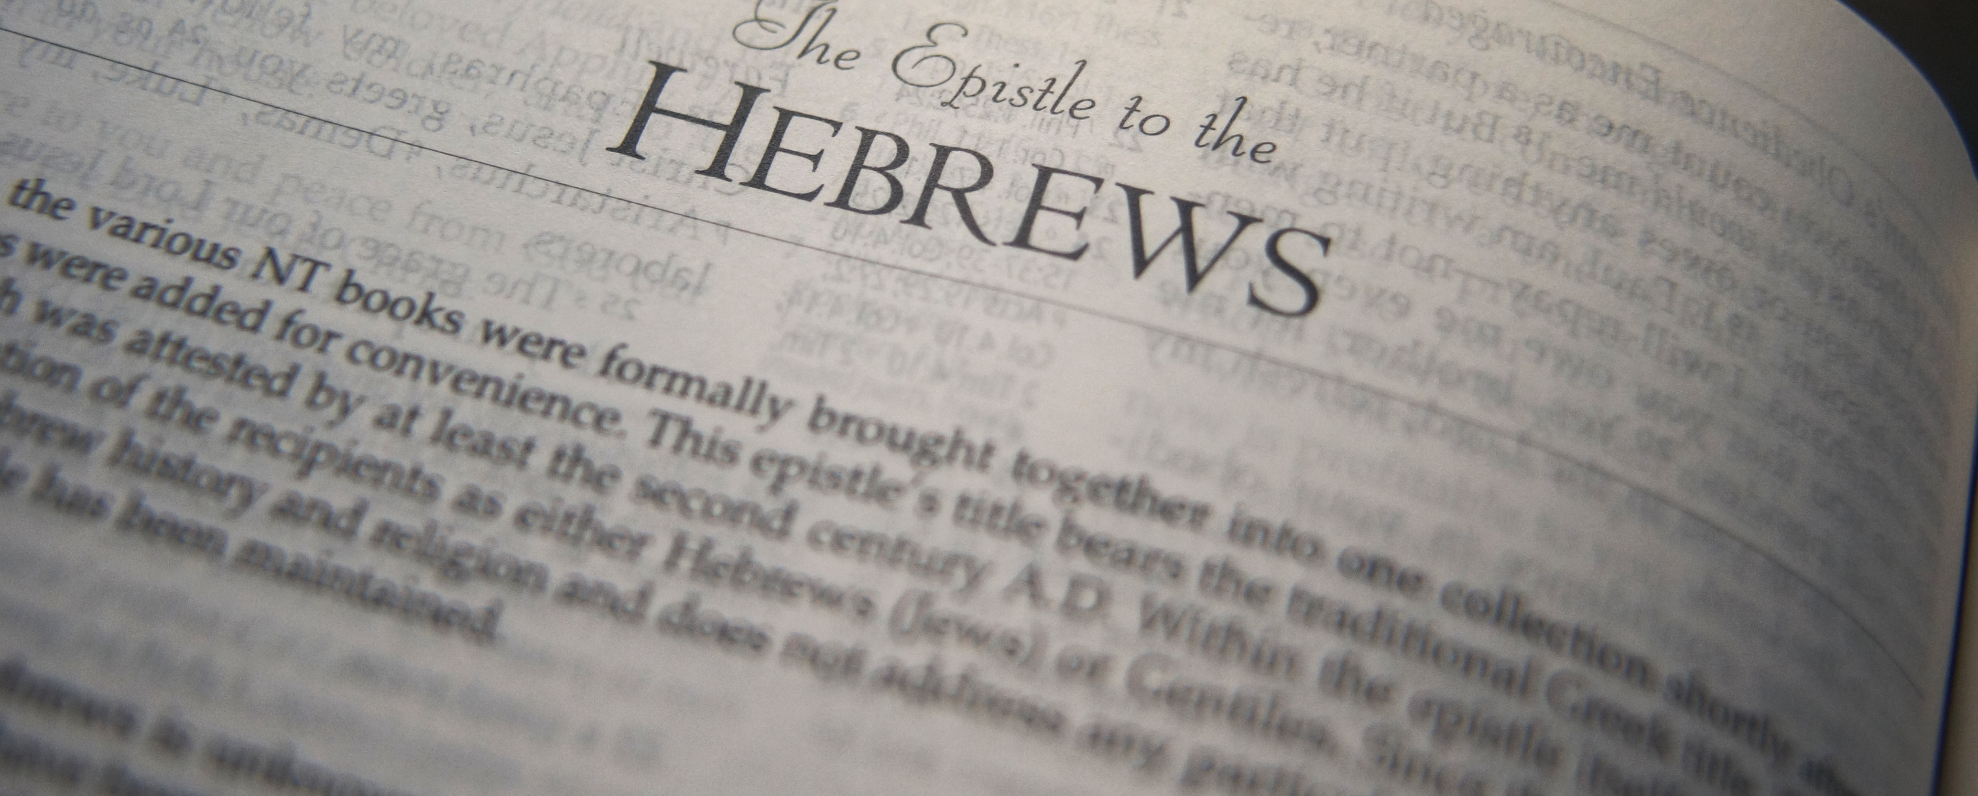
Saving Faith
Hebrews 10:39 – 11:8

Slide 2
What is faith?
Faith is belief, based on evidence, that results in trust. Hebrews 11:1
Substance – “confidence” NIV. “Being sure of” NET.
Evidence – “confidence” NASB ‘95.
Faith is not blind belief.
Faith is essential to be approved of by God. Heb. 11:2
Faith is how we understand things not seen. Heb. 11:3

Slide 3
How Does Faith Come?
We may understand the definition but, how does one “get” faith?
Faith is based on evidence and is related to knowledge. Heb. 11:1, 3
Saving faith comes from hearing the Word of God. Rom. 10:17; Heb. 11:7, 8 (cf. Gen. 12:1-3).

Slide 4
Why Is Faith Necessary?
Faith is 100% essential for salvation. Heb. 11:6
The ancients had it (Heb. 11:2), so what did they have?
They believed God existed (John 8:24).
They believed that He rewarded those who diligently sought Him.

Slide 5
How Is Faith Shown?
Here is how we can know we have a faith that saves:
Look at all the examples in Heb. 11:
Abel offered (Heb. 11:4)
Enoch walked with God (Heb. 11:5; Gen. 5:24)
Noah prepared an ark (Heb. 11:7)
Abraham obeyed (Heb. 11:8)
Saving faith is when I understand what God said and I trust, I act, on what He said.

