Slide 3
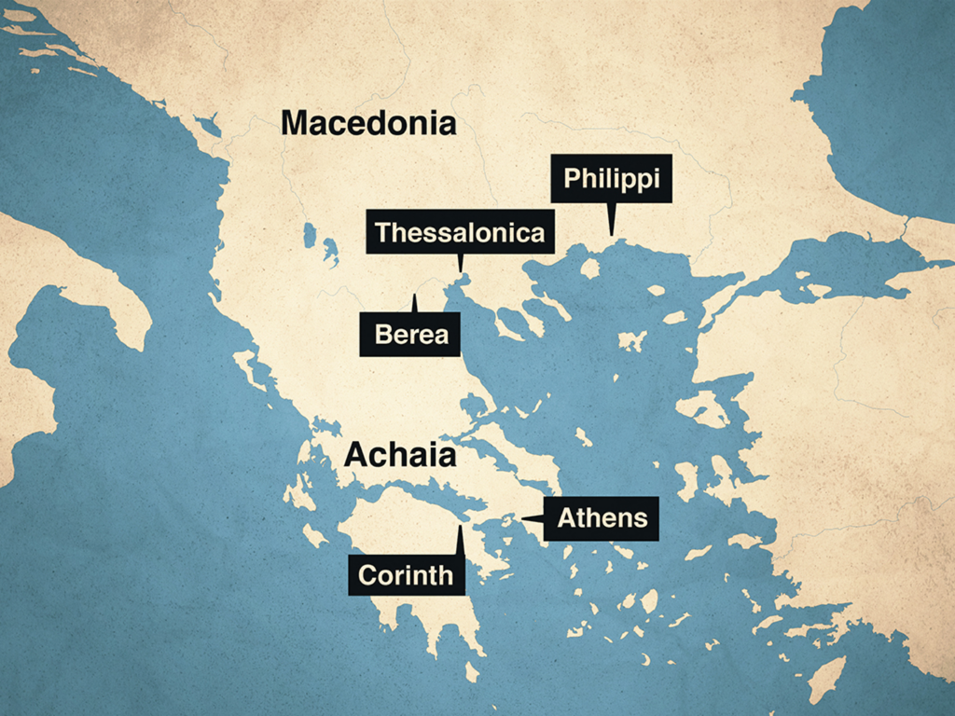

Slide 4
Faith, Love, Hope: 1 Thessalonians 1:1-3
The Thessalonians:
The city Thessalonica:
Capital of Macedonia.
Largely still self-governing.
Greek in culture.
Early center of the imperial cult.
Immensely affluent.

Slide 5
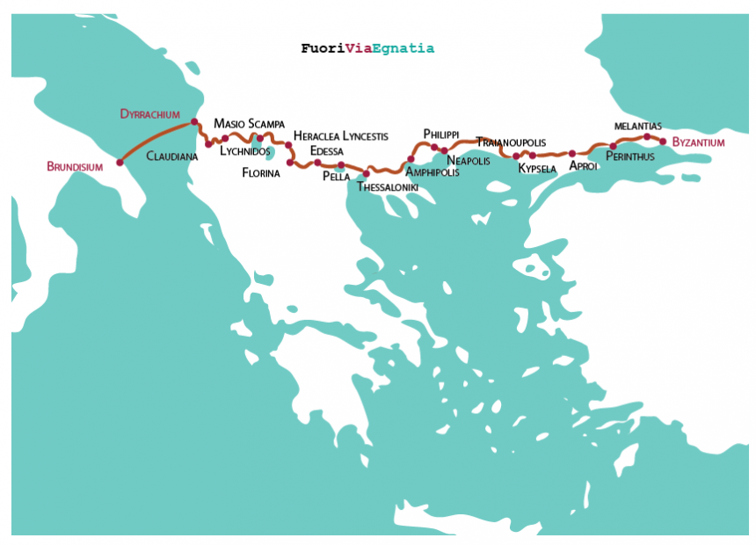

Slide 6
Faith, Love, Hope: 1 Thessalonians 1:1-3
The Thessalonians:
The church at Thessalonica (Acts 17:1-9).
Paul had to flee Philippi (Acts 16; 1 Thess. 2:2).
Preaches in the Synagogue (Acts 17:1-3).
The response (Acts 17:4-9).
Paul sent to Berea (Acts 17:10).

Slide 7
Faith, Love, Hope: 1 Thessalonians 1:1-3
We Give Thanks… (1 Thess. 1:1-3):
For your work of faith (v.3; Jas. 2:14ff).
For your labor of love (v.3; 1 Cor. 13; 1 Thess. 4:9-10).
For your steadfast hope (v.3)

Slide 8
What Is Your Need?
Salvation
Restoration
Needs
Believe
(John 8:24)
Repent
(Luke 13:3)
Confess
(Matthew 10:32-33)
Be Baptized
(Mark 16:16)
Repent
(Acts 8:22)
Confess
(1 John 1:9)
Pray
(Acts 8:22)
Prayer?
(James 5:16)
Membership?
(Acts 9:26)

