Slide 3
Growing As a Church: Ephesians 4:1-16
Walk in Love (Eph. 4:1-6):
“Therefore.”
“Walk… in love” vv.1-2.
“Making every effort” v.3.
Don’t forget what unites you vv.4-6.

Slide 4
Growing As a Church: Ephesians 4:1-16
Appreciate the Differences (Eph. 4:7-13):
Christ gave us each a gift vv.7-8 (Ps. 68:18).

Slide 5
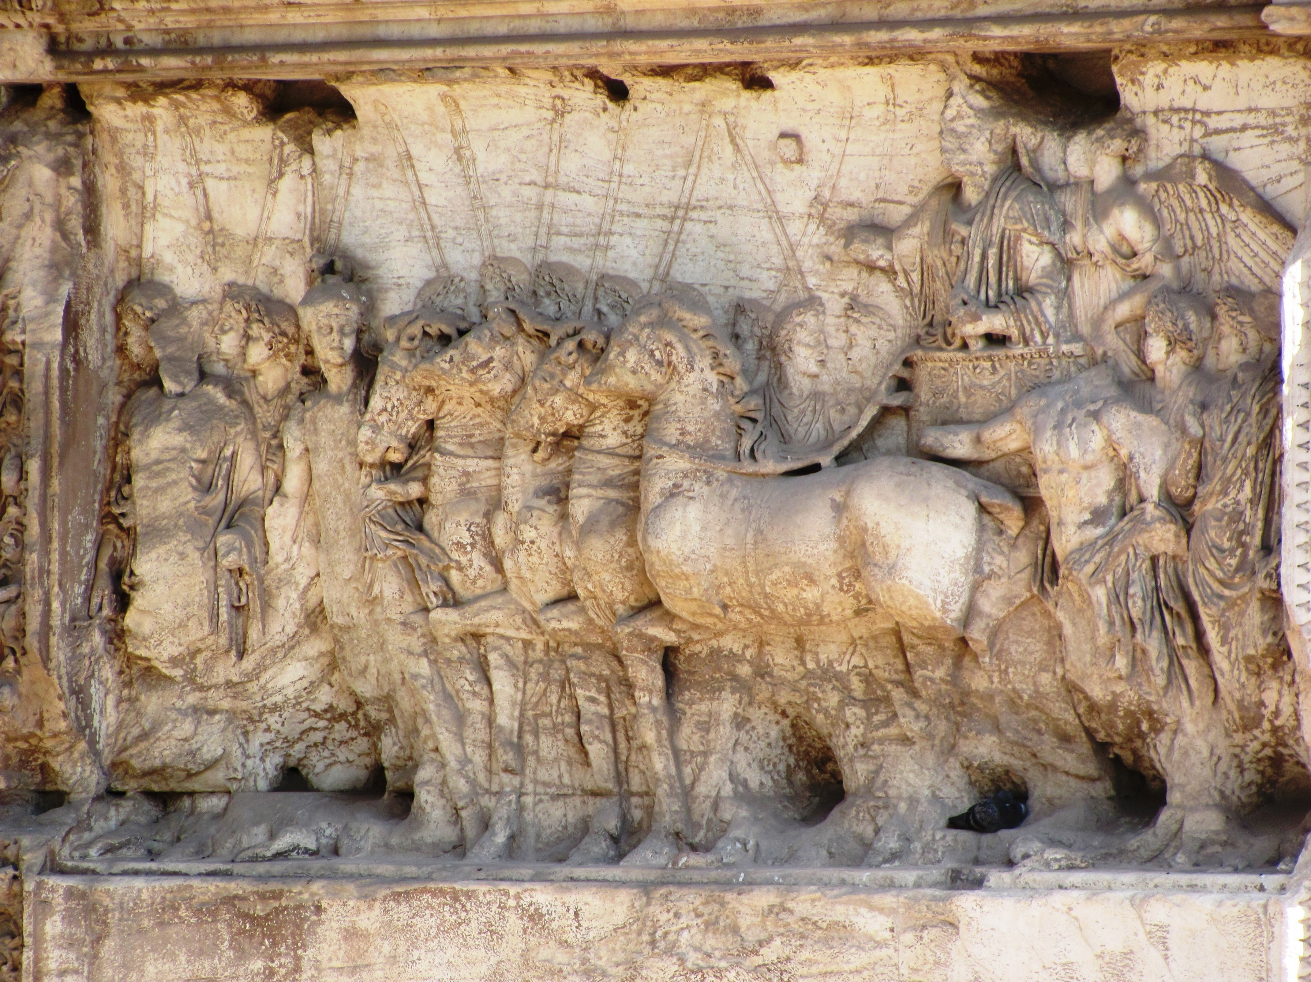

Slide 6
Growing As a Church: Ephesians 4:1-16
Appreciate the Differences (Eph. 4:7-13):
Christ gave us each a gift vv.7-8 (Ps. 68:18).
He gave teachers v.11 (cf. Rom. 12:3-8; 1 Cor. 12).
To equip everyone for service vv.11-13.

Slide 7
Growing As a Church: Ephesians 4:1-16
Grow As a Disciple (Eph. 4:14-15):
Time to grow up! v.14
How do we do this? v.15
The effect is seen in v.16.

Slide 8
What Is Your Need?
Salvation
Restoration
Needs
Believe
(John 8:24)
Repent
(Luke 13:3)
Confess
(Matthew 10:32-33)
Be Baptized
(Mark 16:16)
Repent
(Acts 8:22)
Confess
(1 John 1:9)
Pray
(Acts 8:22)
Prayer?
(James 5:16)
Membership?
(Acts 9:26)

