Slide 1
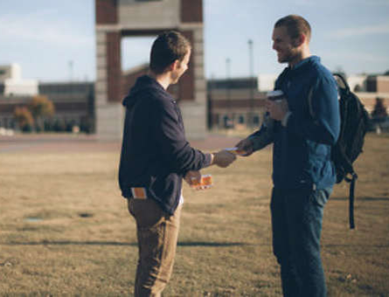
The Power of an invitation
Churchofchristtucson.org

Slide 2
The Power of an invitation Matt. 28:19-20
The state of evangelism:
47% of practicing Christian millennials, believe that evangelism is wrong.
“wrong to share one’s personal beliefs with someone of a different faith in hopes that they will one day share the same faith.”
Notes:
Practicing - churchgoers who consider religion an important part of their lives.

Slide 3
The Power of an invitation Matt. 28:19-20
The state of evangelism:
47% of practicing Christian millennials, believe that evangelism is wrong.
Not just people who don’t share their faith, but people who say it is wrong to do so.
Notes:
Practicing - churchgoers who consider religion an important part of their lives.

Slide 4
The Power of an invitation Matt. 28:19-20
The Power of Word of Mouth:
Evangelism is a command from Christ Matt. 28:18-20; Mark 16:15-16
John told and brought his brother John 1:40-42; 44-46
Christians went about telling the Good news Acts 8:1-4
Phillip answered a Bible question Acts 8:30-35
Notes:
We know it is something that Christ has commanded us to do.
But, being honest not all of us knows how and frankly some are terrified to do so.
All these examples, these people did what they knew how to do. Some brought their friend to the source, others just went out telling people, and others have the skills to teach.

Slide 5
The Power of an invitation Matt. 28:19-20
The Power of an Invitation:
“The churches that are growing, really all they’re doing is encouraging their people to invite their friends, its not any more rocket science than that…” – Carey Nieuwof
Notes:
Carey Nieuwof is a leader in church growth research.

Slide 6
The Power of an invitation Matt. 28:19-20
The Power of an Invitation:
“Churches that grow, grow because people who are in that church are excited about what’s happening and are inviting their friends…”
“They concluded that it’s important enough not only for me to come, but for me to invite my friends…”

Slide 7
The Power of an invitation Matt. 28:19-20
It Takes a Church:
To have edifying Bible classes. 1 Cor. 14:26
To have uplifting worship. Col. 3:16
To be a family of caring Christians. Heb. 13:1-2
To pray for lost souls and opportunities to teach. Ezekiel 36:37-38
Notes:
“a church functions best when everybody does their part. Elders shepherd, Deacons serve. The congregation at large worships and uses their access to a wide array of friends, neighbors, etc. to bring potential converts to the local evangelist whose job it is to teach the lost.” – Ryan Goodwin

Slide 8
The Power of an invitation Matt. 28:19-20
Need Buy In
We need to be sold on the work that is going on here at Country Club Road.
We need to be sold on what Christ offers! John 10:10; 6:68
We need to be sold on the power of the Gospel. Romans 1:16

Slide 9
The Power of an invitation Matt. 28:19-20
Way to get involved today:
Invitation cards.
Community Bible study.
Practicing hospitality.
Being 100% committed to the work.

