Slide 1
The Lord’s Day
Revelation 1:10

Slide 2
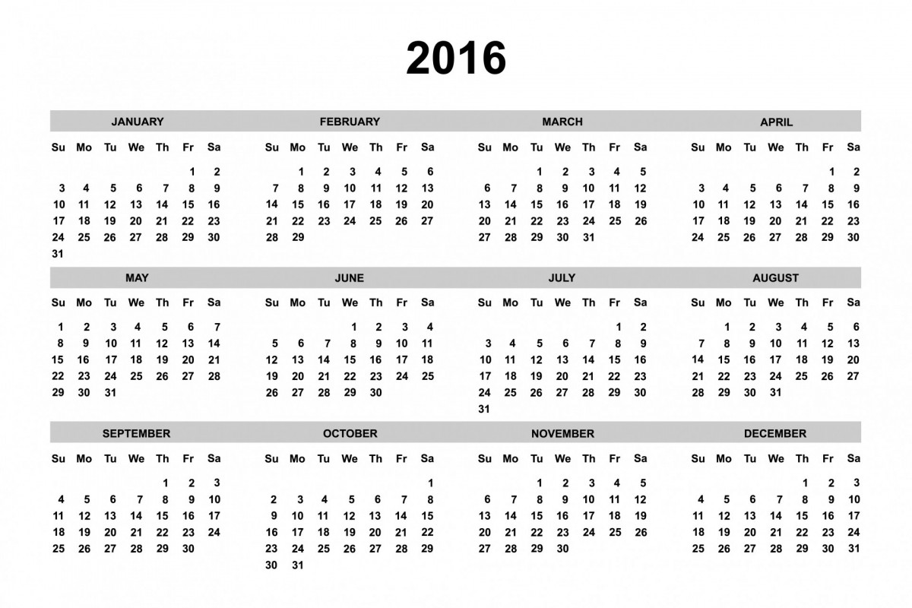
The Lord’s Day
Various festivals mentioned in Scripture Mt. 26:17; Jn. 7:2; Col. 2:16
Matt. 28:1; Mk. 16:9; Lk. 24:1 (v13, 21); Jn. 20:1
Acts 20:7
1 Cor. 16:2
WHEN?

Slide 3
Who has authority to create the Christian Calendar?
God
The Lord’s Day
Man
Advent
Lent
Palm Sunday
Easter
Feast of circumcision of Jesus
Elevation of the Holy Cross
Beheading of John
Matthew 28:18
Colossians 2:20-23

Slide 4
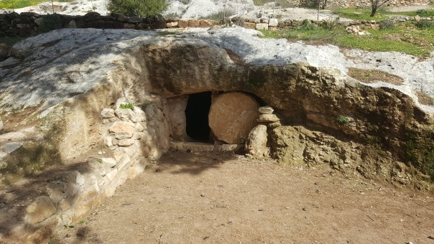
The Lord’s Day & Resurrection
Matt. 28:1; Mk. 16:9; Lk. 24:1 (v13, 21); Jn. 20:1
Acts 20:7
1 Cor. 16:2
WHY?

Slide 5
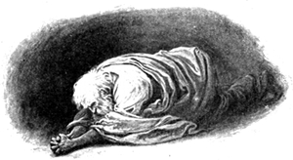
The Lord’s Day & Resurrection
Matt. 28:1; Mk. 16:9; Lk. 24:1 (v13, 21); Jn. 20:1
Acts 20:7
1 Cor. 16:2 (2 Cor. 9:7, 15)
HOW?

Slide 6
Do you believe Jesus, the Son of God, arose?
Will you repent and confess this faith?
Acts 2:38; Rom. 10:10
Or do you not know that as many of us as were baptized into Christ Jesus were baptized into His death? Therefore we were buried with Him through baptism into death, that just as Christ was raised from the dead by the glory of the Father, even so we also should walk in newness of life. (Romans 6:3-4 NKJV)
If then you were raised with Christ, . . . (Colossians 3:1 NKJV)

