Slide 1
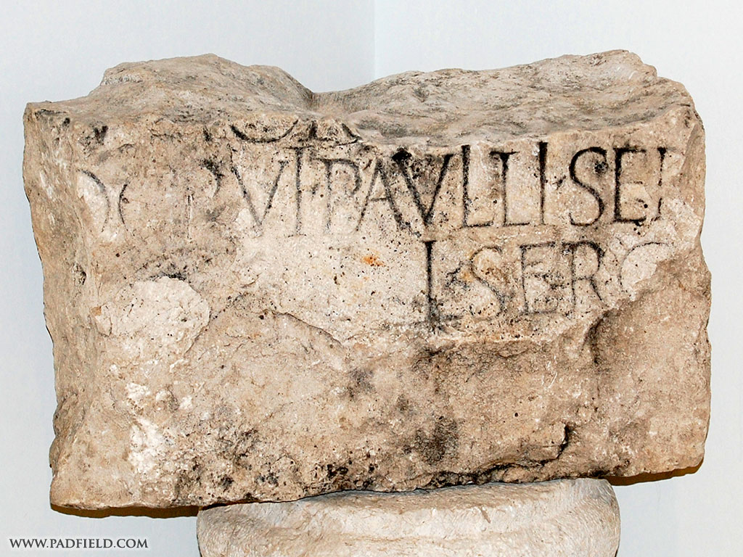
The faith of
Notes:
This inscription was found in Antioch of Pisidia and is housed at the Yalvac museum

Slide 2
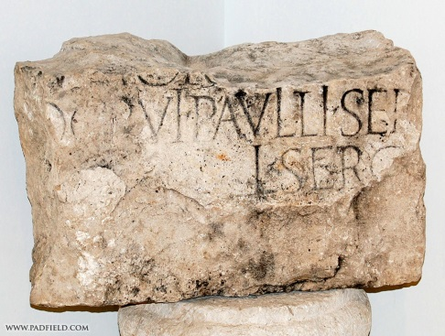
The faith of Sergius Paulus
Who?
. . .who was with the proconsul, Sergius Paulus, an intelligent man. (Acts 13:7 NKJV)

Slide 3
The faith of Sergius Paulus
Sought to hear--
This man called for Barnabas and Saul and sought to hear the word of God. (Acts 13:7 NKJV)
People seek to hear for many reasons Acts 17:19; Jn. 7:32; Acts 16:32; 10:24
Why did you initially seek to hear?
How can you give others an opportunity to hear?

Slide 4
The faith of Sergius Paulus
Interference of false religion
…they found a certain sorcerer, a false prophet, a Jew whose name was Bar-Jesus,… Elymas the sorcerer (for so his name is translated) withstood them, seeking to turn the proconsul away from the faith. (Acts 13:6, 8 NKJV)
Roman gods
Synagogue
Today

Slide 5
The faith of Sergius Paulus
Evidence for faith
Then Saul, who also is called Paul, filled with the Holy Spirit, looked intently at him and said, "O full of all deceit and all fraud, you son of the devil, you enemy of all righteousness, will you not cease perverting the straight ways of the Lord? And now, indeed, the hand of the Lord is upon you, and you shall be blind, not seeing the sun for a time." And immediately a dark mist fell on him, and he went around seeking someone to lead him by the hand. (Acts 13:9-11 NKJV)

Slide 6
The faith of Sergius Paulus
Evidence for faith
God’s record of history
Sergius Paulus
Paphos, Cyprus
proconsul
an intelligent man
Compare to man’s record of history

Slide 8
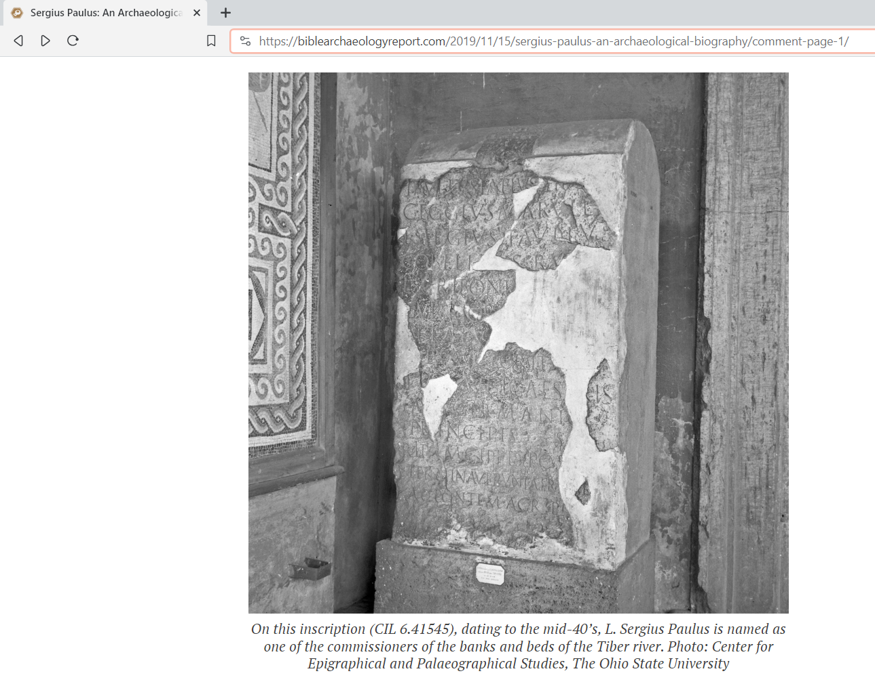

Slide 9
The faith of Sergius Paulus
Evidence for faith
God’s record of history
Sergius Paulus
Paphos, Cyprus
proconsul
an intelligent man
Compare to man’s record of history

Slide 10
The faith of Sergius Paulus
He believed
Then the proconsul believed, when he saw what had been done, being astonished at the teaching of the Lord. (Acts 13:12 NKJV)
Luke describes conversion in different ways Acts 2:41; 4:4a; 5:14; 6:7b
Luke’s point is Sergius Paulus then began to follow Jesus Acts 4:4, 32; 9:42; 10:45; 11:21; 13:48; 14:1, 23; 16:1

Slide 11
The faith of Sergius Paulus
He was astonished
Then the proconsul believed, when he saw what had been done, being astonished at the teaching of the Lord. (Acts 13:12 NKJV)
What astonished him?
What astonished you? Are you still astonished?

Slide 12
The faith of
Turn to Christ Acts 2:38; Rom. 10:10
Return to Christ Acts 8:22; 1 Jn. 1:9
Abide in Christ John 15:7

Slide 13
The faith of Sergius Paulus
What happened next?
But he who received the seed on stony places, this is he who hears the word and immediately receives it with joy; yet he has no root in himself, but endures only for a while. For when tribulation or persecution arises because of the word, immediately he stumbles. (Matthew 13:20-21 NKJV)

Slide 14
The faith of Sergius Paulus
What happened next?
Now he who received seed among the thorns is he who hears the word, and the cares of this world and the deceitfulness of riches choke the word, and he becomes unfruitful. (Matt. 13:22 NKJV)
But he who received seed on the good ground is he who hears the word and understands it, who indeed bears fruit and produces: some a hundredfold, some sixty, some thirty. (Matt. 13:23)

