Slide 1
1 Pet. 3:7 (NKJ)
Husbands, likewise, dwell with them with understanding, giving honor to the wife, as to the weaker vessel, and as being heirs together of the grace of life, that your prayers may not be hindered.
Notes:
I preached this lesson in Baytown at Pruett & Lobit the Sunday following the death of my grandpa, Clifford Bell

Slide 2
1 Pet. 3:7 (NKJ)
Husbands, likewise, dwell with them with understanding, giving honor to the wife, as to the weaker vessel, and as being heirs together of the grace of life, that your prayers may not be hindered.
Notes:
1 Pet. 3:7 says that husband and wife may be heirs together of the grace of life. Of course, to be an heir at all, one must be a child of God (Gal. 3:26-29).

Slide 3
Aquila and Priscilla: Heirs Together
Acts 18:1-3; 1 Pet. 3:7
Notes:
A/P may rightly be called such from what is recorded of them. Though the details of their life are few, what we have shows them to be exemplify as two who sought to be heirs together of ...

Slide 4
Aquila & Priscilla: Heirs Together
I. Working Together in Physical Things Acts 18:1-3
A. Communicate v3
1. Decision-making Eph. 5:23, 25
2. Changes of life v2; Gen. 2:23 (Eccl. 3)
B. Priorities Mt. 6:33; 13:22
Notes:
I. Working Together for Physical Things Acts 18:1-3
- for a home to be financially sound (not rich- healthy, stable) husband and wife must work together. $$ role in failed marriages no secret (#1 cause for divorce).
A. Communicate v3 could not succeed in work if fail to communicate.
1. Decision-making. tent-making has etc decisions to make, as does having a successful home. Being heirs together requires working together in phy/financial things:
budgeting money x,y,z; career decisions (who, what, where; giving to God
2. Sharing life v2 no doubt this is a stressful time, imagine if they can't talk about it? If Aquila doesn't listen or act interested, Priscilla is too busy. . .-- how heirs together??
Prov. 31:11, 29 why does he feel, say such? He knows v12-27 How? Each do “own thing”? He is attentive to her work, ask, listen- praise = part of being heirs together.

Slide 5
Aquila & Priscilla: Heirs Together
II. Working Together in Spiritual Things Acts 18:26
A. Present together v24-26
- why
- not at work
- nothing “fun” to do?
Notes:
II. Working Together for Spiritual Things Acts 18
- Priscilla is more than an interested bystander. She and Aquila's life in Acts indicates that they sought to be heirs together-- what shows such?
A. Present together v24-26 what does this tell us about A/P?
Why would a Christian be at a Jewish temple? To continue to learn the OT scriptures that were being taught, to seek private opportunities to teach the gospel, to speak when given the opportunity (Acts 13:15,16).
- not at work (take time off, using day off), not idle, not required to be here
- did they have “anything better to do”? They lived in Rome for a while, note the lifestyle to which they could have been accustomed to:

Slide 6
Ancient “Pastimes”
Seaside Villas
“Rowboats carrying folk on pleasure excursions move along. . . seaside cabins. . . in their architectural sprightliness much more imaginative and colorful than modern attempts at seashore colonies usually can claim to be. . .”
Notes:
Seaside Villas: “'Nothing in the world can rival the lovely bay of Baiae'. . . Rowboats carrying folk on pleasure excursions move along. . . seaside cabins. . . in their architectural sprightliness much more imaginative and colorful than modern attempts at seashore colonies usually can claim to be. . . they are inexpensive creations designed for the holiday use of a civilization in which great seaside hotels were completely unknown.”1
The Library: “The public library with its reading room, where books from the stacks could be consulted, was to be found not only in long cultured Greek cities and in Rome but even in remote towns of North Africa and Gaul. There is evidence, too, that the books could be borrowed and taken home.”
The Theatre: “The Roman actor's art is said to have reached its zenith in the first century B.C. During the last years of the Republic.”
Sport: “The ceremonies opening the amphitheater in A.D. 80 lasted for a hundred days of festivals, games, and displays to which flocked city dwellers, provincials, and foreigners” (= city-folk, red-necks, tourists)
Tepidarium: The Ancient 'Day-Resort' “No other civilization has ever evolved the conception of a building for public recreation, exercise and amusement even remotely comparable to the imperial Roman baths. The Baths of Caracalla in Rome included an area of more than 20acres, fitted with reading rooms, auditoria, running tracks, covered walks, and planted gardens. . . Often in auxiliary rooms, recitations, readings, lectures, and discussions invited attendance, and any citizen who had one cent to pay his admission to the bath could divert himself for an entire afternoon without quitting the premises.
Similar activities could have been found with ease in Corinth, a city well established in frivolity (church not involved in such!) and yet, where do we find A and P?
2. Listening together v26a
attentive to what was being said, demonstrating the Berean spirit Acts 17:11
able to discern truth from error, didn't allow “time to pass...” (Heb. 5:12) thus prior time was invested in learning. Time spent with Paul- talk about ?? v3. I need to make time to teach and be taught- Titus 2:2ff. Learn to make such times to “listen.”
3. Laboring together v26b
courage to approach Apollos (eloquent, mighty in scriptures, fervent, bold) v26b
-easier together? Eccl. 4:9-10, 12 What more could you and your spouse do for the Lord if you would do it together? Pray more if regularly did it together? Aware of needs of sick? Make time for shut-in? Prepare for class? Talk to family, not xian? Talk to xian in fam in sin? Are you “one” looking for the other? Before you “jump” at the chance to become “two”-- find someone who will help you in these things. If hard now to do these alone- imagine that you have mate who shows no interest in these? Two are better than one only if both are working toward same reward. Aquila – Priscilla-- heir together.
1Everyday Life in Ancient Times p332 (villa), 347 (library), 349 (theatre), 351 (sport), 334 (Tepidarium)

Slide 7
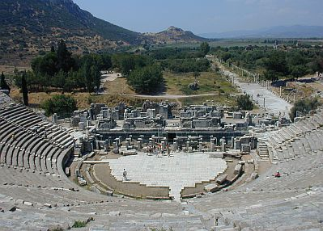
Ancient “Pastimes”
Theatre
Concerts, plays, religious, political and philosophical discussions and for gladiator and animal fights. [Acts 19:23-41]
www.ephesus.us/ephesus/the_great_theatre_of_ephesus.htm
Notes:
Seaside Villas: “'Nothing in the world can rival the lovely bay of Baiae'. . . Rowboats carrying folk on pleasure excursions move along. . . seaside cabins. . . in their architectural sprightliness much more imaginative and colorful than modern attempts at seashore colonies usually can claim to be. . . they are inexpensive creations designed for the holiday use of a civilization in which great seaside hotels were completely unknown.”1
The Library: “The public library with its reading room, where books from the stacks could be consulted, was to be found not only in long cultured Greek cities and in Rome but even in remote towns of North Africa and Gaul. There is evidence, too, that the books could be borrowed and taken home.”
The Theatre: “The Roman actor's art is said to have reached its zenith in the first century B.C. During the last years of the Republic.”
Sport: “The ceremonies opening the amphitheater in A.D. 80 lasted for a hundred days of festivals, games, and displays to which flocked city dwellers, provincials, and foreigners” (= city-folk, red-necks, tourists)
Tepidarium: The Ancient 'Day-Resort' “No other civilization has ever evolved the conception of a building for public recreation, exercise and amusement even remotely comparable to the imperial Roman baths. The Baths of Caracalla in Rome included an area of more than 20acres, fitted with reading rooms, auditoria, running tracks, covered walks, and planted gardens. . . Often in auxiliary rooms, recitations, readings, lectures, and discussions invited attendance, and any citizen who had one cent to pay his admission to the bath could divert himself for an entire afternoon without quitting the premises.
Similar activities could have been found with ease in Corinth, a city well established in frivolity (church not involved in such!) and yet, where do we find A and P?
2. Listening together v26a
attentive to what was being said, demonstrating the Berean spirit Acts 17:11
able to discern truth from error, didn't allow “time to pass...” (Heb. 5:12) thus prior time was invested in learning. Time spent with Paul- talk about ?? v3. I need to make time to teach and be taught- Titus 2:2ff. Learn to make such times to “listen.”
3. Laboring together v26b
courage to approach Apollos (eloquent, mighty in scriptures, fervent, bold) v26b
-easier together? Eccl. 4:9-10, 12 What more could you and your spouse do for the Lord if you would do it together? Pray more if regularly did it together? Aware of needs of sick? Make time for shut-in? Prepare for class? Talk to family, not xian? Talk to xian in fam in sin? Are you “one” looking for the other? Before you “jump” at the chance to become “two”-- find someone who will help you in these things. If hard now to do these alone- imagine that you have mate who shows no interest in these? Two are better than one only if both are working toward same reward. Aquila – Priscilla-- heir together.
1Everyday Life in Ancient Times p332 (villa), 347 (library), 349 (theatre), 351 (sport), 334 (Tepidarium)

Slide 8
Ancient “Pastimes”
Library
“The public library with its reading room, where books from the stacks could be consulted, was to be found not only in long cultured Greek cities and in Rome but even in remote towns of North Africa and Gaul. There is evidence, too, that the books could be borrowed and taken home.”
Notes:
Seaside Villas: “'Nothing in the world can rival the lovely bay of Baiae'. . . Rowboats carrying folk on pleasure excursions move along. . . seaside cabins. . . in their architectural sprightliness much more imaginative and colorful than modern attempts at seashore colonies usually can claim to be. . . they are inexpensive creations designed for the holiday use of a civilization in which great seaside hotels were completely unknown.”1
The Library: “The public library with its reading room, where books from the stacks could be consulted, was to be found not only in long cultured Greek cities and in Rome but even in remote towns of North Africa and Gaul. There is evidence, too, that the books could be borrowed and taken home.”
The Theatre: “The Roman actor's art is said to have reached its zenith in the first century B.C. During the last years of the Republic.”
Sport: “The ceremonies opening the amphitheater in A.D. 80 lasted for a hundred days of festivals, games, and displays to which flocked city dwellers, provincials, and foreigners” (= city-folk, red-necks, tourists)
Tepidarium: The Ancient 'Day-Resort' “No other civilization has ever evolved the conception of a building for public recreation, exercise and amusement even remotely comparable to the imperial Roman baths. The Baths of Caracalla in Rome included an area of more than 20acres, fitted with reading rooms, auditoria, running tracks, covered walks, and planted gardens. . . Often in auxiliary rooms, recitations, readings, lectures, and discussions invited attendance, and any citizen who had one cent to pay his admission to the bath could divert himself for an entire afternoon without quitting the premises.
Similar activities could have been found with ease in Corinth, a city well established in frivolity (church not involved in such!) and yet, where do we find A and P?
2. Listening together v26a
attentive to what was being said, demonstrating the Berean spirit Acts 17:11
able to discern truth from error, didn't allow “time to pass...” (Heb. 5:12) thus prior time was invested in learning. Time spent with Paul- talk about ?? v3. I need to make time to teach and be taught- Titus 2:2ff. Learn to make such times to “listen.”
3. Laboring together v26b
courage to approach Apollos (eloquent, mighty in scriptures, fervent, bold) v26b
-easier together? Eccl. 4:9-10, 12 What more could you and your spouse do for the Lord if you would do it together? Pray more if regularly did it together? Aware of needs of sick? Make time for shut-in? Prepare for class? Talk to family, not xian? Talk to xian in fam in sin? Are you “one” looking for the other? Before you “jump” at the chance to become “two”-- find someone who will help you in these things. If hard now to do these alone- imagine that you have mate who shows no interest in these? Two are better than one only if both are working toward same reward. Aquila – Priscilla-- heir together.
1Everyday Life in Ancient Times p332 (villa), 347 (library), 349 (theatre), 351 (sport), 334 (Tepidarium)

Slide 9
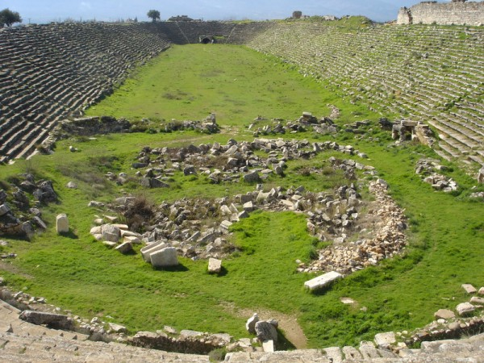
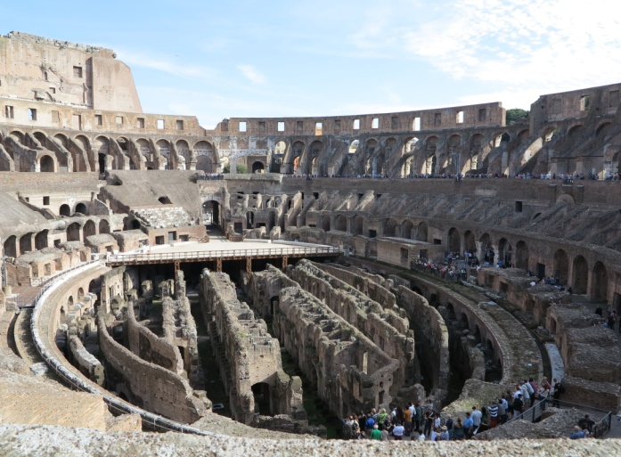
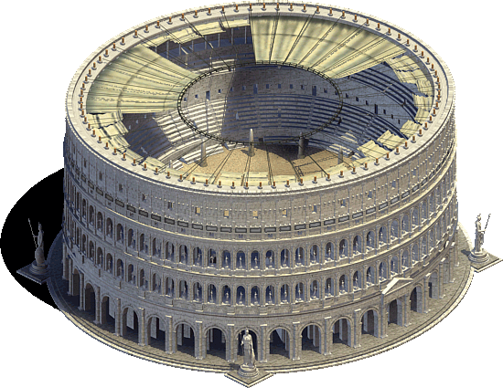
Ancient “Pastimes”
Sports
“The ceremonies opening the amphitheater in A.D. 80 lasted for a hundred days of festivals, games, and displays to which flocked city dwellers, provincials, and foreigners”
http://revtravel.com/international-travel/turkey-international-travel/want-greek-ruins-go-to-turkey/
Notes:
Seaside Villas: “'Nothing in the world can rival the lovely bay of Baiae'. . . Rowboats carrying folk on pleasure excursions move along. . . seaside cabins. . . in their architectural sprightliness much more imaginative and colorful than modern attempts at seashore colonies usually can claim to be. . . they are inexpensive creations designed for the holiday use of a civilization in which great seaside hotels were completely unknown.”1
The Library: “The public library with its reading room, where books from the stacks could be consulted, was to be found not only in long cultured Greek cities and in Rome but even in remote towns of North Africa and Gaul. There is evidence, too, that the books could be borrowed and taken home.”
The Theatre: “The Roman actor's art is said to have reached its zenith in the first century B.C. During the last years of the Republic.”
Sport: “The ceremonies opening the amphitheater in A.D. 80 lasted for a hundred days of festivals, games, and displays to which flocked city dwellers, provincials, and foreigners” (= city-folk, red-necks, tourists)
Tepidarium: The Ancient 'Day-Resort' “No other civilization has ever evolved the conception of a building for public recreation, exercise and amusement even remotely comparable to the imperial Roman baths. The Baths of Caracalla in Rome included an area of more than 20acres, fitted with reading rooms, auditoria, running tracks, covered walks, and planted gardens. . . Often in auxiliary rooms, recitations, readings, lectures, and discussions invited attendance, and any citizen who had one cent to pay his admission to the bath could divert himself for an entire afternoon without quitting the premises.
Similar activities could have been found with ease in Corinth, a city well established in frivolity (church not involved in such!) and yet, where do we find A and P?
2. Listening together v26a
attentive to what was being said, demonstrating the Berean spirit Acts 17:11
able to discern truth from error, didn't allow “time to pass...” (Heb. 5:12) thus prior time was invested in learning. Time spent with Paul- talk about ?? v3. I need to make time to teach and be taught- Titus 2:2ff. Learn to make such times to “listen.”
3. Laboring together v26b
courage to approach Apollos (eloquent, mighty in scriptures, fervent, bold) v26b
-easier together? Eccl. 4:9-10, 12 What more could you and your spouse do for the Lord if you would do it together? Pray more if regularly did it together? Aware of needs of sick? Make time for shut-in? Prepare for class? Talk to family, not xian? Talk to xian in fam in sin? Are you “one” looking for the other? Before you “jump” at the chance to become “two”-- find someone who will help you in these things. If hard now to do these alone- imagine that you have mate who shows no interest in these? Two are better than one only if both are working toward same reward. Aquila – Priscilla-- heir together.
1Everyday Life in Ancient Times p332 (villa), 347 (library), 349 (theatre), 351 (sport), 334 (Tepidarium)

Slide 10
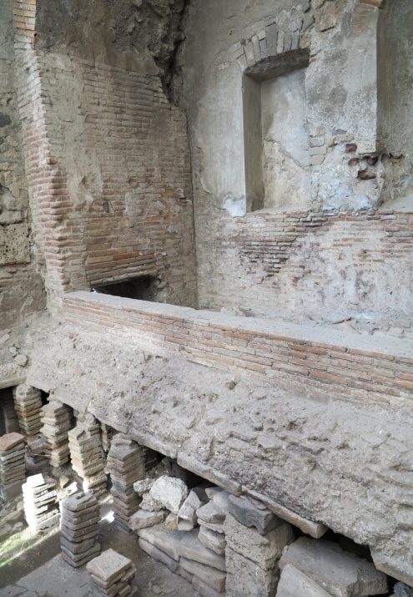
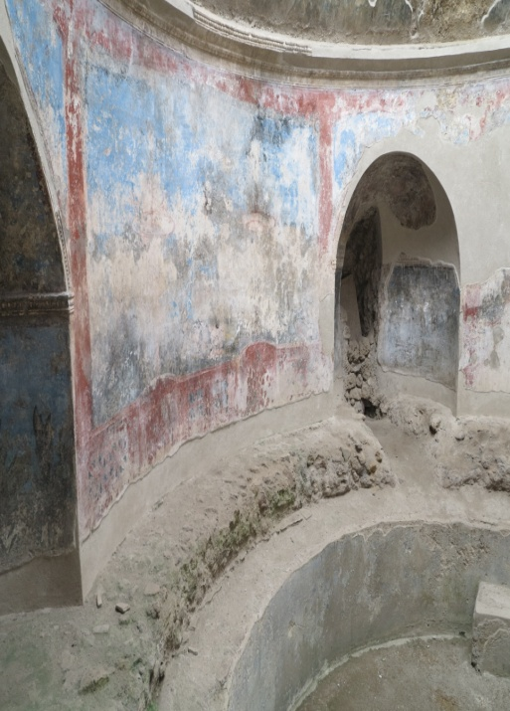
Ancient “Pastimes”
Resorts (Tepidarium)
“The Baths of Caracalla in Rome included an area of more than 20 acres, fitted with reading rooms, auditoria, running tracks, covered walks, and planted gardens. . .
Where are Aquila and Priscilla?
Notes:
Seaside Villas: “'Nothing in the world can rival the lovely bay of Baiae'. . . Rowboats carrying folk on pleasure excursions move along. . . seaside cabins. . . in their architectural sprightliness much more imaginative and colorful than modern attempts at seashore colonies usually can claim to be. . . they are inexpensive creations designed for the holiday use of a civilization in which great seaside hotels were completely unknown.”1
The Library: “The public library with its reading room, where books from the stacks could be consulted, was to be found not only in long cultured Greek cities and in Rome but even in remote towns of North Africa and Gaul. There is evidence, too, that the books could be borrowed and taken home.”
The Theatre: “The Roman actor's art is said to have reached its zenith in the first century B.C. During the last years of the Republic.”
Sport: “The ceremonies opening the amphitheater in A.D. 80 lasted for a hundred days of festivals, games, and displays to which flocked city dwellers, provincials, and foreigners” (= city-folk, red-necks, tourists)
Tepidarium: The Ancient 'Day-Resort' “No other civilization has ever evolved the conception of a building for public recreation, exercise and amusement even remotely comparable to the imperial Roman baths. The Baths of Caracalla in Rome included an area of more than 20acres, fitted with reading rooms, auditoria, running tracks, covered walks, and planted gardens. . . Often in auxiliary rooms, recitations, readings, lectures, and discussions invited attendance, and any citizen who had one cent to pay his admission to the bath could divert himself for an entire afternoon without quitting the premises.
Similar activities could have been found with ease in Corinth, a city well established in frivolity (church not involved in such!) and yet, where do we find A and P?
2. Listening together v26a
attentive to what was being said, demonstrating the Berean spirit Acts 17:11
able to discern truth from error, didn't allow “time to pass...” (Heb. 5:12) thus prior time was invested in learning. Time spent with Paul- talk about ?? v3. I need to make time to teach and be taught- Titus 2:2ff. Learn to make such times to “listen.”
3. Laboring together v26b
courage to approach Apollos (eloquent, mighty in scriptures, fervent, bold) v26b
-easier together? Eccl. 4:9-10, 12 What more could you and your spouse do for the Lord if you would do it together? Pray more if regularly did it together? Aware of needs of sick? Make time for shut-in? Prepare for class? Talk to family, not xian? Talk to xian in fam in sin? Are you “one” looking for the other? Before you “jump” at the chance to become “two”-- find someone who will help you in these things. If hard now to do these alone- imagine that you have mate who shows no interest in these? Two are better than one only if both are working toward same reward. Aquila – Priscilla-- heir together.
1Everyday Life in Ancient Times p332 (villa), 347 (library), 349 (theatre), 351 (sport), 334 (Tepidarium)

Slide 11
Aquila & Priscilla: Heirs Together
II. Working Together in Spiritual Things Acts 18:26
A. Present together v24-26
B. Listening together v26 (Acts 17:11; Heb. 5:14)
C. Laboring together v26; Eccl. 4:9-10,12
Notes:
B. Listening together v26a
attentive to what was being said, demonstrating the Berean spirit Acts 17:11
able to discern truth from error, didn't allow “time to pass...” (Heb. 5:12) thus prior time was invested in learning. Time spent with Paul- talk about ?? v3. I need to make time to teach and be taught- Titus 2:2ff. Learn to make such times to “listen.”
C. Laboring together v26b
courage to approach Apollos (eloquent, mighty in scriptures, fervent, bold) v26b
-easier together? Eccl. 4:9-10, 12 What more could you and your spouse do for the Lord if you would do it together? Pray more if regularly did it together? Aware of needs of sick? Make time for shut-in? Prepare for class? Talk to family, not xian? Talk to xian in fam in sin? Are you “one” looking for the other? Before you “jump” at the chance to become “two”-- find someone who will help you in these things. If hard now to do these alone- imagine that you have mate who shows no interest in these? Two are better than one only if both are working toward same reward. Aquila – Priscilla-- heir together.

Slide 12
Aquila & Priscilla: Heirs Together
III. Hospitality Acts 18:3; Rom. 16:5
A. Imposes on our:
1. Privacy Mt. 14:12ff
2. Time Eph. 5:16
3. Energy
And remember the words of the Lord Jesus, that He said, “It is more blessed to give than to receive." (Acts 20:35 NKJV)
Notes:
III. Hospitality (heir together-- hospitality, etc expressions of love).
A. Imposes on our:
Privacy
“I don't like people coming inside my home.” Prefer not to have privacy interrupted?
-- Mt. 14:13ff Jesus' privacy constantly interrupted. Attitude? v14 ready to meet need.
When does need for hospitality end?
Time Eph. 5:16
-- Remember, A/P had all the same distractions at their disposal that I do. What makes them different than me? Why could they make time for it and I can't?
-- is this not a worthy investment of our time, considering the benefits? We make time for those things which we deem wise investments of our time.
Energy Phil. 2:25, 30
-- Epaphroditus literally risked his life to meet a need that he recognized. Do we see the value of supplying what may be lacking in the lives of each other?

Slide 13
Aquila & Priscilla: Heirs Together
III. Hospitality Acts 18:3; Rom. 16:5
A. Imposes on us
B. Toward Paul Acts 18:2-3, 18; Rom. 16:3-4
C. Toward other brethren Rom. 16:5; 1 Cor. 16:19
Notes:
III. Hospitality (heir together-- hospitality, etc expressions of love).
B. Toward Paul Acts 18:2-3
- What will become a close, Christian relationship begins with A/P opening their home to Paul. If Aquila or Priscilla objects (inconvenient- busy enough already, need privacy,...) preventing this association with Paul, think of all that they would have lost. Required A/P giving up some privacy, time and energy to make this work. Was it worth it?
-- Travel with Paul 18:19. Who better to set sail with than the apostle Paul? What conversations did they have?!
--What did Paul experience with them causing him to later write Rom. 16:3-4? God didn't record what happened but imagine how their faith in God was strengthened by this. None of it w/o A/P together opening their home to Paul.
Acts 2:46 “breaking bread from house to house”- would I have opened my home? Do I open my home? What did little children, young men/women learn from being with other Christians on occasions such as this? Hear about Peter/John before Sanhedrin, their time with Jesus? Do similar discussions not arise in our homes with Christians- The trials we face(d), what Jesus has taught us, . . .? Why not provide such opportunities for self, fam?
C. Toward the church Rom.16:5; 1 Cor.16:19
Privacy, time, and energy spent to have the church in your home at least once every week (they didn't have vacuum, modern conveniences!) Like Epaphroditus, they saw the need and provided that which they were able.

Slide 14
Aquila & Priscilla: Heirs Together
Acts 18:1-3; 1 Pet. 3:7
Notes:
A/P may rightly be called such from what is recorded of them. Though the details of their life are few, what we have shows them to be exemplify as two who sought to be heirs together of ...

Slide 15
“What Must I Do To Be Saved?”
Hear The Gospel (Rom. 10:17)
Believe In Christ (Jn. 8:24)
Repent Of Sins (Acts 2:38)
Confess Christ (Rom. 10:10)
Be Baptized (I Pet. 3:21)
For The Erring Child:
Repent (Acts 8:22), Confess (I Jn. 1:9),
Pray (Acts 8:22)

