Slide 1
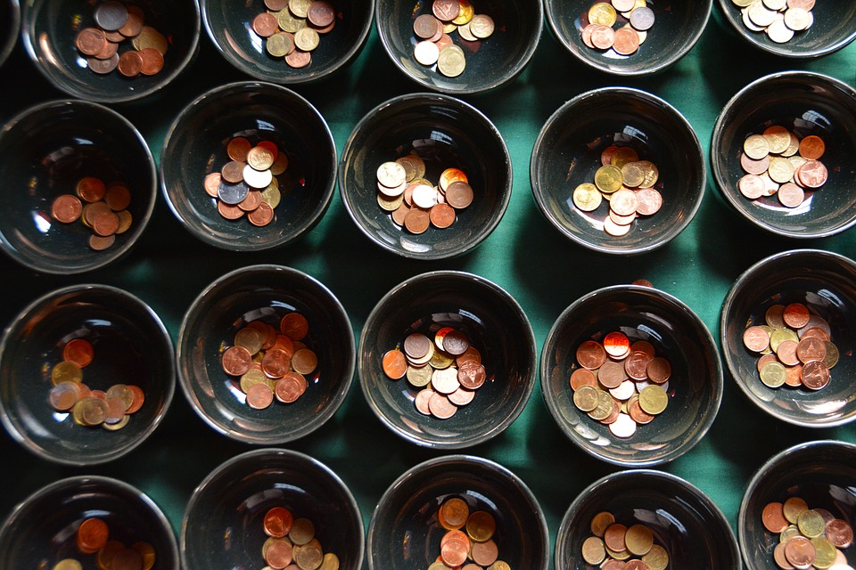
How Much?

Slide 2
How Much . . .
1. …should I read the Bible, pray, and/or sing praises to God on my own?
2. …time/money should I spend with personal hobbies, which do not involve anyone else (TV, video games, internet)?
3. …time should I spend with my family in permissible entertainment? (vacations, clubs, teams, etc)
4. …time each day/week should I read the Bible, sing, and/or pray with my spouse and/or children as a family?
5. …time each day/week should I spend with people outside my family (encourage, strengthen friendships, email, social media, etc.)?
6. …money does my family need to live? …time should I spend working?
7. …time/money should I give to the church’s work?
8. …time/money should I spend on luxury, recreation, entertainment,…?
9. …time/money should I spend on helping other people who have physical needs?

Slide 3
How Much?
How important is this to God?
How much do I have available?
Does the benefit justify the cost?
How do I make similar decisions in other areas?

Slide 4
1. How Important Is This To God?
How Much?
A. Right or wrong?
- Based on God’s revelation Heb. 1:1; Mt. 28:18
B. Permitted
1. some things are permissible, not commanded Rom. 14:3 (1 Cor. 8:8; Gal. 5:6)
2. sometimes, what is permissible is not best 1 Cor. 6:12 (1 Cor. 9:6, 12b; 2 Cor. 11:7, 12)
3. Want or need? (Prov. 19:10)

Slide 5
2. How Much Do I Have Available?
How Much?
Proverbs 27:23-27
A. God has given what I have Js. 1:17 (Jn. 3:27)
1. time
2. money (Ro. 1:21)
B. God does not expect more than I have 2 Cor. 8:12
1. 1 Jn. 5:3 God does not expect too much
2. 1 Kg. 12:28 Jeroboam

Slide 6
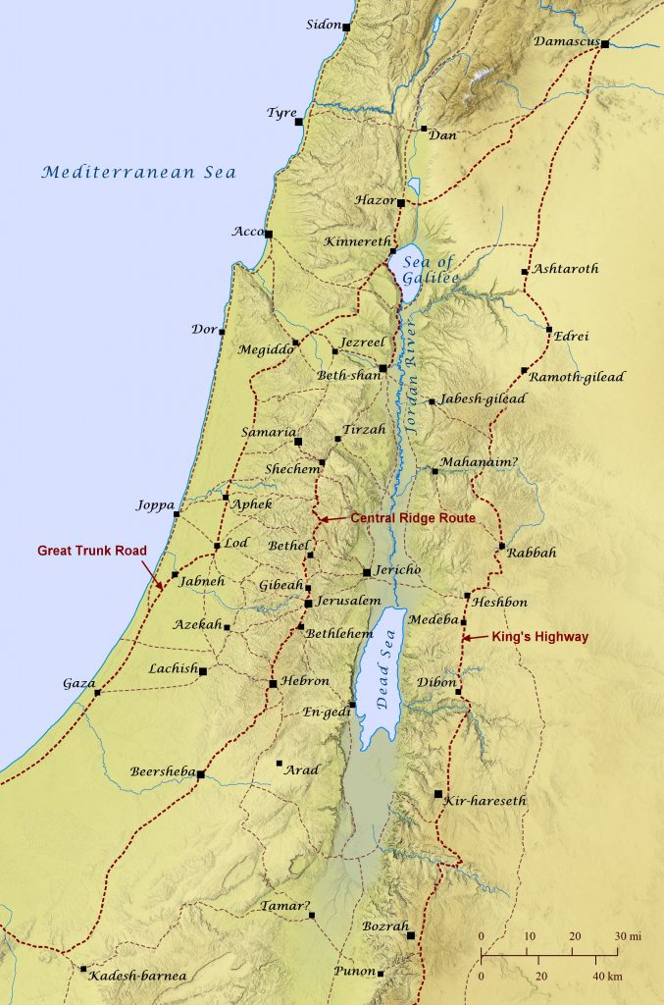
It Is Too Much For You…
* Dan to Jerusalem, around 100 mi
* Bethel to Jerusalem, around 10 mi

Slide 7
2. How Much Do I Have Available?
How Much?
A. God has given what I have
B. God does not expect more than I have
C. God expects the best of what I have Mt. 6:19, 24, 33 (Acts 16:3)

Slide 8
3. Does the benefit justify the cost?
How Much?
A. Sin never justifies any cost Heb. 11:25-26
B. Some benefits justify any cost Mt.16:26; Pro. 4:7
C. Some benefits justify minimal cost Eccl. 2:1-11
D. I (they) will reap based on sowing 2 Cor. 9:6-7
1. In what do you hope to reap sparingly, bountifully?
2. In what do you want your children to reap sparingly, bountifully?

Slide 9
4. How do I make similar decisions in other areas?
How Much?
Mal. 1:8; Mt. 6:33
In which areas do we find ourselves:
- stretching, sacrificing in order to have time VS quickly concluding there is little or no time?
- pushing ourselves to the limits of our energy VS quickly concluding there is little or no energy?
- saving, sacrificing, scraping money together VS quickly concluding there is little or no money?

Slide 10
How Much?
You must give ALL your heart if you will:
Turn to Christ Acts 2:38; Rom. 10:10
Return to Christ Acts 8:22; 1 Jn. 1:9
Abide in Christ John 15:7

