Slide 2
Present your bodies
Notes:
‘present’
your bodies - i.e., how you live, what you DO with your body
It concerns both our bodies and our minds, the presentation of our bodies to God and our transformation by the renewal of our minds. First, our bodies. Stott - Romans
cp. Roman 6:13-19 - NOT present your ‘members’ (of your body) as instruments of unrighteousness.. BUT present your members to God as instruments of righteousness!
→ Living sacrifice

Slide 3
Living sacrifice
Notes:
a living sacrifice — for me to LIVE is Christ, …
Phil. 1:21 - For to me to live is Christ, and to die is gain.
Gal. 2:20 I have been crucified with Christ. It is no longer I who live, but Christ who lives in me. And the life I now live in the flesh I live by faith in the Son of God, who loved me and gave himself for me.
→ Holy and acceptable

Slide 4
Holy and acceptable
Notes:
Holy –
Nadab & Abihu – I will be sanctified by those who draw near!...
1Pet. Be ye HOLY as I am HOLY …
THAT is acceptable unto God
→ THAT is our reasonable service…

Slide 5
Reasonable service
Notes:
reasonable -
rational -
If the former is correct, then the offering of ourselves to God is seen as the only sensible, logical and appropriate response to him in view of his self-giving mercy.
If ‘rational’ is correct, then it is ‘the worship offered by mind and heart’ (reb), spiritual as opposed to ceremonial, ‘an act of intelligent worship’ (jbp), Stott – Romans
→ Conformed or transformed

Slide 6
Conformed or Transformed
Notes:
Two life styles now set before us.
Here these two ARE contradictory and opposing..
“The true contrast in this verse is not between two kinds of change,
but between two totally different models according to which one may shape his life. “(Cottrell, Romans)
→ Conform to the WORLD?

Slide 7
World?
‘Age’
Notes:
Not world - but the will of God
world - used in different ways.. NOTE here is aionos - ‘age
1 for ever, an unbroken age, perpetuity of time, eternity. 2 the worlds, universe. 3 period of time, age. Louw&Nida
period of time - for in fact the ‘age’ of thought is transitory and shifting. Whether styles and fashions or morals. We dare NOT try and stand on the ‘foundation’ of the age!
→ hence, it is the thoughts and standards of the AGE
‘save yourselves from the present evil age… ‘
Dark ages -
Age of ‘enlightenment’ -
Age of Reason -
YET - NEVER does it agree with or comply to the WILL OF GOD.
→ ALREADY been there

Slide 8
World? Thoughts and standards
Notes:
Every ‘age’ has its thoughts and standards -
Dark ages -
Age of ‘enlightenment’ -
Age of Reason -
YET - NEVER does it agree with or comply to the WILL OF GOD.
→ ALREADY been there

Slide 9
World? Thoughts and standards
NOT conformed to
Notes:
NOT conformed to -
Eph 2:2 ‘course of this world’
Ephesians 2:2 (ESV) ²in which you once walked, following the course of this world, following the prince of the power of the air, the spirit that is now at work in the sons of disobedience—
1 Corinthians 1:20 (ESV)
²⁰Where is the one who is wise? Where is the scribe? Where is the debater of this age? Has not God made foolish the wisdom of the world?
1 Corinthians 3:18 (ESV)
¹⁸Let no one deceive himself. If anyone among you thinks that he is wise in this age, let him become a fool that he may become wise.
→ transformed

Slide 10
Transformed
Metamorphisized
Notes:
Transformed = metamorphisized
AS with butterfly
→ The process

Slide 11
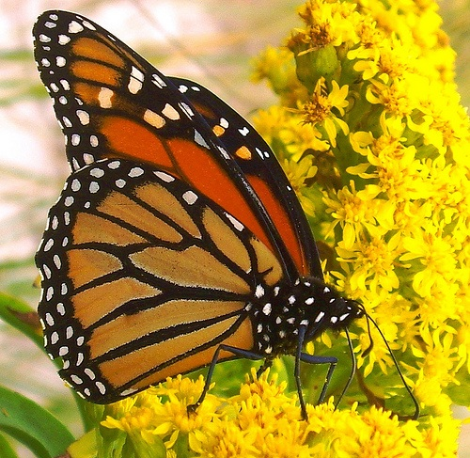
GOD
GOD
Notes:
The Caterpillar stage…
Gives way to the butterfly!
BUT goes through pupa stage

Slide 12
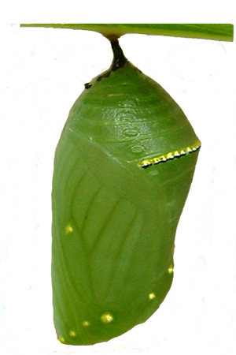
GOD
GOD
Notes:
MUST go through the struggle of the pupa (chrysalis)
The four stages of the monarch butterfly life cycle are the egg, the larvae (caterpillar), the pupa (chrysalis), and the adult butterfly.
The outside of the chrysalis is really clear and what you see is the green "pupa" inside. As the pupa changes from the body parts of a caterpillar into the body parts of a butterfly, you can see a definite color change inside the chrysalis. When it's ready to make its way into the world, the chrysalis color will turn brown, yellow and orange.
In this stage, it is believed that the caterpillar actually ‘dissolves itself, leaving the main building blocks that regrow into the butterfly’…
Upon emerging, it must dry, pump necessary fluid into its wings to expand them, and then exercise the ‘flying muscles’ … a complete change process…..
An absolute complete change –
→ People – get stuck in our caterpillar stage

Slide 13
Notes:
People become enamored with themselves and the wisdom of the AGE…
Thus – refuse to change –
Refuse being converted –
NEVER become what God created us FOR !
→ Battle of the mind

Slide 14
Battle for your MIND
Notes:
The arena - our minds!
need to be RENEWED in our way of thinking.
Back to ‘transformed’ - as caterpillar —> butterfly — must go through the cocoon phase, the complete change..
Learning - + experience
Rom. 5: the struggle - experience…
by testing - practice - Discern -
dokimazw — 1 to test, examine, prove, scrutinize (to see whether a thing is genuine or not), as metals. 2 to recognize as genuine after examination, to approve, deem worthy.
repeat of the infinitive - to test by testing, to scrutinize by testing,.. etc. DO
→ NOT the world but the WILL of GOD

Slide 15
NOT the WORLD but the will of God
Notes:
The Will of God = good, acceptable, perfect / complete / mature.
Leviticus 18:3 (ESV) ³You shall not do as they do in the land of Egypt, where you lived, and you shall not do as they do in the land of Canaan, to which I am bringing you. You shall not walk in their statutes.
Matthew 6:8 (ESV) ⁸Do not be like them, for your Father knows what you need before you ask him.
→ Did God SAY ?

Slide 16
Did God say?
Notes:
Did GOD SAY - do you KNOW what God said?
The ‘god of this world’, the tempter, the liar from the beginning –
ALWAYS the ‘other side’ – the ‘other truth’ –
There is NO OTHER truth – it is a LIE
→ You shall SURELY Die -
You shall NOT Die…
Do you BELIEVE what God said? NOT just intellectually, but in living …
Will you LIVE BY every word that proceeds out of the mouth of God? (Jesus did)… that is our goal.

Slide 17
You shall surely die OR You shall NOT die
Notes:
Such is the LIE – still repeated in THIS AGE (today)
Eph. 5:2-6 sexual immorality and covetousness - be not deceived
Do you BELIEVE what God said? NOT just intellectually, but in living …
Will you LIVE BY every word that proceeds out of the mouth of God? (Jesus did)… that is our goal.
→ Battle is for your MIND

Slide 18
Battle for your MIND
Notes:
The arena - our minds!
Eph. 4:17-24…
1Pet 3:1-2…
→ Romans continues showing the different way of thinking .. NOT have to ‘figure it out, have to believe it!

Slide 19
Relationship
to God 1-2
to ourselves 3-8
to each other 9-16
to enemies 17-21
Notes:
Relation to God - 1-2
Relation to ourselves - 3-8
Relation to each other - 9-16
Relation to evil doers and enemies - 17-21
Continue into ch. 13
Relation to the State - 13:1-7
Relation to the law - 8-10
Relation to the day of the Lord’s return - 11-14
Relation to the weaker members - 14:1 - 15:13

Slide 20
Relationship
to the state 1-7
to the law 8-10
to Lord’s return 11-14
Notes:
Relation to the State - 13:1-7
Relation to the law - 8-10
Relation to the day of the Lord’s return - 11-14
Relation to the weaker members - 14:1 - 15:13
→ Our relationship with God – heart, soul, MIND…

Slide 21
Love God with all your heart, soul, and MIND
Notes:
You shall love the Lord your God with all your heart and with all your soul and with all your mind.
→ Commission - convert → transform Matt. 28:18-20

Slide 22
Converted
Transformed
Notes:
God’s people
Converted --
Transformed --
Matt. 28: 18-20
Make disciples – baptizing them….
Teaching them to observe all that I have commanded…

