Slide 2
Marriage:
A Gift from God
GOD
GOD
Notes:
Marriage: A Gift from God
MY experience with Chinese wedding pictures –
THIS relationship did NOT just ‘happen’ – it came from our CREATOR.
→ Gen. 1:

Slide 3
“And God saw that it was good.”
GOD
GOD
Gen. 1:10, 12, 18, 21, 25
Notes:
“… it is good.” and God saw that it was good.
10, 12, 18, 21, 25,
31 God saw all that He had made, and behold, it was very good.

Slide 4
God saw all that He had made, and behold, it was very good.
GOD
GOD
Gen. 1:31
Notes:
God saw all that He had made, and behold, it was very good.
→ NOT GOOD

Slide 5
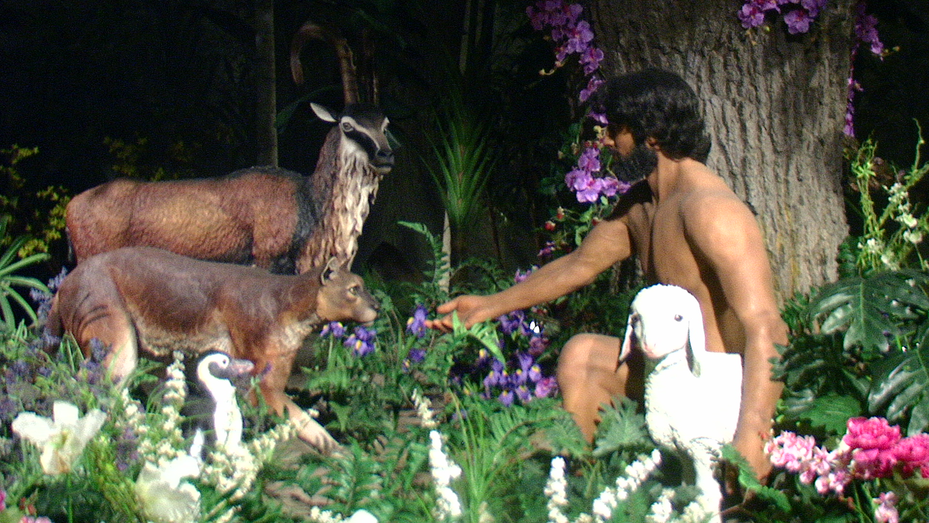
It is NOT good…
GOD
GOD
Notes:
It was NOT good — for man to be alone. Gen. 2:18
Then the Lord God said, “It is not good for the man to be alone; I will make him a helper suitable for him.”
→ Eccl. 4:8-12

Slide 6
Eccl. 4:8-12
GOD
One alone…
TWO are better …
GOD
Notes:
Ecclesiastes 4:8–12 — ⁸ one person who has no other, either son or brother, yet there is no end to all his toil, and his eyes are never satisfied with riches, so that he never asks, “For whom am I toiling and depriving myself of pleasure?” This also is vanity and an unhappy business. ⁹ Two are better than one, because they have a good reward for their toil. ¹⁰ For if they fall, one will lift up his fellow. But woe to him who is alone when he falls and has not another to lift him up! ¹¹ Again, if two lie together, they keep warm, but how can one keep warm alone? ¹² And though a man might prevail against one who is alone, two will withstand him—a threefold cord is not quickly broken.
→ A Mate SUITABLE – bone of my bone, ‘of man’ -

Slide 7

A mate suitable…
GOD
GOD
Notes:
A Mate SUITABLE – bone of my bone, flesh of my flesh, ‘of man’ -
22 The Lord God fashioned into a woman the rib which He had taken from the man, and brought her to the man.
23 The man said,
“This is now bone of my bones,
And flesh of my flesh;
She shall be called Woman,
Because she was taken out of Man.”
→ Proverbs – 18:22

Slide 8
For THIS REASON…
GOD
… a man shall leave his father and his mother, and be joined to his wife; and they shall become one flesh
GOD
Notes:
A Mate SUITABLE – bone of my bone, flesh of my flesh, ‘of man’ -
For this reason a man shall leave his father and his mother, and be joined to his wife; and they shall become one flesh.
→ Proverbs – 18:22

Slide 9
He who finds a wife finds a good thing and obtains favor from the Lord.
GOD
GOD
Prov. 18:22
Notes:
Finding a wife = a good thing.
Proverbs 18:22 — ²² He who finds a wife finds a good thing and obtains favor from the Lord.
→ Prov. 5:18

Slide 10
Let your fountain be blessed, and rejoice in the wife of your youth,
GOD
GOD
Prov. 5:18
Notes:
Proverbs 5:18 — ¹⁸ Let your fountain be blessed, and rejoice in the wife of your youth,
→ Prov. 6:29

Slide 11
So is he who goes in to his neighbor’s wife; none who touches her will go unpunished.
GOD
GOD
Prov. 6:29
Notes:
Proverbs 6:29 — ²⁹ So is he who goes in to his neighbor’s wife; none who touches her will go unpunished.
→ Created TO LOVE

Slide 12
Created in the Image of God:
LOVE
GOD
GOD
Genesis 1:27
Notes:
Created in the image of God…
1:27 God created man in His own image, in the image of God He created him; male and female He created them.
Able to LOVE and BE LOVED …
God provided for mankind this absolute unique relationship wherein to experience this.
Used it to ‘illustrate’ the very relationship between God and man… both in Israel of the OT and the church in the NT
→ Chinese wedding symbol --

Slide 13

GOD
GOD
Double happiness
Notes:
Chinese symbol that is common at Chinese weddings –
→ Happiness / Joy

Slide 14
喜
GOD
GOD
Happy / Joy
Notes:
囍 is not really a character you will use in verbal communication.
Its equivalent in daily speech is 喜 (xǐ, ‘happy’ or ‘joy’).
Notice the similarity? Yes, when you double the character 喜, you
→ Double character --

Slide 15
喜喜
GOD
GOD
Happy / Joy x 2
Notes:
you get 囍 (shuāngxǐ, double ‘xi’), which is only used as an ornamental design motif associated with Chinese weddings. With two 喜 compressed to assume the square shape of a standard Chinese character, Shuangxi means ‘double happiness’ to coincide with the new couple. Chinese culture also believes that “happiness comes in twos” (好事要成双 hǎoshì yào chéng shuāng), and weddings especially follow the auspicious sayings.
→ Love ☺

Slide 16

GOD
GOD
Notes:
Thus the symbol proliferates at Chinese weddings…
Happiness Times 2
→ Marriage = to TIE in marriage

Slide 17
结婚
GOD
GOD
jié hūn
to marry / to get married
Notes:
The literal translation of jié hūn is “to tie in marriage.”
The Mandarin Chinese phrase for “married” is jié hūn which has two characters: 結婚.
The first character, jié, means “knot,” “bond,” or “to bind.”
The second character, hūn, means “to marry” or “marriage.”
→ Song of Solomon – 1:14

Slide 18
My beloved is to me a cluster of henna blossoms in the vineyards of Engedi.
GOD
GOD
S of S 1:14
Notes:
My Beloved is MINE - Song of Solomon.
Song of Solomon 1:14 — ¹⁴ My beloved is to me a cluster of henna blossoms in the vineyards of Engedi.
Song of Solomon 1:16 — ¹⁶ Behold, you are beautiful, my beloved, truly delightful. …

Slide 19
Behold, you are beautiful, my beloved, truly delightful.
GOD
GOD
S of S 1:16
Notes:
My Beloved is MINE - Song of Solomon.
Song of Solomon 1:16 — ¹⁶ Behold, you are beautiful, my beloved, truly delightful. Our couch is green;
Song of Solomon 2:3 — ³ As an apple tree among the trees of the forest, so is my beloved among the young men. With great delight I sat in his shadow, and his fruit was sweet to my taste.

Slide 20
As an apple tree among the trees of the forest, so is my beloved among the young men.
GOD
GOD
S of S 2:3
Notes:
My Beloved is MINE - Song of Solomon.
Song of Solomon 2:3 — ³ As an apple tree among the trees of the forest, so is my beloved among the young men.
→ continued: With great delight I sat in his shadow, and his fruit was sweet to my taste.

Slide 21
With great delight I sat in his shadow, and his fruit was sweet to my taste.
GOD
GOD
S of S 2:3
Notes:
My Beloved is MINE - Song of Solomon.
Song of Solomon 2:3 — ³ As an apple tree among the trees of the forest, so is my beloved among the young men. With great delight I sat in his shadow, and his fruit was sweet to my taste.
Song of Solomon 2:8 — ⁸ The voice of my beloved! Behold, he comes, leaping over the mountains, bounding over the hills.

Slide 22
The voice of my beloved! Behold, he comes, leaping over the mountains, bounding over the hills.
GOD
GOD
S of S 2:8
Notes:
My Beloved is MINE - Song of Solomon.
Song of Solomon 2:8 — ⁸ The voice of my beloved! Behold, he comes, leaping over the mountains, bounding over the hills.
→ Song of Solomon 2:16 — ¹⁶ My beloved is mine, and I am his; he grazes among the lilies.

Slide 23
My beloved is mine, and I am his;
GOD
GOD
S of S 2:8
Notes:
My Beloved is MINE - Song of Solomon.
Song of Solomon 2:16 — ¹⁶ My beloved is mine, and I am his; he grazes among the lilies.
→ Jesus - Matt. 19:4-6

Slide 24
Jesus
GOD
GOD
Matthew 19:4-6
Notes:
Matthew 19:4–6 — ⁴ He answered, “Have you not read that he who created them from the beginning made them male and female, ⁵ and said, ‘Therefore a man shall leave his father and his mother and hold fast to his wife, and the two shall become one flesh’? ⁶ So they are no longer two but one flesh. What therefore God has joined together, let not man separate.”
→ GOD created it

Slide 25
God Created and ordained it
GOD
GOD
Notes:
God created and ordained it.
FOR our good. BUT also for the good of children, family, society…
→ God authorized it

Slide 26
God authorized it
GOD
GOD
Notes:
God authorized it.
God SAID:
→ God legislates it

Slide 27
God legislates it
GOD
GOD
Notes:
God legislates it.
→ chart
male & female / man & wife
TWO
TWO become ONE flesh.
LEAVE father / mother
CLEAVE unto his wife
LET not man put asunder..

Slide 28
God Legislates
Male & Female
TWO
Become ONE Flesh
LEAVE father / mother
CLEAVE
Let Not Man
Put Asunder
Notes:
God legislates it.
male & female / man & wife
TWO
TWO become ONE flesh.
LEAVE father / mother
CLEAVE unto his wife
LET not man put asunder..
→ God is INVOLVED

Slide 29
God
Is Involved in It
GOD
GOD
Notes:
God is involved in it.
What GOD has joined together…
→ Let the marriage bed be held in honor…

Slide 30
Let marriage be held in honor among all, and let the marriage bed be undefiled
GOD
GOD
Hebrews 13:4
Notes:
In THIS relationship God provided for the population of the world.
Hebrews 13:4 — ⁴ Let marriage be held in honor among all, and let the marriage bed be undefiled,
for God will judge the sexually immoral and adulterous.

Slide 31
for God will judge the sexually immoral and adulterous.
GOD
GOD
Hebrews 13:4
Notes:
In THIS relationship God provided for the population of the world.
Hebrews 13:4 — ⁴ Let marriage be held in honor among all, and let the marriage bed be undefiled, for God will judge the sexually immoral and adulterous.
→ 1 Cor. 7: to avoid fornication, EACH have OWN…

Slide 32
Each
‘his’ own
GOD
GOD
1 Cor. 7:1-2
Notes:
1 Corinthians 7:1–3 —
¹ Now concerning the matters about which you wrote: “It is good for a man not to have sexual relations with a woman.” ² But because of the temptation to sexual immorality, each man should have his own wife and each woman her own husband. ³ The husband should give to his wife her conjugal rights, and likewise the wife to her husband.
to avoid fornication, EACH have OWN…
→ Marriage IS a GIFT from God.. Enjoy it as HE INTENDED…

Slide 33
Marriage:
A Gift from God
GOD
GOD
Notes:
Thus we see that Marriage – the RELATIONSHIP – is a Gift from God.
It is a responsibility, a stewardship,
It requires us to learn, obey, submit, and LOVE …
Let us be thankful for this – and HONOR IT.

Slide 34
GOD
GOD

