Slide 1
Notes:
From article posted May 2015 in our reading of Romans.

Slide 2
Wrath of God
GOD
GOD
Notes:
Romans shows us the two sides of dealing with God.
Two concepts – wrath and love
Love - 17 times.
Wrath – 12, most of God, and of God ALWAYS against SIN – Rom. 1:18
Interesting study of words in the OT – designed to show the awfulness of His wrath
Love –
Wrath -

Slide 3
Anger Pictured As:
Hot displeasure,
Heat, inward burning
Notes:
Yet a THIRD word tied to ‘heat’ -
Heat, inward burning of anger
Charon → “heat, inward burning of anger”, Numbers 11:1
Now when the people complained, it displeased the Lord; for the Lord heard it, and His anger was aroused (kindled – KJ). So the fire of the Lord burned among them, and consumed some in the outskirts of the camp.
→ ‘ap’ – nostrils, to snort – be angry

Slide 4
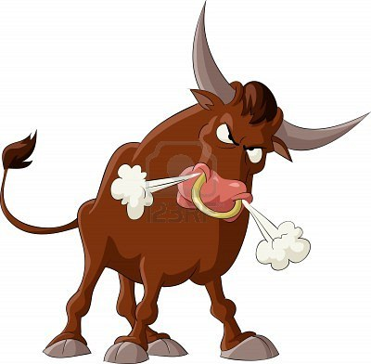
Anger Pictured As:
Hot displeasure,
Heat, inward burning
To snort, be angry
Notes:
To snort, be angry
‘ap → basically refers to the nostrils (of divine wrath 170 times). It comes from the verb ‘anap,which means “to snort, to be angry”
Psalm 2:5 – at the rejection of the Messiah – the rebellion of the people against God’s anointed
Then He shall speak to them in His wrath, And distress them in His deep displeasure:
Also Psalm 18:8(see Ps. 18:8)
Because He was angry. Smoke went up from His nostrils, And devouring fire from His mouth; Coals were kindled by it.
→ Overflowing with fury

Slide 5
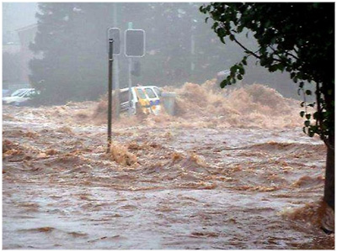
Anger Pictured As:
Hot displeasure,
Heat, inward burning
To snort, be angry
Overflowing with fury
Notes:
Overflowing with fury
‘ebrah → from a verb meaning to “be full, to overflow”, thus means “to be angry, to be full of wrath, to be overflowing with fury.”,
→ cp. Psa. 78:49
He cast on them the fierceness of His anger, Wrath, indignation, and trouble, By sending angels of destruction among them.
→ To Storm, to RAGE

Slide 6
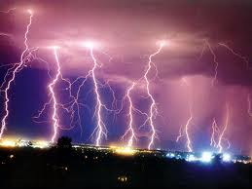
Anger Pictured As:
Hot displeasure,
Heat, inward burning
To snort, be angry
Overflowing with fury
To storm, to rage
Notes:
To storm, to rage
Za’ap / za’am → these carry the connotation of intense anger … being related to words that mean “to storm, to rage” …
God’s wrath against Nineveh – vs. 2
2 The LORD is a jealous and avenging God; the LORD is avenging and wrathful; the LORD takes vengeance on his adversaries and keeps wrath for his enemies. 3 The LORD is slow to anger and great in power, and the LORD will by no means clear the guilty. His way is in whirlwind and storm, and the clouds are the dust of his feet.
BUT When God DOES get angry – it is INTENSE – to storm, to rage…
cp. Nahum 1:6 &
Who can stand before His indignation? And who can endure the fierceness of His anger? His fury is poured out like fire, And the rocks are thrown down by Him.
→ A Breaking Forh

Slide 7
Anger Pictured As:
Hot displeasure,
Heat, inward burning
To snort, be angry
Overflowing with fury
To storm, to rage
Breaking forth
Notes:
Breaking forth of something under pressure
Qetsep → “the breaking forth of something under pressure” –
used some 50 times for God’s anger,
God’s indictment against idols .. Warning to Israel to NOT learn ‘the ways of the nations’ –
God ‘blows up’ – but not ‘out of control’ – rather judicious wrath against evil.
Is against SIN -
→ NT -

Slide 8
Wrath in NT
Orge –
‘anger, wrath’
Thumos –
Anger, fury, wrath, rage…
Notes:
Wrath in NT – 2 words
Orge – ‘anger, wrath’ ‘of temperment, also ‘anger, indigntion, wrath’ - 36 times
BDAG Greek Lexicon:
① state of relatively strong displeasure, w. focus on the emotional aspect, anger
② strong indignation directed at wrongdoing, w. focus on retribution, wrath
Thumos – ‘ Louw Nida (Grk. Lexicon) – 18 times -
a state of intense anger, with the implication of passionate outbursts—‘anger, fury, wrath, rage.
Romans 1:18 –

Slide 9
Wrath Against Sin
GOD
GOD
Romans 1:18
Notes:
God's Wrath - is against SIN - 1:18:
"For the wrath of God is revealed from heaven against all ungodliness and unrighteousness of men, who by their unrighteousness suppress the truth.”
In this we learn that God's wrath is Always and Only against SIN.
Paul then shows that the Gentiles sinned (ch. 1:19-31).
After showing that God shows no partiality in His judgment against sin (ch. 2),
Paul shows that the Jews also sinned (ch. 3).
He concludes ALL have sinned and thus ALL are facing the wrath of God (3:20-21).
→ God’s Wrath IS REVEALED

Slide 10
Wrath IS Revealed
GOD
GOD
Romans 1:18
Notes:
God's Wrath IS revealed.... IS = present tense.
God has been, is, and WILL display his wrath against sin.
Sometimes it is displayed directly: i.e., Nadab and Abihu, Kora and Dathan, Adam & Eve, Ananias and Sapphira -- etc.
Sometimes it is displayed thru 'agency': the various national judgments brought by raising up other nations (book of Judges, Assyria against Israel, Babylon against Judah, etc.).
Paul shows in Romans 13 that the various governments are also the agency of God's wrath against evildoers within society.
Here in Chapter 1 – God ‘reveals wrath’ by letting SIN bring consequences and further sin.. A downhill spiral!
→ YET a future day of wrath

Slide 11
Yet A Future day of Wrath
GOD
GOD
Romans 2:5-6
Notes:
There is YET a future day of judgment and wrath - 2:5-6.
Temporal judgments against sin are NOT the end of the wrath of God.
We fear not those who can kill the body, but Him who can cast both body and soul into hell (Matt. 10:28; Luke 12:4).
Paul here speaks of THE DAY when He will judge all men through Jesus.
John 5: all in the grave shall come forth unto judgment -
We ALL must stand before the judgment seat of Christ (2Cor. 5:10).
We will each then face either the wrath of God OR, if we belong to Jesus, we will be accepted on the basis of our having been forgiven.
→ Law Brings Wrath

Slide 12
LAW brings wrath
GOD
GOD
Romans 4:15
Notes:
Law brings wrath - 4:15.
Law - a rule of conduct with a penalty attached (as opposed to a 'suggestion' or 'recommendation').
The penalty for transgressing God's law is death: the wages of sin is death (Rom. 6:21).
Once law is broken, there is no undoing of it.
No amount of keeping other law will undo the breaking that has occurred;
there is only receiving the penalty
OR finding forgiveness and mercy with the Judge. Such is ONLY to be found in Jesus.
→ God’s Wrath is RIGHTEOUS

Slide 13
God’s Wrath is Righteous
GOD
GOD
Romans 2:5
Notes:
God's Wrath is righteous -- 2:5.
God's wrath against sin shows the degree of God's righteousness.
A Righteous God does not overlook or condone sin of any kind.
In describing this judgment of God, Paul calls it the 'righteous judgment of God' (2:5).
The question is often asked: "What will God do with the man who ... ?"
While we cannot definitively answer such hypothetical questions,
we trust that God will NOT do that which is unfair, unrighteous.
There is NO partiality with God when it comes to such judgment of sin (2:10-11).
The eternal condemnation comes not from OUR view of the severity of the transgression, but rather from the holiness of the one whom we have sinned against.
→ We Are SAVED from wrath – propitiation thru the blood of Jesus

Slide 14
We are SAVED from wrath – propitiation
GOD
GOD
Romans 3:25
Notes:
We are saved FROM such wrath thru the propitiatory sacrifice of Jesus – 3:25.
We are saved; saved from WHAT?
The wrath of God! Apart from the blood of Jesus sinners can only look forward to experiencing the wrath of God.
→ The Kindness and Severity of God – Rom. 11:22

Slide 15
Note the Kindness and Severity
GOD
GOD
Romans 11:22-23
Notes:
Romans 11:22-23
Note then the kindness and the severity of God: severity toward those who have fallen, but God’s kindness to you, provided you continue in his kindness. Otherwise you too will be cut off.
23 And even they, if they do not continue in their unbelief, will be grafted in, for God has the power to graft them in again.
Which will it be?

Slide 16
GOD
GOD

