Slide 1
GOD
GOD

Slide 2
I believe…
GOD
GOD
Notes:
FaitH = “I Believe….”
The sun is hot. My car will start. My front door is locked. Etc. Etc.
Much of life is lived ‘by faith’...
→ Believe WHAT?

Slide 3
I believe…
GOD
GOD
WHAT?
Heb. 11:6; John 20:30-31;
Romans 10:9-10
Notes:
Faith
Without faith it is impossible to be saved – Heb. 11:6
Not just 'believe something' – but specifics involved…
1. God exists
2. He is a rewarder of those who diligently seek Him.
John 20:30-31 – Jesus is the Christ, the Son of God.
Romans 10:9-10 – Jesus raised from the dead
Romans 10:9– because, if you confess with your mouth that Jesus is Lord and believe in your heart that God raised him from the dead, you will be saved.
→ HOW to believe – the process…

Slide 4
How to believe
GOD
GOD
Notes:
How faith is established… how people come to believe.
How to we come to a conclusion ?
How do we establish such ‘belief’ ?
Rom. 10:17 – by hearing … the Word
John 17:20 – believe THROUGH THEIR WORD.

Slide 5
How to believe
Faith comes by hearing
… the Word of God
GOD
GOD
Romans 10:17 John 17:20
Notes:
How faith is established… how people come to believe. Rom. 10:17 –
So faith comes from hearing, and hearing through the word of Christ.
→ John 17:20 – believe THROUGH THEIR WORD.

Slide 6
How to believe
Believe…
Thru their
Word.
GOD
GOD
Romans 10:17 John 17:20
Notes:
How faith is established… how people come to believe.
John 17:20 – believe THROUGH THEIR WORD.
“I do not ask for these only, but also for those who will believe in me through their word,
→ Hearing → Belief… the process

Slide 7
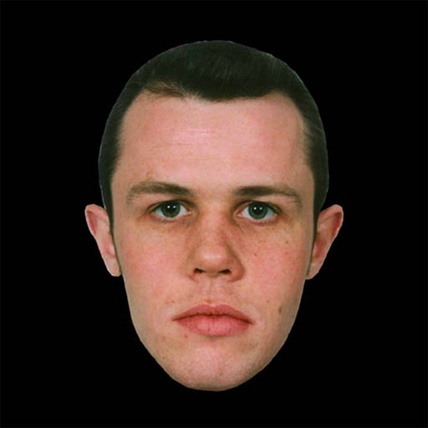
Hear -- Believe
GOD
GOD
Reason – Evaluate - Conclude
Notes:
Hear – Believe but what is represented by the DASH? Something happens here!
We analyze, think about, and reason in our minds – we examine the evidence.
Some REJECT..
NOT necessarily the lack of evidence or the weakness of such –
Prejudice –
Simply not WANT TO … will deny in the face of evidence.
Demands of such faith -
→ HENCE – Acts 17:1-4 REASONED from the scripture

Slide 8
Reasoned from the Scriptures
GOD
GOD
Acts 17:1-4
Notes:
Example: Paul 'reasoned' – Acts 17:1-4
From the scriptures –
The Christ must suffer, die, and be raised…
Jesus IS this Christ.
THIS repeated: 14:1; 18:4; 19:8; 24:25
NOT the picture of modern preaching / yelling / threatening / intimidation / etc.
→ NOT a leap of faith!

Slide 9
NOT a ‘leap of Faith’
GOD
GOD
Notes:
Faith is NOT 'unreasonable' –
NOT a leap of faith,
Presented ‘evidence’ / reason –
Was evaluated – true? Reasonable? False?
Conclusion drawn.
→ The presentation of Evidence?

Slide 10
Evidence ?
GOD
GOD
Prophecy
Notes:
Evidence? What kind?...
Reason? – prophecy → Christ = Jesus
Overall story of the Bible –
Someone is coming → someone is HERE
→ ‘thus it fulfilled’ – Matthew;

Slide 11
Evidence ?
GOD
GOD
Prophecy
Thus it fulfilled –
Mtt. 1:22, 2:15, 23; 4:14
Notes:
Reason? – prophecy → Christ = Jesus
Overall story of the Bible –
Someone is coming → someone is HERE
‘thus it fulfilled’ – Matthew;
ALSO – confirmed with miracles thru the messenger…

Slide 12
Evidence ?
GOD
Prophecy
GOD
Miracles
Mark 16:20; 1Thess. 1:4-5
Acts 8:5-6
Notes:
In first century, as it began, the Lord CONFIRMED with signs and wonders –
Mark 16:20 –
1 Thess. 1:4-5
Romans 15:17-20..
The gospel is NOW CONFIRMED AND ESTABLISHED – HEB. 2:3-4
Hebrews 2:3–4 — 3 how shall we escape if we neglect such a great salvation? It was declared at first by the Lord, and it was attested to us by those who heard, 4 while God also bore witness by signs and wonders and various miracles and by gifts of the Holy Spirit distributed according to his will.
HENCE John 20:30-31
→ Acts 8:30-36 example of prophecy used…

Slide 13
Conversion – Acts 8
GOD
Preaching (4-5)
Miracles confirmed (6-7)
Paid attention (6)
WERE Baptized – (12-13)
Joy – (8)
GOD
Notes:
Philip – Acts 8:1-13
4-5 - Went everywhere preaching …Philip preached Christ
6-7 seeing the miracles…
6 – 'paid attention' – 12-13 … when believed, were baptized.
8 – SO much JOY
→ Example from Acts 2

Slide 14
Acts 2
GOD
Jesus = Lord & Christ (36)
Tongues – (1-13)
Prophecy – (14-21)
Reasoning – 22-36
raised from the dead –
GOD
Notes:
Example from Acts 2
Jesus = Lord & Christ (36)
Tongues –
Prophecy –
Joel 2: (vs. 14-21)…
Raised from the dead -
REASONING –
→ RESULT… hearing – believed (pricked in their heart)...

Slide 15
Acts 2
GOD
Jesus = Lord & Christ (36)
Tongues – 1-13
raised from the dead –
Prophecy –
Reasoning – 22-36
GOD
Heard ---
Pricked in Heart
Notes:
Example from Acts 2
Jesus = Lord & Christ (36)
…
REASONING –
Vs 37 = RESULT… hearing – believed (pricked in their heart)...

Slide 16
Do YOU have faith?
GOD
GOD
Notes:
Do you have faith?

